Slide 1
Documentation and registration of intangible cultural heritage: methods, legal framework, best practices.

Slide 2
Documentation and research
Research:
Beyond documentation
Uses documentation for analysis and interpretation
Part of safeguarding
“With regard to intangible cultural heritage (ICH), research aims at better understanding
a given element of ICH, its history, meanings, artistic and aesthetic features, social,
cultural and economic functions, practice, modes of transmission, and the dynamics of
its creation and re-creation. Research is conducted systematically and progressively”

Slide 3
Documentation, research and inventorying
Research
Analysis and Interpretation
Documentation
Inventory
Incorporate documentation and research
Collection of information and data

Slide 4
Documentation and ICH
The Convention and the ODs refer to documentation as part of a range of safeguarding measures, that institutions are encouraged to carry out
For the purpose of providing datas to create inventories,
Requires documentation for the purpose of nomination
‘Documentation consists of recording ICH in tangible forms, in its current state, and
collecting documents that relate to it’.
Documentation and the inventory
Inventory formats (structured, limited for publication and access, provide basis for safeguarding
Documentation provides the detailed context, practices and beliefs associated, viability and other facts that are necessary for creating an Inventory
Process not product (knowledge / technique / skill / process / training)

Slide 5
Documenting an ICH element
An element is part of a larger cultural entity → background infos, i.e. origin, history, variations, schools of performance, area(s) in which practiced, significance in community, associated myths, stories, text, associated beliefs
ICH elements are mostly linked with each other, and one genre can incorporate more than one ICH activity, i.e. songs sung during weaving, during agricultural activity, scroll paintings with singing, dancing with creating designs
Documentation is an ongoing process
is intended to describe and understand, not freeze
descriptive not prescriptive
objective and perspective

Slide 6
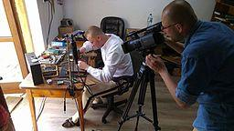
Documentation
Primary
Primary
Observation and experience
In actual or arranged context
Secondary or supplemental
Secondary
Interviews
Reference
Recordings
Photographs
Notes Transcriptions
Traditional forms
Manuscripts, song books, ritual texts
Available and stored in
Archives, libraries
Museums Databases
Internet
Notes:
"Documenting the work of Mr Andrzej Wojtas over highland jewelery in Bukowina Tatrzanska" [https://commons.wikimedia.org/wiki/File:Documenting_the_work_of_Mr_Andrzej_Wojtas_over_highland_jewelery_in_Bukowina_Tatrzanska.jpg] by Klarqa[https://commons.wikimedia.org/wiki/User:Klarqa]
is licensed under CC BY-SA 4.0[https://creativecommons.org/licenses/by-sa/4.0/deed.en]

Slide 7
Documents for documentation
Questionnaires (structure, comprehensive, consistent data)
Free form (led by community ideas)
Recording sheets (technical detail and content for recordings made)
Numbering indexing systems
Forms for free, prior and informed consent
Access to materials ( in local language, avoid jargon, create with community member)
Documentation: for future use
Annotate recordings (date and place, element recorded, equipment used, recordist, camera person etc.)
Write reports, descriptions, and summaries
Information on permissions, customary restrictions if any, special instructions
Contact person(s) for future permissions

Slide 8
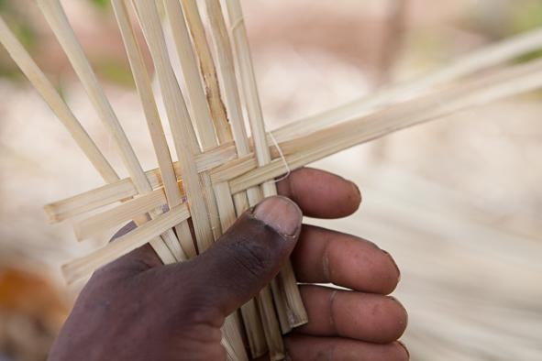
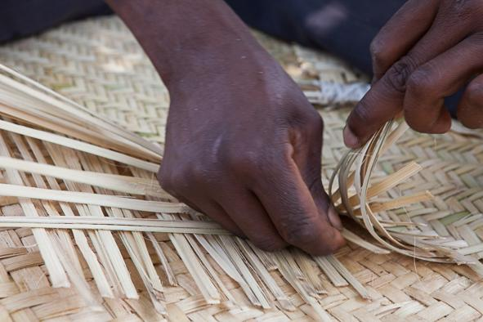
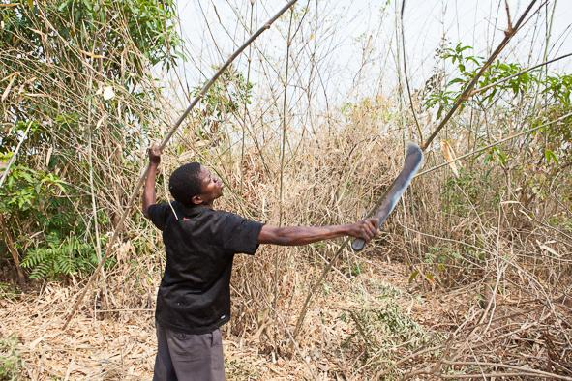
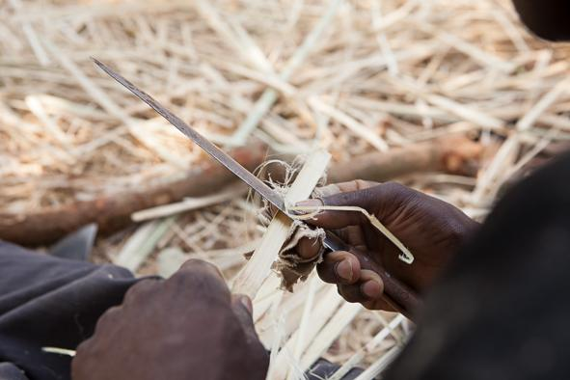
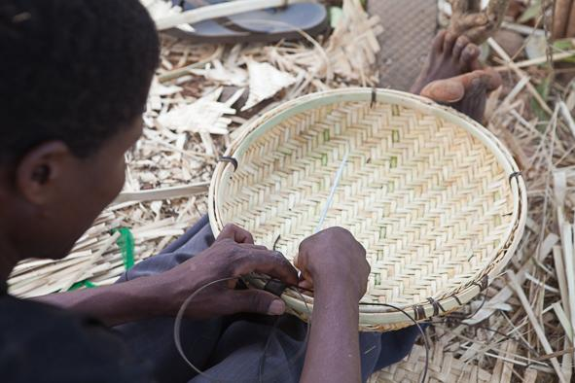
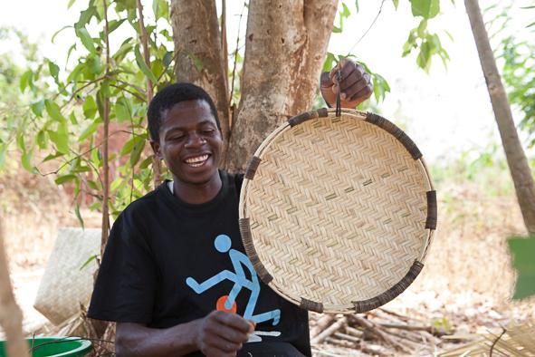
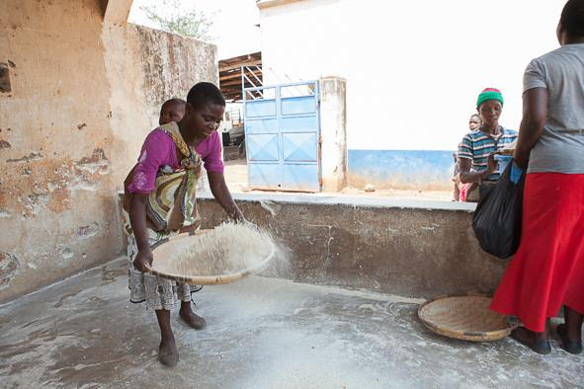
Documenting the process
© UNESCO / James Muriuki
Notes:
© UNESCO / James Muriuki

Slide 9
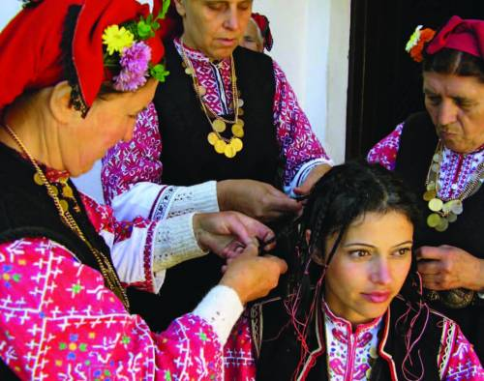
Context – the linch-pin of ICH documentation
What is it called?
By whom? -Performer(s)/practitioner(s), Participants
Why?
For whom? Audience/consumer
When?
Where?
The Bistritsa Babi
© Prof. M. Santova
Situating the element
in the local context
Accept variants and versions
Verify with various voices
Ownership not authenticity
Avoid classification and categories
Use local, not global terms
Notes:
© 2015 by Sanjay Jagtap, India

Slide 10
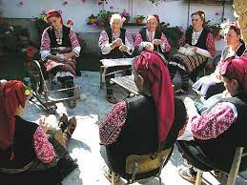
The wider context: intangible and tangible
Crafts
Objects
Musical Instruments
Scrolls
Masks
Ritual objects
Spaces
Built heritage
Monuments, places of worship
The Bistritsa Babi
© Prof. M. Santova
Notes:
© 2009 by E. Sacayón / FLAAR

Slide 11
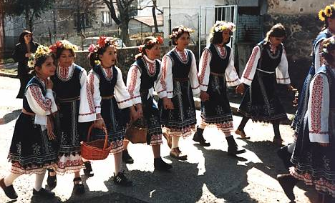
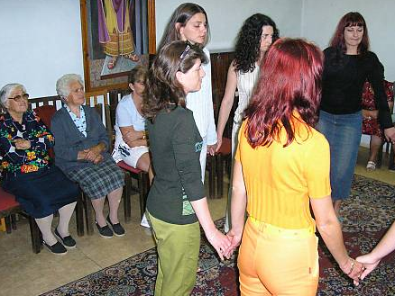
Training and transmission
Traditional methods i.e. father to son, mother to daughter,
teacher to pupil / disciple,
apprenticeship,
school or Institution
Contemporary methods i.e. institutional,
support for traditional,
introduced in schools /colleges
The Bistritsa Babi
© Prof. M. Santova
The Bistritsa Babi
© Prof. M. Santova

Slide 12
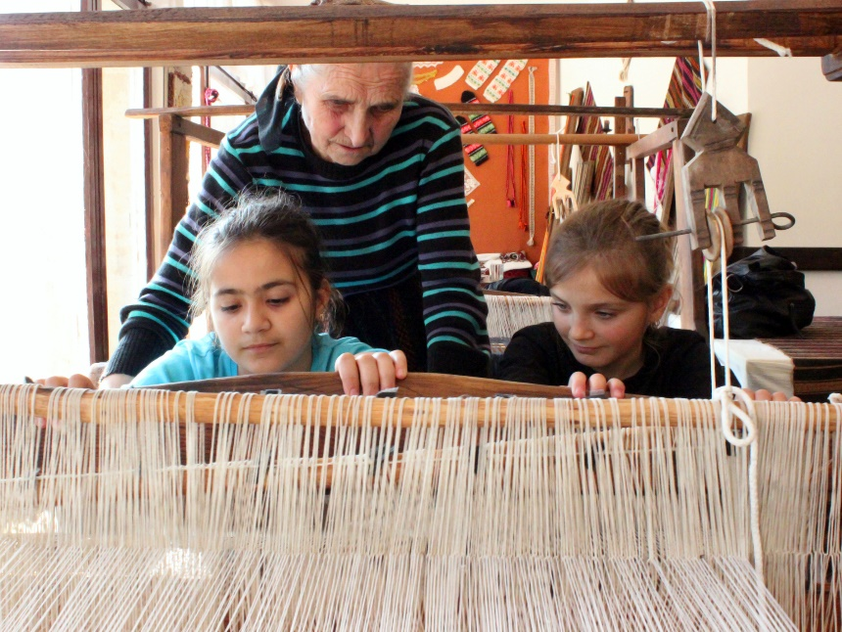
Documenting viability
How active is the tradition?
Performance in original context?
Support for the practice?
Transmission
Livelihood concerns
© Ministry of Culture of Bulgaria/Tsvetan Nedkov, 2013
Notes:
© Ministry of Culture of Bulgaria/Tsvetan Nedkov, 2013

Slide 13
Documentation and inventorying in the 2003 Convention

Slide 14
Advice on inventorying from UNESCO?
No specific instructions in Convention or ODs
No indications from Committee or Secretariat, but on the website of the Convention:
Descriptions of inventorying exercises
Kit of the Convention
Model questionnaire for adaptation (Unit 6 Hand-out)
Twelve Ethical Principles

Slide 15
States Parties are invited to take general measures for safeguarding ICH Articles 11(b)–15:
Inventory the ICH
Adopt legal, administrative and financial measures for safeguarding the ICH
Raise awareness and foster respect for ICH
Regulate the participation of communities in safeguarding activities and involve them in the management of their ICH
Article 11(b) Each State Party shall:
… identify and define the … intangible cultural heritage present in its territory, with the participation of communities, groups and relevant non-governmental organizations.
Article 12. To ensure identification with a view to safeguarding, each State Party shall draw up, in a manner geared to its own situation, one or more inventories of the intangible cultural heritage present in its territory …

Slide 16
Safeguarding in ICH means
ensuring the viability of ICH, while preserving its values (Article 2.3)
actions taken to promote ICH in general or to revitalize specific ICH elements (Art. 2.3)
Examples of Safeguarding Measures for specific ICH elements:
Identification
Inventorying
Documentation
Research
Revitalization
Protecting related places and materials
Encouraging transmission through education
Awareness-raising
All the above mentioned with participation and consent of communities, groups and individuals
Convention Ref: Art.2.3, 12, 13 and 14

Slide 17
Why are inventories needed?
Identifying and defining
Establishing viability
Building relationships for safeguarding
Raising awareness
Reinforcing sense of identity and continuity of ICH bearers, community building
Contributing to good governance, sustainable development
Collecting and presenting information on ICH elements in a systematic way.

Slide 18
Leeway and restrictions
Leeway
Adapted to the particular situation of each State
Ethical requirement of information generation
Free, prior and informed consent
Release forms including signed consent
Restrictions
Identification and definition of the ICH present in a State’s territory
Established with a view to safeguarding
Respecting customary practices governing access
Regularly updated
Reported on

Slide 20
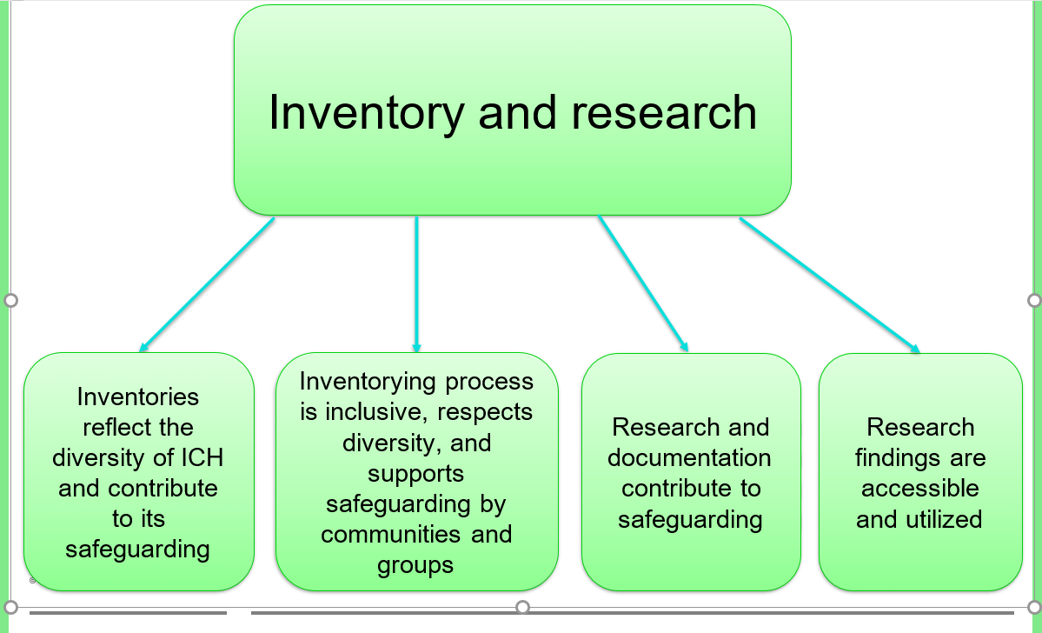

Slide 21
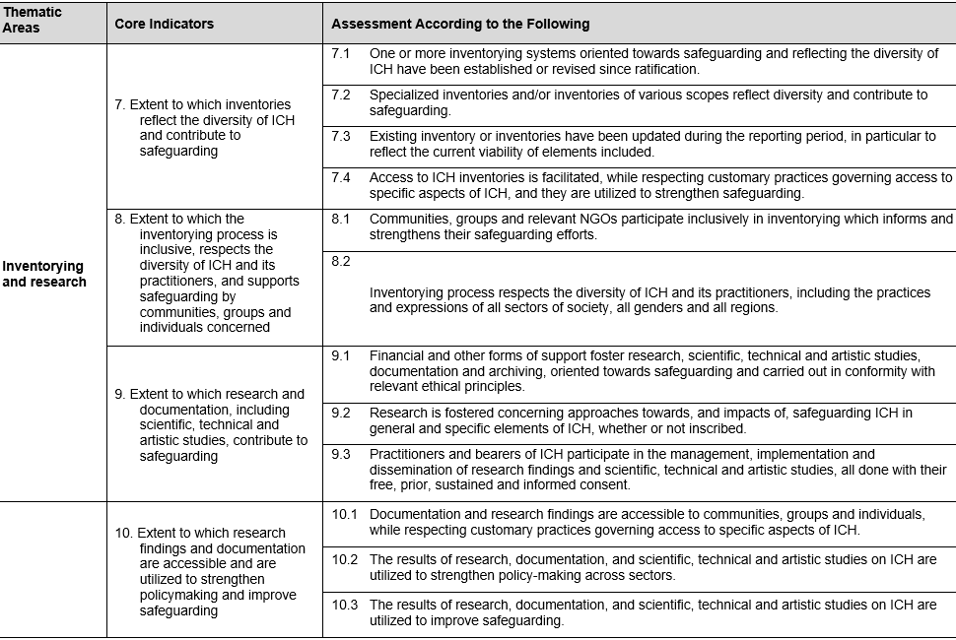

Slide 22
Scope and size of inventories
The Convention does not refer to the preparation of one ‘national’ inventory
The ODs refer to ‘inventories’ within a State, thus indicating that there may be a number of inventories within a single State Party (OD153(a)).
The scope and size of inventories may vary considerably depending on
the aim
available resources
methods of information generation and systematization
Organizing the information
Against the spirit of the Convention the hierarchies between ICH elements
Non-exhaustive set of domains (Art. 2.2), often with adaptations and/or additions,
Alternative classification systems

Slide 23
Criteria for inclusion in an inventory
Clear and transparent and in line with the aims of the Convention (i.e. creating dialogue and understanding among communities, and promoting respect for each other's ICH)
The Convention does not prevent States Parties from using their own definitions of ICH at the national level, for example, in inventorying, but any elements nominated to one of the Convention’s Lists must comply with the Convention’s definition of ICH (ODs 1–2)

Slide 24
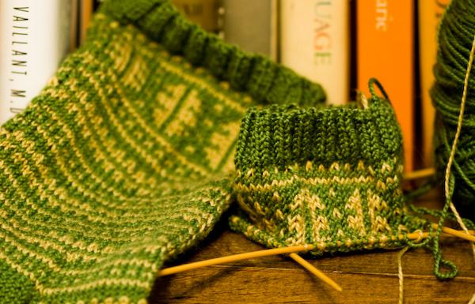
Case study: identifying and safeguarding Estonian handicrafts
What to inventory, what to safeguard?
Traditional knitted and woven products
Skills to create traditional products
Skills to use and develop traditional patterns (even in new products)
Notes:
"Laila's Socks - Progress on #2"
[https://www.flickr.com/photos/lollyknit/2924260152/in/photolist-aTRUp6-4eWkJr-aoNBKA-4eWm5M-5vAjAW-akK7oQ-5vw1BF-ntiDCA-nrdVnq-ntgi9e-nbLTBi-nbM2ud-nbLVWP-5spAEu-5vw1zR-4NTf6q-59Zoe2-5vw1AM-YwoE5Z-7pfsk-ZxBagp-Z9LAuj-YwoEBk-YwoDTg-6PBFMd-nbM2kA-6kSy66] by LollyKnit [https://www.flickr.com/photos/lollyknit/]
is licensed under CC BY-NC 2.0 [https://creativecommons.org/licenses/by-nc/2.0/]

Slide 25
Using existing inventories
Existing registries or lists compiled before State Parties ratified the Convention may be presented to the Committee
This can, however, cause difficulties as States Parties are expected to indicate how the communities concerned participated in the identification of the information presented, and how they gave their consent for the information to be included
Older inventories of ICH may require updating not just to include new elements but also to check and, if necessary, adjust existing information
See also the issue of sustained consent (in EP 4) and the need for regular updating

Slide 26
Case study: many inventories and a registry in Brazil
Institutional and legal infrastructure for ICH research and inventorying since the 1950s
Numerous inventories on lower level
A national inventory and a registry
Strong emphasis on community participation and consent

Slide 27
Access to information about the element
Article 13(d)(ii)
… each State Party shall endeavour to:
adopt … measures aimed at: ensuring access to the intangible cultural heritage while respecting customary practices governing access to specific aspects of such heritage.

Slide 28
Case study: Australian Institute of Aboriginal and Torres Strait Islander Studies
Code of ethics for researchers
Enforces customary limitations on access to indigenous ICH databases
Requires users to respect cultural sensitivities
Protocols allow indigenous control over access to sensitive items

Slide 29
From inventories to nominations
Nominated elements to be included in an inventory of the ICH present in the territories of the submitting States Parties (Criteria U.5 and R.5 in ODs 1– 2)
Proof of inclusion of the element on the inventory required on the forms
Inventory can be work-in-progress

Slide 30
Planning an inventorying project: basic tasks
Determining the purpose of the inventory
Identifying and involving the communities concerned and other stakeholders (including NGOs)
Addressing the gender dimension of identifying and inventorying
Building consultative mechanisms and trust, obtaining consent
Finding resources
Identifying/creating structures for information gathering and networking
Information gathering and data entry
Dissemination, access and updating

Slide 31
How to do community-based inventorying?
The big challenge: How to do it?
An emerging practice ...
Community-based inventorying uses techniques such as individual and group interviewing, participatory mapping, photovoice and participatory video as interactive vehicles to generate and systematize knowledge about the ICH of a community.

Slide 32
Key characteristics of community-based inventorying
Not an end in itself, but a key step in establishing a dialogue for safeguarding ICH.
Not immediate material benefits.
Inclusive and participatory
Creative process of generating and systematizing information with and within the community and not extracting information from the community, recognizing community members as creators and experts of their ICH, not simply as informants.
Non-community participants are first and foremost co-facilitators, learning about the ICH in question and assisting communities in the process of self-documentation.
Values divergent and different opinions – there is no truth, only identification with ICH and opinion.
Should be ncluded in all work relating to ICH.

Slide 33
Core values of community-based inventorying
Inclusion: a key principle
Marginalized communities or groups
Migrant communities or groups
Women
Young – Children
Valuing diversity,
transparency,
flexibility
Source: http://tinyurl.com/oa5vef

Slide 34
Case study: a community-driven inventory in Estonia
Community members with specialist skills manage inventory project after initial consultations with national working group
Community organizations and schools get involved
ICH database managed by a central state agency for ICH

Slide 35
Case study: Newfoundland and Labrador (Canada) inventory
Inventory-making as part of provincial policies for safeguarding ICH
Coordinating structures appointed
Community participation
Community development as a major purpose
Cooperation between government, academia, NGOs and communities
Results available online

Slide 36
Case study: community-based inventory in Uganda
Ministry tasks local NGO
Twelve Busoga community members trained to identify and inventory ICH elements in their own community
Questionnaires developed
Community consulted
Information gathered will be included in the national ICH inventory for Uganda
Busoga community practising their interviewing skills for inventorying the intangible heritage © Centre for Performing Arts and Culture

Slide 37
METHODOLOGY

Slide 38
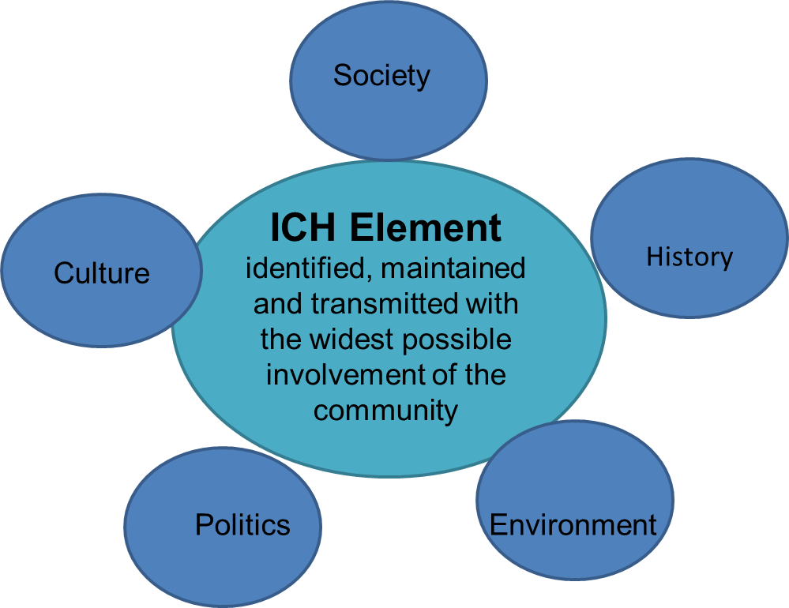
Holistic view of ICH
Thus pluridisciplinarity of
participants and stakeholders

Slide 39
Planning inventorying projects: basic tasks
Step-by-step process
No universal or standardized blueprint for community ground preparation
Encourage community members and facilitators to use their own creativity and develop their own process guides.
Determine the purpose of the inventory
Identify and involve the communities concerned and other stakeholders (including NGOs)
Build consultative mechanisms and trust, obtain consent
Locate resources
Identify/create structures for information gathering and networking
Information gathering and data entry
Dissemination, access and updating

Slide 40
The inventory team: community members and other stakeholders
The insider/outsider perspective to conclude to a group work with multiple perspectives, multiple roles assigned and complementary skills
The experts: NGOs’ representatives, ethnologists/folklorists, museum specialists, ICH facilitators according to the ICH form to be inventoried. Their role: to support the community in any further inventorying activities that it wishes to take forward.
Community representatives as co-facilitators to assist in accessing local ways of expressing knowledge, in understanding cultural factors, enabling inclusivity, and balancing multiple methods:
direct roles such as practitioners, knowledge bearers, performers, craftspeople, shamans; and
indirect participants such as patrons and audiences.

Slide 41
Defining objectives and expected outcomes
What are the expectations of the community and workshop participants regarding the fieldwork practicum?
What are the expected goals given the limited time and specific circumstances?
What are the expected outcomes?
Defining the ‘field’
= An area entered to collect information/samples/data to be analysed later.
Deciding/defining a field area:
village, neighbourhood, district, geo-cultural area;
community, ethnic group, occupational group;
genre of performance;
event, festival or ceremony.

Slide 42
Establish contacts and build rapport
Share the purpose of inventory making.
Respect community/local feelings on secrecy or access.
Involve members as much as possible, even if not part of the proposed team.
Make note of individuals/groups/ institutions who may be capable of carrying out an inventory.
Keep in mind that inventorying is part of the larger goal of safeguarding.
Building rapport between ‘outsiders’ and ‘insiders’ is essential for effective participation.
Initial contacts could be made with community leaders, who then would introduce the team to the wider community.
Facilitators and community members should talk about the inventorying process and allow questions.

Slide 43
Become familiar with the community surroundings
Some activities that can help facilitators learn about the community include:
take walks or drives with local people to observe;
participate in the daily activities of communities;
listen to conversations in public places, conducting oral histories and draw daily activity schedules and seasonal calendars with different groups; and
stay overnight in villages to listen to histories and folk tales.
Reflecting on community collaboration
Who is the collaborating community and how was it identified?
How was the free, prior and informed consent of the collaborating community obtained for hosting the fieldwork practicum?

Slide 44
Preparing information-generation exercises
What is to be identified and described?
A specific ICH element?
ICH elements from one or different domains?
Various elements of the same domain?
Refine the inventorying framework.
Choose techniques to be used and prepare materials/equipment.
Methods of information generation
Archive and literature review (existing reports, studies, videos, photos, maps, documents) to avoid dublication and to validate the collected data
Observation and note taking (listening and watching, field notes, Seeing what we expect to see and what we want to see)
Interviews
Photography
Participatory video, audio recording, mapping

Slide 45
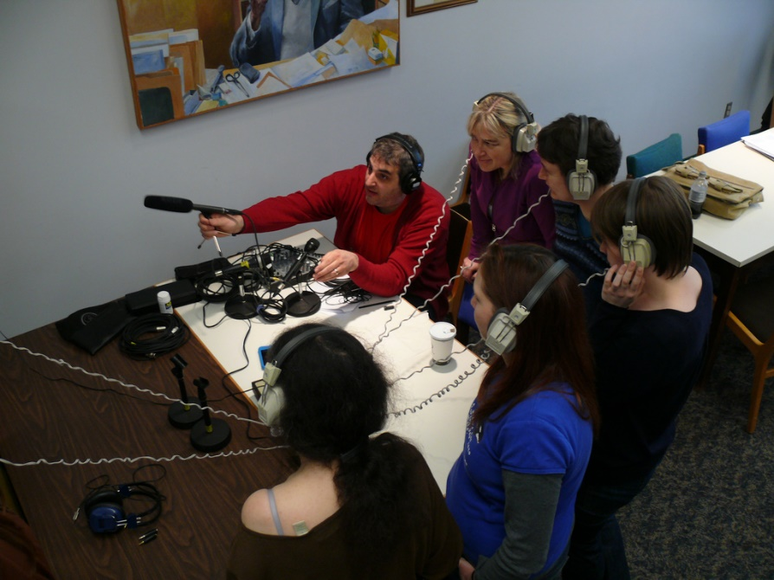
Permission is required for data collection
To record
To photograph
To interview
To participate
FPI= Free Prior and Informed Consent
Notes:
"P1110958 Digital Audio Workshops"
[https://www.flickr.com/photos/dalejarvis/4459686103/] by Dale Jarvis [https://www.flickr.com/photos/dalejarvis/]
is licensed under CC BY-NC-SA 2.0 [https://creativecommons.org/licenses/by-nc-sa/2.0/]

Slide 46
Interviews A good interview is like a good conversation.
Define the scale: dialogue between two or more people or focus groups
Structured, semi-structured or unstructured interviews
Preliminary questions
Make initial contact and inform potential interviewees about: the inventory, the expectations, the place, the circumstances and the duration of the interview
Choose a location, consulting the community, free of distractions and background voices, easily accessible and comfortable for the interviewee
Reassure the right equipment and its charging (audio recorders, microphones, video cameras)
information about the inventory
how long the interview will last
where it will take place
who will be present, and
what will be expected of the interviewee.

Slide 47
Structured interviews: pros and cons
Pros
Comparability across a group of people
May not require transcription (less time-consuming)
Cons
May not reveal the true concerns of community
members if they cannot deviate from questions
Do not allow for the inclusion of interesting or
revealing stories
Semi-structured interviews: pros and cons
Pros
Allow for a degree of comparability
Still allow for the inclusion of some incidental comments or stories
Cons
May still be seen as ultimately representing the agenda of researchers from outside the community

Slide 48
Unstructured interviews: pros and cons
Pros
Recognize the unique body of knowledge possessed by each respondent
Are driven by community members
Allow for the full expression of each person’s ideas
Cons
Easily get off track
May spend time discussing seemingly irrelevant points
Are more time-consuming than other techniques
May require transcription

Slide 49
Questions -As questions one at a time in a manner
Good questions | Bad questions
Inspire discussion, Generate important and interesting information about the ICH element, Flow naturally with the conversation Make the interviewee feel comfortable | No insight about the ICH element, Upset the interviewees or make them feel awkward, Disengagement of the interviewee Disruption of the flow of conversation.
Open-ended questions | Closed questions
cannot be answered with a ‘yes’ or ‘no’, are more conversational, can help an interviewee to open up | can be answered with a ‘yes’ or ‘no’, provide specific information, and can help warm up an interviewee at the outset

Slide 50
Wording of questions What, where, who, how, why and when: potential formula for getting the full story. Neutral phrasing Paraphrasing shows understanding but is to be used moderately and in timely manner Avoid leading or “why”questions Conclude the interview: verify that nothing is to be added and wrap up

Slide 51
Active listening – interaction with the interviewee
Active listening is achieved by:
facing the interviewee,
maintaining eye contact,
responding appropriately,
focusing on what is being said,
keeping an open mind,
avoiding personal opinions, and
not interrupting,
acknowledging answers, timely and kept to a minimum, with non-verbal cues, as head nodding, smiling and eye contact.

Slide 52
Focus groups: pros and cons
Pros
Collaborative problem solving
Time-effective and cost-effective
Place community members on equal footing
Flexible format
Cons
Cannot provide the same kind of in-depth information as one-on-one conversations
Some community members may feel uncomfortable speaking up
Group think leads to agreement on popular ideas

Slide 53
Photography (people/places/events/ actual or archival)
Pros
Enhances aesthetic and content value to the words of community members
Is meaningful regardless of language or literacy
Depicts people, places and events in a way that could not be accomplished using words alone
Cons
Not guaranted technical familiarity by all CBI facilitators/community members
Could convey the wrong impression
Some community members may feel uncomfortable in front of the camera
May raise ethical issues of information access

Slide 54
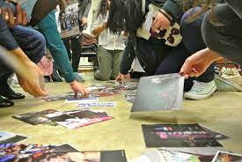
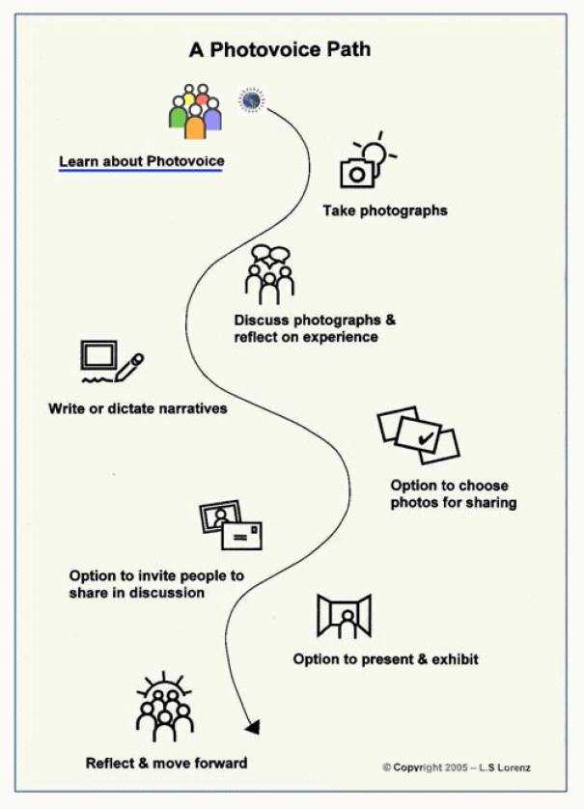
Photo-voice
Qualitative research
method used in community
-based participatory research:
gathering participant-taken
photographs and narratives to translate experience into
actionable knowledge, representing the interests of community
members who normally may not have a voice.
Enables community members to be the photographers.
Benefits communities by:
- providing an outlet for inventorying ICH
- elements and teaching community members a new skill set.

Slide 55
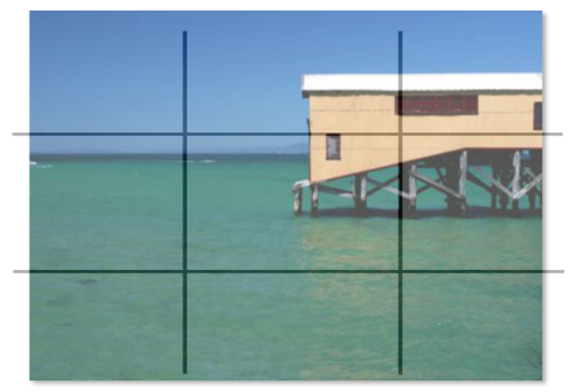
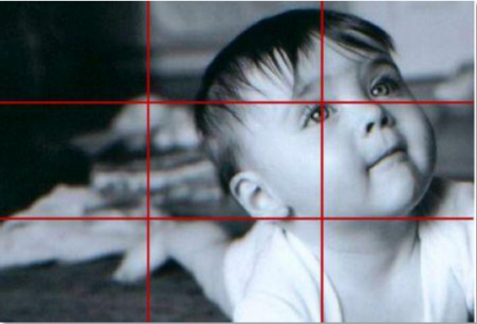
Creating photographs
Composition:
how to set up the subject in the frame, communicating meaning, placing subjects with intention and purpose: facing the camera, filling the picture not being too far away, be framed within the picture
manage details such as nose room and headroom
working with light, camera angle and the camera lens.
Type of shots: extreme or medium close-up, medium, long or extreme long shot
The rule of thirds:
divide an image into thirds horizontally and vertically, so the image
is composed of nine squares and place points of interest in the
intersections along the lines.
Notes:
Picture from Handout on the Fundamentals of Photography from Module 14, Unit 5 of the Training Kit on Participatory Spatial Information Management and Communication by Jon Corbett and Kasondra White is licensed under CC BY-NC-SA 3.0.

Slide 56
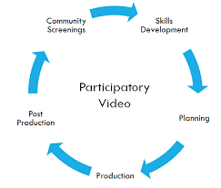
Participatory video and ICH inventorying: Why and how
Provides a tool for community-ICH inventorying and transmitting
Overcomes language and literacy issues
captures the changing character of living heritage involving living
traditions, activity, performance etc.
Cost- effective means
Power and widespread of the visual medium
How will the community use the video ?
Who controls rights to community video ?
Who is the audience ?
Facilitator vs. community

Slide 57
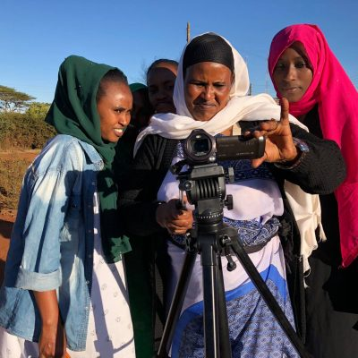
Participatory video Participatory film making/ Community media/ Community video
Depicts: events, emotions, everyday affairs
Shares ideas regardless of language or literacy, and
Involves the community in film-making, as a tool for social improvement and inclusion.
Pros | Cons
Conveys action, so is a preferred means of conveying events Is meaningful regardless of language or literacy Allows for the depiction of emotion | Relatively expensive compared with other techniques Not granted technical familiarity of all facilitators/community members Some community members may feel uncomfortable in front of the camera

Slide 58
Methods of participatory video: a comparison
Short video films – stories
Directed by the participants and shown to the wider community for feedback and inputs.
Creates a collaborative product that is easy to share
Authorship
3. Mediated
4. Not recorded in context
5. Voice of creator
Ongoing video recording
Recording every day life and events as they happen in context
Not a product
Would tend to be an individual perspective
Direct
Recorded in context
Voice of practitioners

Slide 59
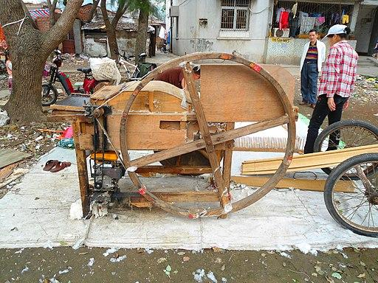
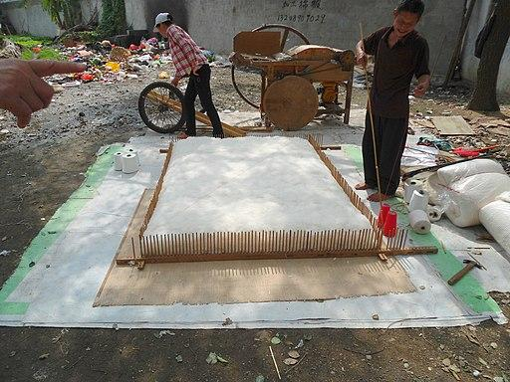
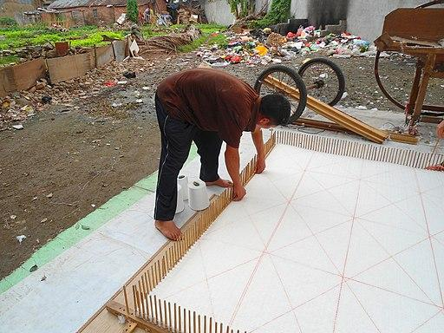
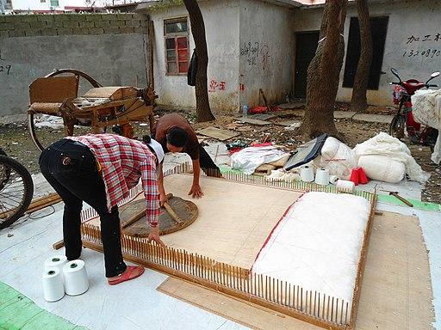
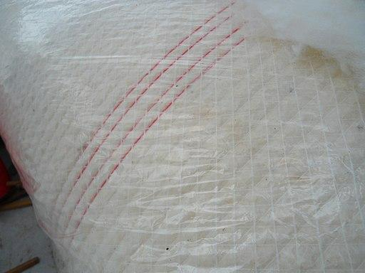
Documentation video tips
ICH focusses on process and not product
Show background area – general shots
Do short interviews to explain footage that has been shot
Think about where close ups are needed. e.g. hand and foot movements for dance, facial expressions etc.
Notes:
"Quilt making 01.JPG“
[https://commons.wikimedia.org/wiki/File:Quilt_making_01.JPG] by Anna Frodesiak
[https://commons.wikimedia.org/wiki/User:Anna_Frodesiak]
"Quilt making 03.JPG“
[https://commons.wikimedia.org/wiki/File:Quilt_making_03.JPG] by Anna Frodesiak
[https://commons.wikimedia.org/wiki/User:Anna_Frodesiak]
"Quilt making 05.JPG“
[https://commons.wikimedia.org/wiki/File:Quilt_making_05.JPG] by Anna Frodesiak
[https://commons.wikimedia.org/wiki/User:Anna_Frodesiak]
"Quilt making 08.JPG"
[https://commons.wikimedia.org/wiki/File:Quilt_making_08.JPG] by Anna Frodesiak
[https://commons.wikimedia.org/wiki/User:Anna_Frodesiak]
"Quilt making 11.JPG"
[https://commons.wikimedia.org/wiki/File:Quilt_making_11.JPG] by Anna Frodesiak
[https://commons.wikimedia.org/wiki/User:Anna_Frodesiak]
"Quilt making 19.JPG"
[https://commons.wikimedia.org/wiki/File:Quilt_making_19.JPG] by Anna Frodesiak
[https://commons.wikimedia.org/wiki/User:Anna_Frodesiak]
is licensed under CC0 1.0 [https://creativecommons.org/publicdomain/zero/1.0/deed.en]

Slide 60
Audio recording
Create podcast
Combined with photos or videos
Used in interviews
Audio recordings
Different future use
Archival purposes
Participatory
video

Slide 61
Audio recording: pros and cons
Pros | Cons
Conveys mbience, tone and carries critical information to photographs and other information-generation and presentation approaches to inventorying Allows relocating segments and re-listening to aid in feedback sessions and discussions of ICH elements Discret when you do not want to be intrusive, or not make people self conscious audio recording is a good option Complementary to bad sound video cameras The training to use audio recording is easier Audio files are smaller and easier to send and store, edit, manipulate and upload on the internet for access and for broadcasting | Digital recorders and related equipment can be expensive Not guaranteed technical familiarity of ICH facilitators/community members Can be time-consuming to transcribe recordings and/or apply them to other media

Slide 62
Important tips
Choosing equipment:
- Digital recorder either with portable battery operation or electrical charging is the best asset for inventorying
- Storage media for digital recorders range from SD Cards to Hard disks and pen drives
- Headphones: to check the balance between performers/interviewees and ambience, to listen with accuracy, to check the ongoing interview or recording
Microphones or ‘mikes’ (external microphone or inbuilt mikes)
Microphone positioning
- Not to ‘overload’, as far away as wider the group is, a single performer at about one meter
Choosing a spot indoors or outdoors
Large room with high ceiling, irregular shape and things that can absorb sound like rugs, curtains and furniture. People also help in this case. Windy spaces are hard to deal with.
Storing and Backing-up recordings
Notes:
"Zoom H2 Recorder" [https://www.flickr.com/photos/wfryer/5241424890/] by Wesley Fryer [https://www.flickr.com/photos/wfryer/] is licensed under CC BY-SA 2.0 [https://creativecommons.org/licenses/by-sa/2.0/]

Slide 63
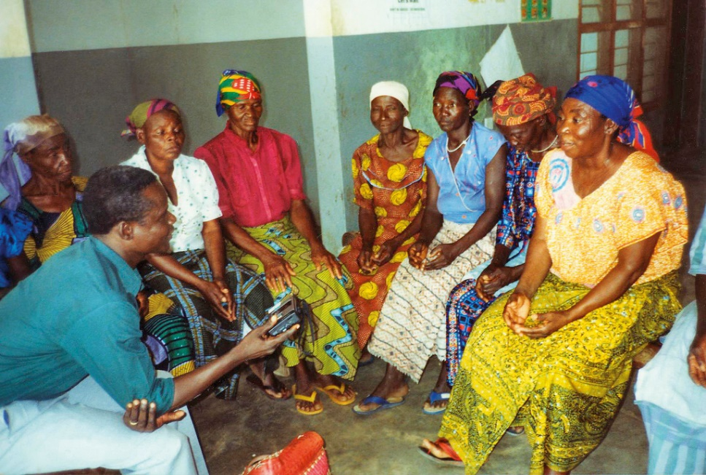
Participatory audio recording
Community representatives should undergo the training
Short workshop session for familiarity with equipment
Recording should be carried out by community members and with their guidance
Recording interviews
Identification of all participants, announcement of the place, date, and purpose of the interview, record the
permission to record, people speaking one at a time, notes - supplement of the recording.
Recording music and dance
Difference between speech and music: volume (the louder the most far). A circular dance can be recorded with the mike in the middle!
Notes:
"A research assistant runs a focus group discussion on traditional treatments of children’s eye conditions. GHANA."
[https://www.flickr.com/photos/communityeyehealth/5553306988/in/photolist-9sJ9Gd-47WWwT-591ZUs-cFYmVd-EtPcgg-bzZttZ-eYsu3Q-X6W7wb-gZ8xG6-nRBaud-gZaFmi-gZ8yFG-5B2Cws-gZ8mTn-gZ9GEf-nWxY2f-bmVcHr-8YcLkh-SzTZfy-4mvpH6-8HRdNq-qDXCk8-czQ7f7-dLoYZL-RPS3xW-b6wrn4-uBoA5-nnJzDv-auo3mP-ePjRGA-8YcL9y-bWDE1g-djsYxL-fV7JL3-Xd49Lm-frDh91-e4EnkB-qxZGxP-qWod2a-b6wpVe-9NyKtj-gZ8NhZ-gZaax1-gZ9JvC-gZ8m7c-gZ8hqp-gZaddR-gZ8z3o-VRj5ns-gZ94ni] by Community Eye Health [https://www.flickr.com/photos/communityeyehealth/]
is licensed under CC BY-NC 2.0 [https://creativecommons.org/licenses/by-nc/2.0/]

Slide 64
Participatory mapping
Depicts the cultural landscape (social values,
norms and practices) relative to an ICH
element as identified by the community themselves.
Pros
Collaborative and constructive,
Communities take a leading role in generating information,
Stakeholders relate to mapping products,
Recording and archiving local knowledge,
Visibility of community knowledge of an ICH element.
Cons
Possible accuracy lack,
Possible authority lack with stakeholders,
Possible ethical issues,
Relatively complex process requiring a range of competencies.

Slide 65
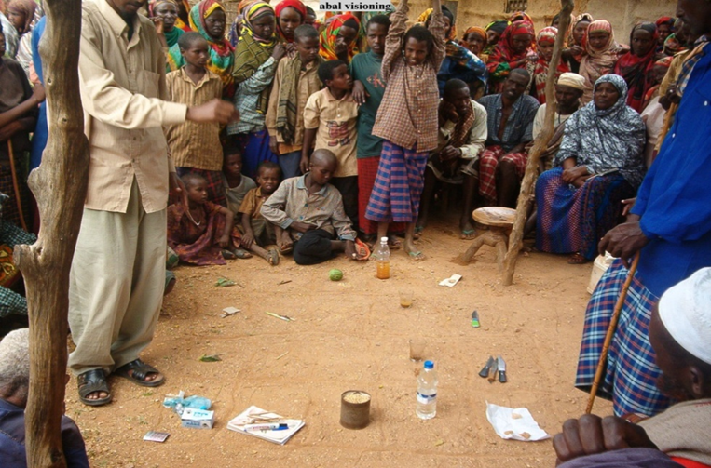
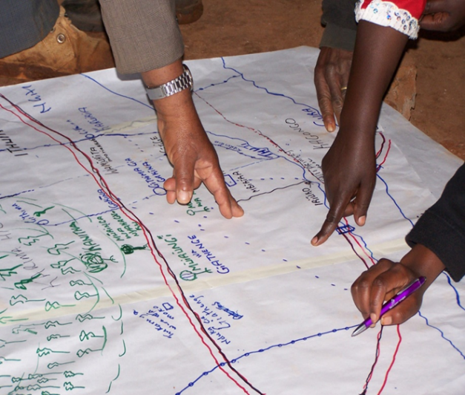
Ground and sketch mapping
A commonly used method, suitable when introducing mapping to a community
Facilitating the development of a participatory forest management map in Karima Forest, Kenya. 2007.
Picture courtesy of Julius Muchemi, ERMIS Africa.
Most basic map-making method, drawn on the ground
Uses raw materials (e.g. soil, pebbles, sticks, leaves)
Participants store acquired knowledge as mental maps
and mentally recompose them when needed.
Used to map physical and cultural landscapes as the
local communities perceive them to be.
A slightly more elaborate mapping method that uses
large sheets of craft paper.
Features are depicted with natural materials or, more
often, with coloured pens or chalk.
Room for interpretation.
Technical and logistical preparation.

Slide 66
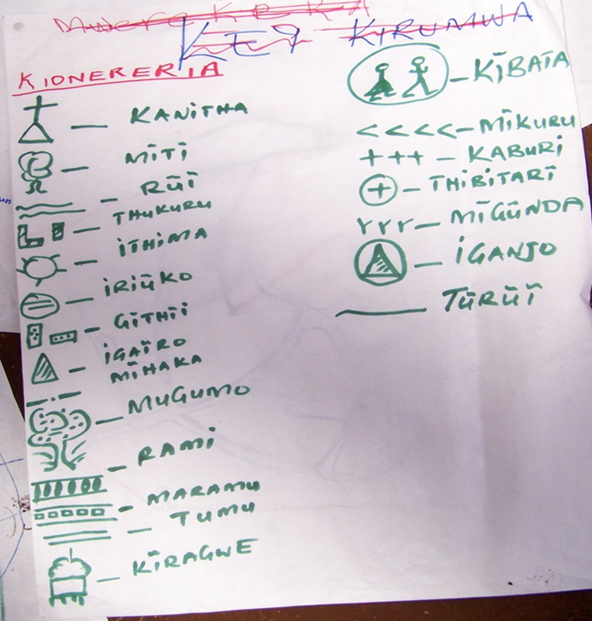
The map legend
Information is preserved through the collection process.
Records are preserved in a legend and interpreted using depicted symbols.
Mental map analysis is used to:
illustrate that different groups of people within communities or organizations may have different perceptions about the same mapping space;
identify map features and determine their attributes, position, patterns, trends and relationships.
A legend developed by local communities in developing a sketch map for participatory forest management, Kenya. 2007. Picture courtesy of Julius Muchemi,
ERMIS Africa.
Notes:
Picture from PPT on Ground and Sketch Mapping from Module 8, Unit 1 of the Training Kit on Participatory Spatial Information Management and Communication by Julius Muchemi (ERMIS Africa) is licensed under CC BY-NC-SA 3.0

Slide 67
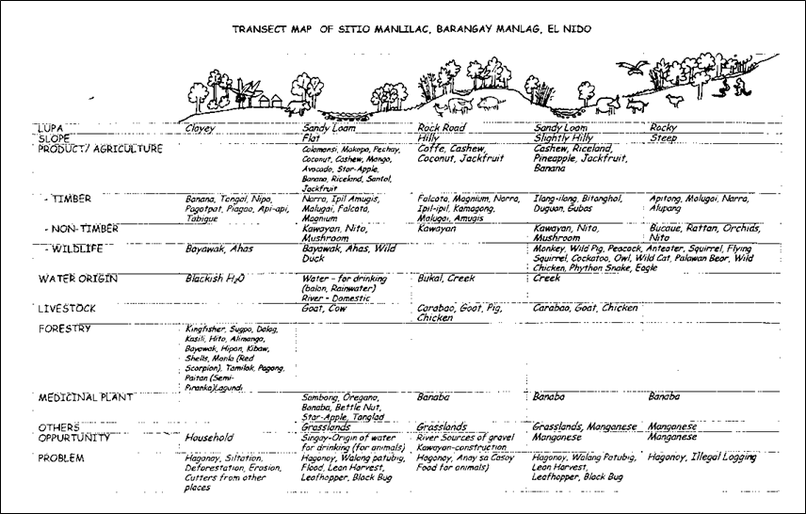
Transect walk
A cross-section groundtruthing exercise
Traverses across entire landscape
Covers ecological, production and social contexts along the chosen route relative to ICH element
Assists in…
PRA conducted in El Nido, Palawan in January – February 1997, National Integrated Protected Areas Programme (NIPAP). Adapted from G. Rambaldi
Notes:
Picture from PPT on Ground and Sketch Mapping from Module 8, Unit 1 of the Training Kit on Participatory Spatial Information Management and Communication by Julius Muchemi (ERMIS Africa) is licensed under CC BY-NC-SA 3.0

Slide 68
Strengths of mapping | Weaknesses of mapping
Local communities take a leading role in: generating local and indigenous knowledge, and visualizing spatial perceptions of ICH elements; Engages non-expert users; Stakeholders can relate to mapping products; Low-cost approaches to mapping; Not technologically dependent; and Easily facilitated because of their tactility. | Ground and sketch maps lack accuracy Not useful for location and quantitative accuracy Not used to determine quantitative measurement May lack authority Interpretation is subjective Ground and sketch maps are short-lived

Slide 69
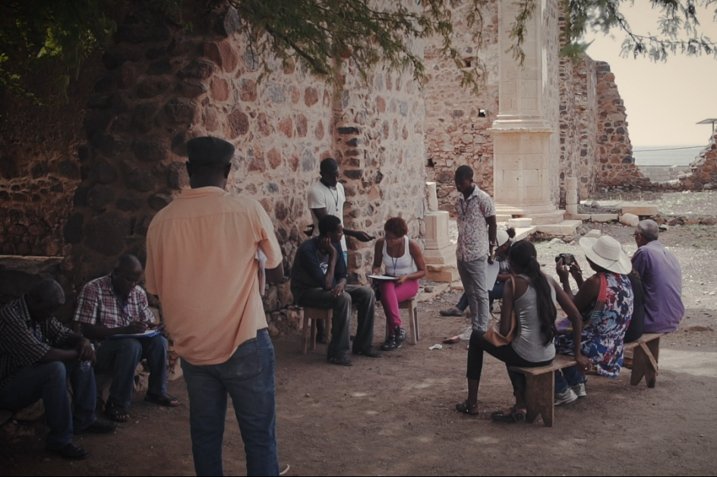
Before you leave the fieldwork venue
Verify facts, names and spelling of people, events, genres, objects, places
What is the data to be organized?
Audio and video recordings (logs about name and nature of event or interview, date and place, people involved
Photographs,
Notes, observations, interviews,
Infos on audiovisual recordings and photos, artifacts, objects
etc.
Collate materials (sort and list together recordings, photos and notes
for each event, number linking documents, recordings, photographs,
logs and recording sheets
Transcribe and translate
Data implications for digital content (file formats, safely stored,
logging and listing, consistent naming systems
Remember: organization of data is reliant on what you collect
©UNESCO / Tatenda
Notes:
©UNESCO / Tatenda

Slide 70
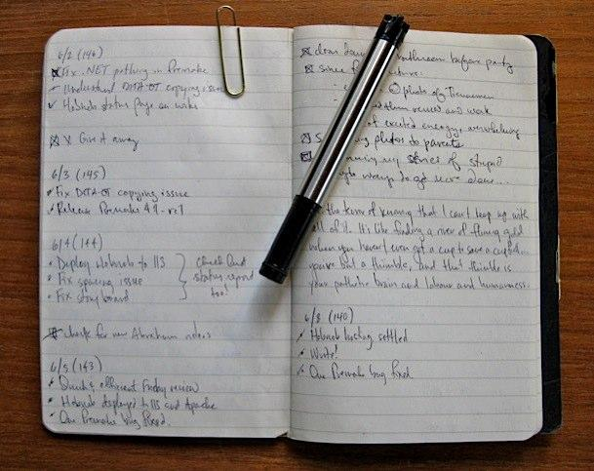
Revise, complete and follow up notes
Further elaborate on rough field notes
Add information that you can recollect
Expand on abbreviations
Check on doubts
Sort and separate
Interviews: find notes on recordings
Check contact information and names
Find ways of grouping data gathered
Notes:
"Pen and Paper"
[https://www.flickr.com/photos/starkos/3629075584/] by Jason Perkins [https://www.flickr.com/photos/starkos/]
is licensed under CC BY-SA 2.0 [https://creativecommons.org/licenses/by-sa/2.0/]

Slide 71
Cataloguing
Use of cataloguing
museums, aid community and collaborators to locate and use information
Form of cataloguing
list, card catalog, database, spreadsheet
Function
describe the materials in a systematic way, aid retrieval
Language
use local names for genres, instruments, crafts
Add general descriptions or translations
Add images or other visual aids to improve access

Slide 72
Beyond inventorying … access and dissemination
Publication print (Books, Brochures, Curricular materials, Training manuals, Scholarly articles and
books) or electronic (Videos, CDs, Publications combining text with audio or video, i.e. Participatory
Videos, Performance of Dance, Music CDs)
Can reach people outside and outside the community
Issue of language and literacy
Higher costs, but can provide revenue
Broadcasting
Television can be local or international
Raises visibility
Community radio and FM – local
Internet radio
No literacy barrier and can reach niche communities
Internet (Websites, Blogs, Online sales and distribution, Social
Media, i.e.Facebook, Instagram etc, You Tube)
Local and international access
Many free options
Lower costs
Requires internet connection within community
Notes:
Picture by geralt [https://pixabay.com/fr/users/geralt-9301/] is licensed under CC0

Slide 73
Purpose
Adds value to Inventory
Raises awareness
Contributes to sustainability of ICH
Part of Safeguarding
Creates participation in ICH
Within community
Outside the community
Needs and Planning
Consent, permission and participation
Budgets and Resources
Agreements about royalties and revenue, if any
Partnering with resource persons, experts, consultants
Plans and projects

Slide 74
Plans for community access
Creating rights agreements that allow access according to community custom
Copies given to practitioners and others accordingly
Deposit in community archive, museum or community centre.
Inventory materials deposited in archives, museum, etc. with stipulations for community access, and appropriate use
Example: songs and stories from Uganda
13 stories, songs, lullabies and game songs of the Baganda people of Southern Uganda
Texts in Luganda with music notation for anybody to be able to sing them.
Translations in English
Pronunciation to be able to pronounce Luganda words.
Notes:
"2013_11_07_Radio_Mogadishu_I.jpg"
[https://www.flickr.com/photos/au_unistphotostream/10795982973/in/photostream/] by AMISOM Public Information
[https://www.flickr.com/photos/au_unistphotostream/]
is licensed under CC0 1.0 [https://creativecommons.org/publicdomain/zero/1.0/]

Slide 75
Legal framework

Slide 76
Related terms
Ethics: what does it mean?
Doing the ‘right’ thing
Honesty, transparency
Sensitivity to cultural norms
Not exploiting Morally / Legally / Commercially
Privacy
Tradition
Permission
Confidentiality
Respect
Customary
practice
Acknowledgement
Creativity
Rights
Add some more …

Slide 77
Ethical principles for safeguarding ICH 2015 Valencia meeting first step in the global discussion on a model code of ethics for ICH 12 Ethical principles for safeguarding ICH to be used as a basis for the development of specific codes of ethics many are relevant for inventorying
Key aspects of ethics in community-based inventorying
Ethics is culture specific
Ethics usually refers to engagement with ‘the other’
Ethnographic research
Ethics statements of professional bodies, archives, museums …
Issues of ‘insider’ vs. ‘outsider’

Slide 78
Ethical and legal issues
Ethical and legal issues often overlap
Ethical norms often come to the foreground when the law fails to protect
Moral rights
Free, prior and informed consent
Possible conflicts
Copyright
State laws
Ethics
Law

Slide 79
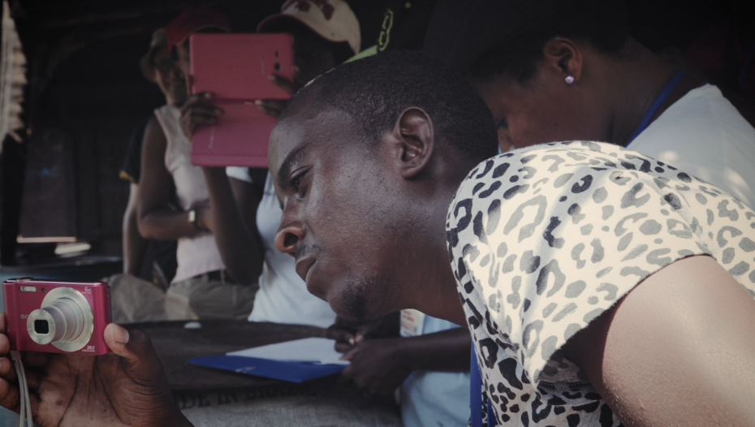
Ethics, editing and rights
Whose story is it ?
Transparency of purpose
Community consensus and editing
Achieving collective editing and authorship
Acknowledgment and attribution
Community screening
Copyright and IPR issues
©UNESCO / Tatenda
Notes:
©UNESCO / Tatenda

Slide 80
Metadata
‘data about data’
digital content
contained and stored in all digital files
can be stored outside the files in a database

Slide 81
Data rights issues
Ensure all forms for free prior and informed consent are obtained and filed
Transfer any conditions for access and use to documents and lists for further use
Note if permission has been obtained for public or online access
Thank and acknowledge all those who participated
Arrange to send copies of photos/recordings if they have been promised
Notes:
"Elias with tablet"
[https://www.flickr.com/photos/colalife/15625192520/in/photolist-AKU8df-qMR6bn-qDxGtB-VUDFCw-SXkde-VUDDKo-SXfnV-VUDH6b-X7MVeA-qKS17m-BP2mU9-2rPduz-6SSywo-ejtH6f-5Hr8wr-ejtGLh-VUDJVd-7PyVSb-7kmVSZ-pNKcn3-oBSQZ4-5Hvstj-fvb4YE-ejtHHb-VUDDaA-7URYvL-7kqQ4s-ejtFFw-7t5hZr-ejtGA9-VXh6cv-ejtJaS-ejnZNx-dQThZU-7PyNjG-pRgw4T-7PuSH4-ejtGZG-ejtJ11-dqVpTe-7URVTs-7kqQ5W-6K51bQ-dQwiXV-Xy9iQq-64e6Y3-5Hvsmd-7UUw54-5HvrMb-7PyVMJ/] by Simon Berry
[https://www.flickr.com/photos/colalife/]
is licensed under CC BY-SA 2.0 [https://creativecommons.org/licenses/by-sa/2.0/]

Slide 82
Community access
Attempt to fund copies for practitioners
Create or assist in creating community, museum, or media centre
Deposit copies in such a centre if it exists
While depositing in an archive not directly controlled by the community, assure community access as part of the agreement
Community access should involve getting copies, ability to create and recreate materials
Any benefits from inventoried materials must assure community benefit

Slide 83
Permission is required for future use
Publish
Educational use
Publicity
Broadcast
Radio, TV, internet..
Archive
Share with others
Research
Learn/perform

Slide 84
Creating an environment of trust
Inform the community about the process and intent of the inventory
Enable discussion and consensus
Be open and transparent
Represent your ICH accurately
Do not rely on your own internal perceptions and knowledge
Include all shades of opinion
What kind of use would be fair according to people in your community ?
Respect individual wishes of practitioners

Slide 85
ICH ownership
ICH …
is evolving
permanently recreated
shared
owned collectively
Applying intellectual property rights with the current legislative framework is therefore not satisfactory

Slide 86
Individual and community rights
Individual
Copyright
Community
Traditional cultural expressions and community rights
(WIPO)

Slide 87
Some tips …
Ensure free, prior and informed consent
Keep records of all agreements
List degrees of access for specific materials
Recording agreements
List all those to whom recordings and photos have to be sent
Fair use Educational use
‘For the greater good of society’
Fair dealing Non-commercial use

Slide 88
EXERCISES

Slide 89
Developing a scenario
Exercise (45 minutes):
Develop a scenario for the fieldwork practicum with the collaborating community

Slide 90
Exercise: organizing information
What are the various headings you can think of for cataloguing the material you have collected?
List all the ways in which you think the materials can be described?
Which of these would be useful for searching specific images, recordings or written notes?
Compile a list by combining everybody’s inputs

