Slide 1

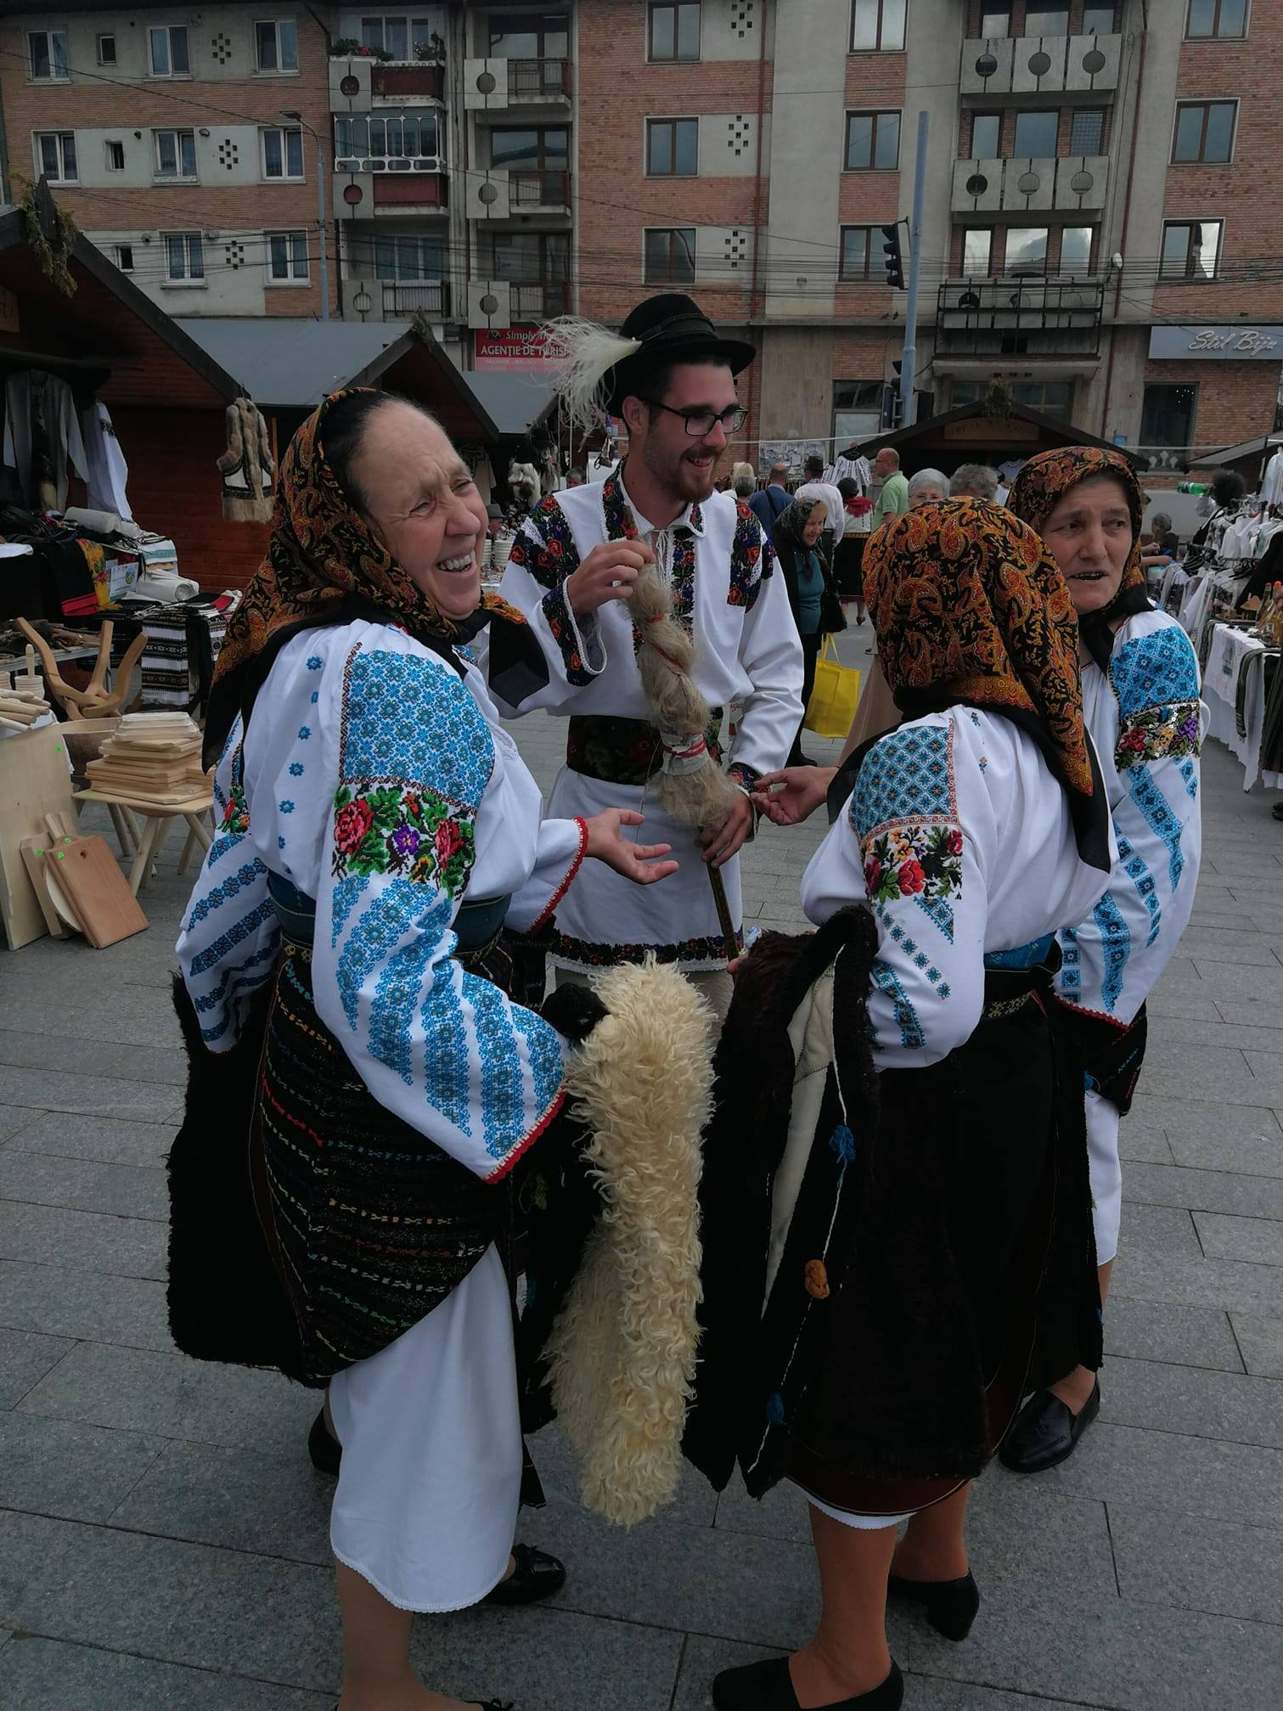


Community participation in the process of identification, documentation and promotion of intangible cultural heritage
PhD. Adina Ciubotariu, Senior researcher, The Romanian Academy, Iași Branch / Global Facilitator for the 2003 Convention

Slide 2




I. PART: Identification of ICH elements
II. PART:
documentation
III. PART:
promotion

Slide 3
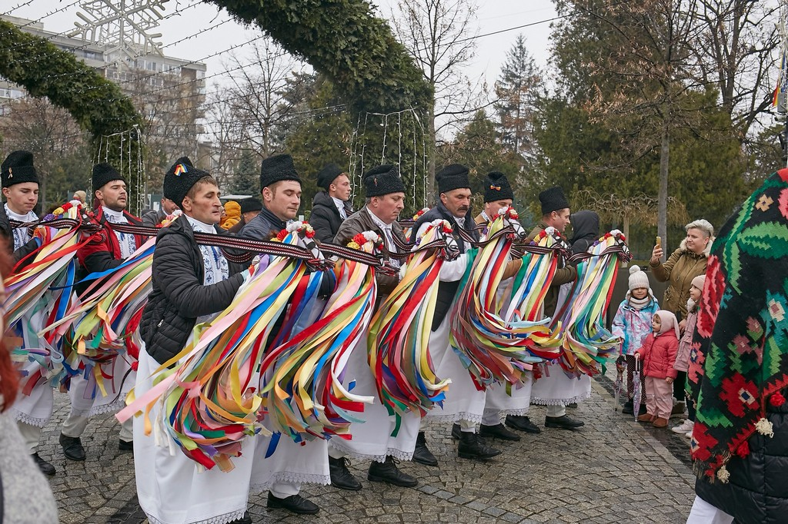
Why involve the community? To avoid the following situations:
Initiative taken from outside, including well-meant but one-sided proposals
Disputes over who constituted the community
Disputes over who represented the community
Disputes over how the community would benefit
Disputes over what constitutes valid community consent

Slide 4
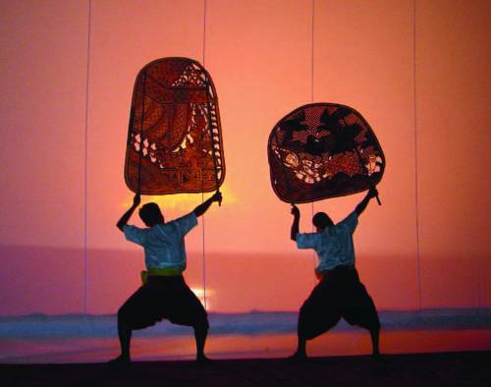
Again, why community participation?
People enact and transmit ICH and identify with it (Article 2.1)
They carry with them the knowledge and skills for enacting and transmitting it (Article 2.1)
It is their heritage; they are its stewards
Any safeguarding will fail without their participation and consent (Article 15)
Sbek Thom shadow theatre
© National Museum of Cambodia
Notes:
http://www.unesco.org/culture/ich/en/RL/00108

Slide 5
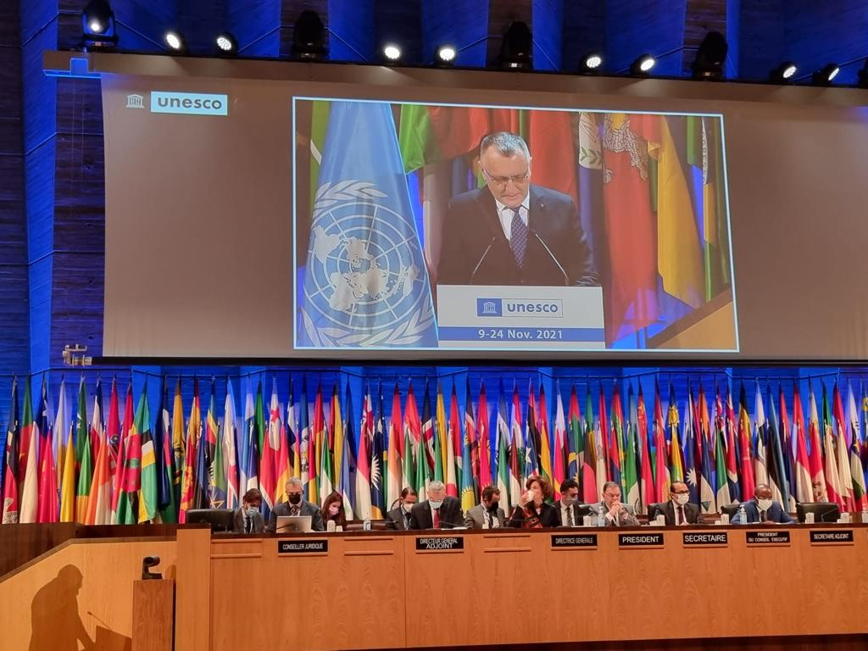
Role of States and the rights of communities
The Convention is an agreement between States
It does not impose obligations on communities
The Convention and the ODs request States Parties to involve and assist communities, with their consent, in managing and safeguarding their ICH (Articles 11(b) and 15)

Slide 6
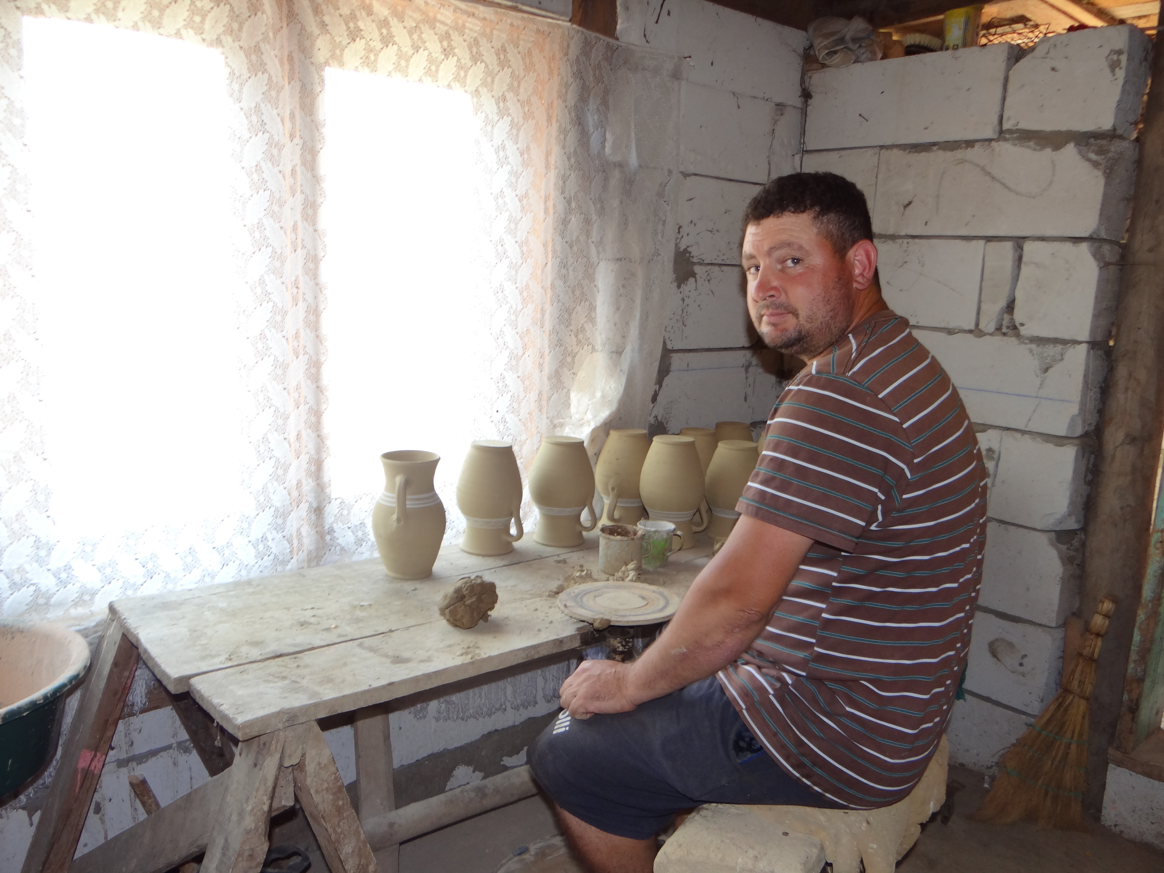
“Communities, groups or individuals”
“The last potter from Schitu - Stavnic”

Slide 7
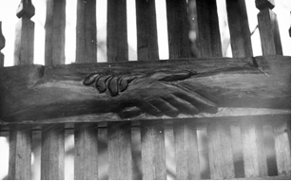

Identifying the communities concerned
People who identify with one or more ICH elements
Some communities are already recognized within the State Party (local, ethnolinguistic, religious communities, etc.)
People may belong to several communities; leave or join communities
People concerned should agree with their identification as a community
©AFMB Wooden gate from Bacău – Romania, 1980
Facade of a buiding in Sibiu – Romania, 2019
Notes:
http://www.unesco.org/culture/ich/index.php?lg=en&pg=00011&RL=00281

Slide 8
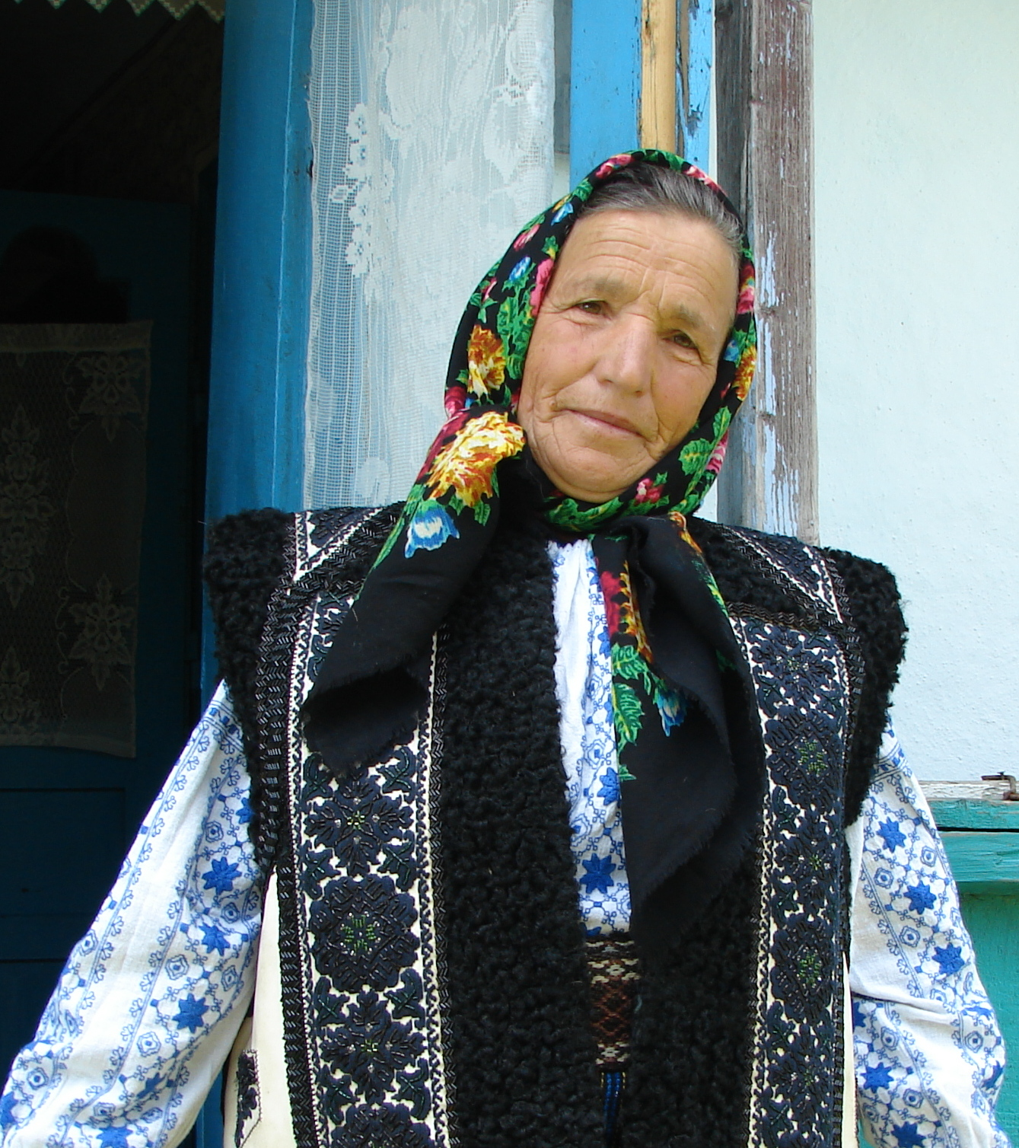
What the Convention and the ODs say (some guidance, much leeway )
Involve the communities concerned in management of their ICH (Article 15)
Obtain and document the free, prior and informed consent of communities concerned
(ODs 1, 2, 7 and 101(b))
No specific guidance on how to identify communities or how to involve them in safeguarding their ICH

Slide 9
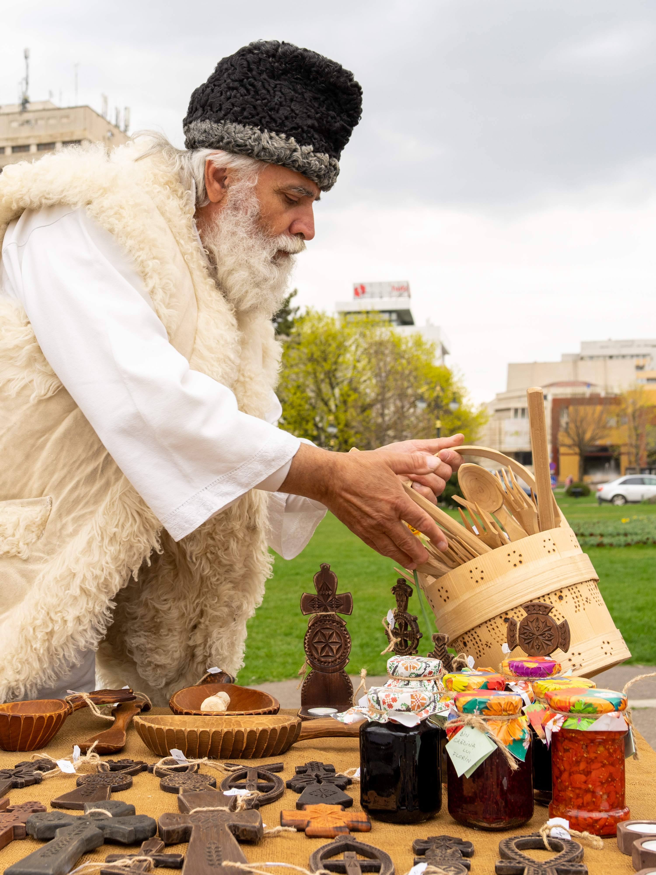
Community participation in what?
Inventorying (Articles 12 and 15)
Identifying and defining (Article 11(b))
Awareness-raising (Articles 14 and 15)
Capacity building (Articles 14 and 15)
Safeguarding, management (Article 15)
Nominations (ODs 1, 2 and 7)
International assistance requests (OD 12)
Periodic reporting (ODs 157 and 160)

Slide 10
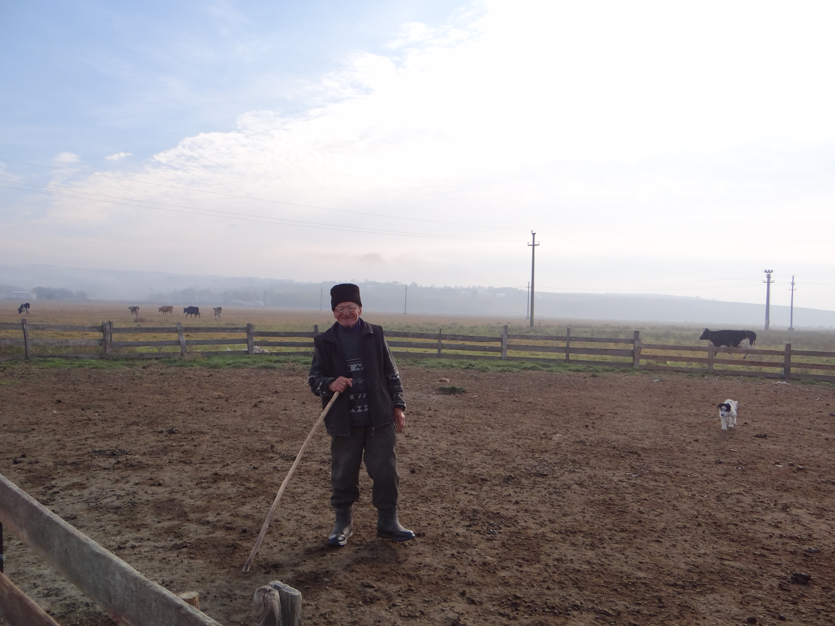
Identifying community representatives
The need for representatives
Existing representatives or not?
Mandate and legitimacy of representatives
Different views within communities

Slide 11
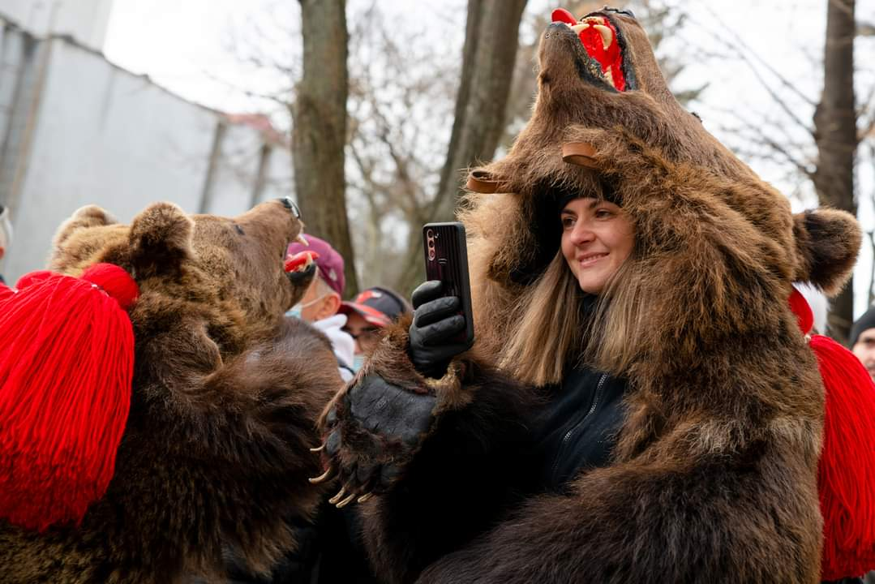
Community participation
Through: workshops, meetings, consultations, polls, media, capacity building, awareness-raising, etc.
For: identification of elements, awareness-raising, safeguarding, developing nominations, etc.

Slide 12



Slide 13
I. Identifying the element of living heritage
Creation, practice and transmission; stewardship, gender roles and identities
Communities, groups and individuals concerned
ICH
Sense of identity and continuity, enjoyment,
self-respect, sustainability, income generation, gender norms and values

Slide 14
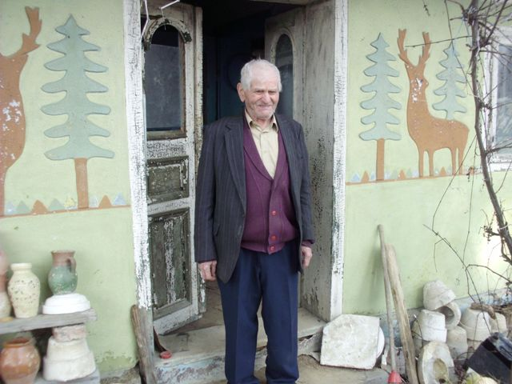
Community participation in inventorying
... what is really needed is for the community to participate in the process [of inventorying] ... If the inscription [on an inventory] takes place without dialogue with the community ... I wonder whether there will actually be any involvement in safeguarding ...
Dr Londres Fonseca (IPHAN, Brazil)
Notes:
Fonseca interview clip: “In my own opinion, what is really needed is for the community to participate in the process [of inventorying], because otherwise our vision is going to be too remote from what is actually happening and we shall fail to realize that the name and category of the element are not the only thing that matters. What matters above all are its meanings, the values attributed to it and how people practise it, which varies a lot. These are older people, and, of course, an anthropologist’s view helps a lot, but I doubt whether the anthropologist’s view is enough. No doubt an anthropologist is very helpful and knows the methodology, but the problem is not just description, because for us an inventory is the first step towards safeguarding. If the population takes part in the inventory, if the community is involved, it has already become a partner in this process. If the inscription takes place without dialogue with the community, even if there is a formal gesture in this direction, I wonder whether there will actually be any involvement in safeguarding or whether this involvement will have to be built afterwards. This is not impossible, but I think it is better to do it beforehand if possible. However, I realize that scale is something very complicated here, and I think that each country must find its own answers.”

Slide 15
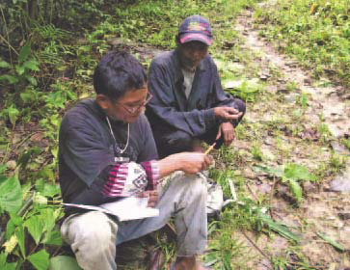
Documenting Subanen indigenous knowledge
(the Philippines)
Elders realized that their knowledge about local plants was not being passed on to younger community members
They asked for help to train young people to document this knowledge within the community
Copyright protection gained
Materials included in the school curriculum
Transmission enhanced
A Subanen member of the documentation team receiving
information from an older member of the community
Notes:
Could not locate the URL for this picture – if not in UNESCO archives please discard

Slide 16
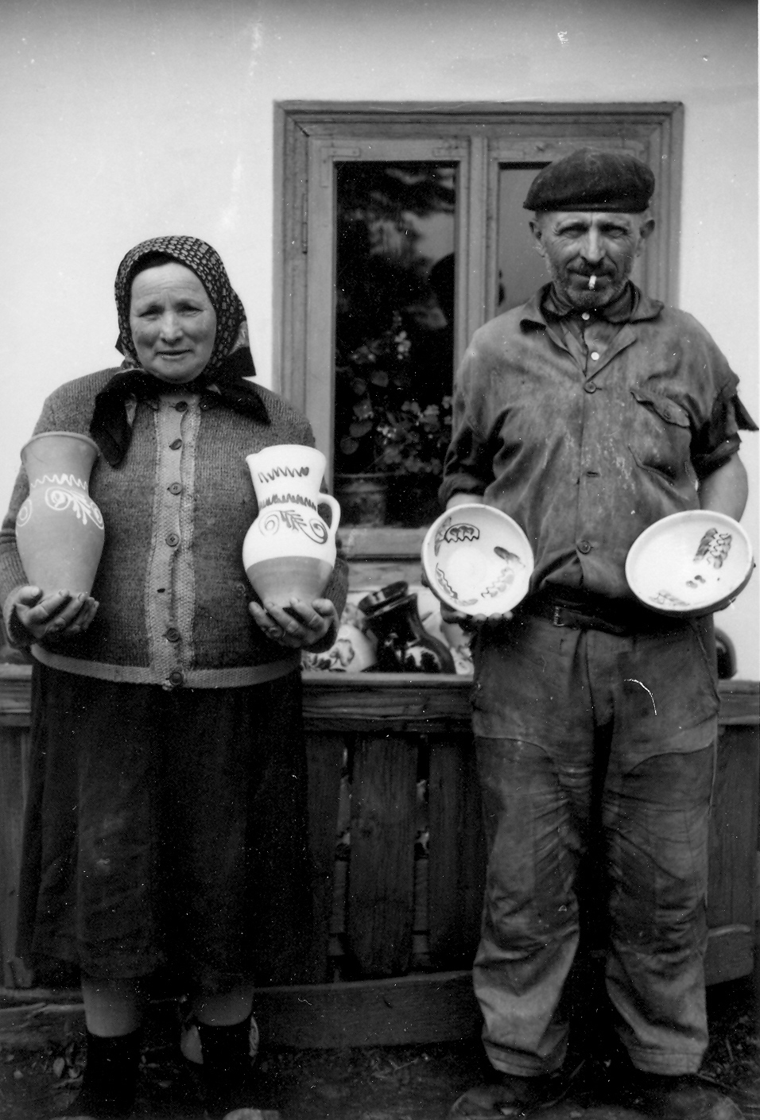
Gender and community involvement
Why is a gender-based approach essential when considering community involvement and participation within the framework of the Convention?
Contextualizes the practices and activities of gender-defined groups by analysing the social relationships that are established and the power dynamics of the community concerned
Ensures that women and marginalized gender groups are equal spokespersons vested with the authority to reshape the communities they desire to be a part of and those they want to create
© AFMB, Elisabeta and Mihai Farcaș - Hudești, 1981

Slide 17
II. Documentation
Community participation
in nominations and international assistance requests
Proof is required of:
Community participation in:
- identification of the ICH/projects concerned (Article 2.1; ODs 1 and 2)
- preparation of the files (ODs 1, 2, 7 and 12)
- Community consent for submission of nominations/requests (ODs 1, 2 and 7)
- Community commitment to safeguard the element, if appropriate (OD 1)

Slide 18
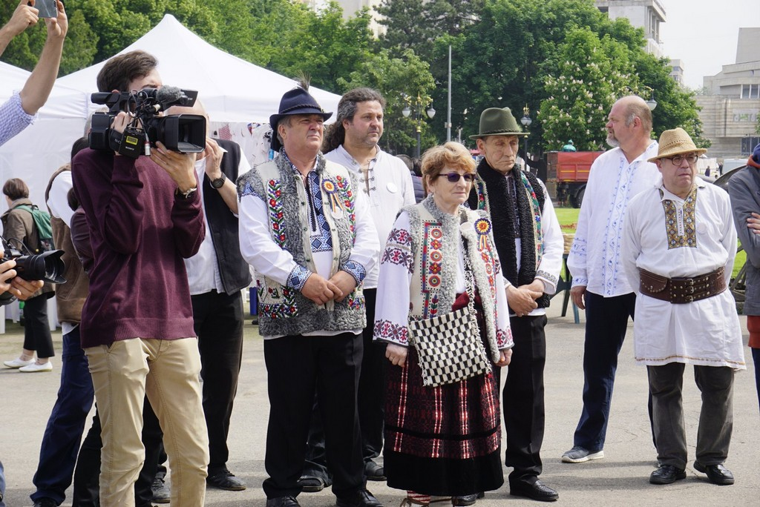
Ensuring that communities benefit
Practising ICH brings benefits to communities; so can safeguarding activities
Communities’ capacities to manage their ICH should be enhanced (OD 107(m))
Communities should benefit from awareness-raising activities (OD 81 and 101(d))
Communities should be the primary beneficiaries of any commercial activities (OD 116)

Slide 19
‘Free’: no undue pressure was exerted on those whose consent was sought
‘Prior’: the information needed for deciding whether or not to give consent was provided in advance
‘Informed’: all relevant information required for making a balanced judgement was provided
free
prior
informed
consent

Slide 20

What not to do
A French ethnologist had studied a procession that takes place every six years in a village in the west of France. He was concerned that the procession was now attracting fewer people than it had some decades earlier and that it was taking on a folkloric flavour.
He felt that it would be a good candidate for listing under the Convention and announced in the press that ‘Paris’ had already approved the idea of nominating the procession to the Representative List (RL), with a view to safeguarding it.
He developed a nomination file, more or less by himself, which he shared with the local population at a relatively late stage of the process.
A series of meetings started in the village: most people who were directly involved – such as those whose territory was crossed by the procession – were surprised, suspicious and displeased by the ethnologist’s activities. They were worried that customary rights of way would be permanently established over their land, and were doubtful of the benefit of having tourists join the procession.
The villagers thus collectively decided to halt the nomination process. The case was reported extensively in the local press.

Slide 22
III. Promotion
The ODs encourage States Parties to ensure community participation in raising awareness about their own ICH (OD 101(b))
And to obtain their free, prior and informed consent (OD 101(b))
This can help to ensure that awareness-raising activities do not misrepresent or disadvantage communities and their ICH (OD 102)
States Parties shall
endeavour
to ensure ...
that the rights of the communities, groups and individuals … are duly protected when raising awareness about their heritage or engaging in commercial activities (OD 104)

Slide 23
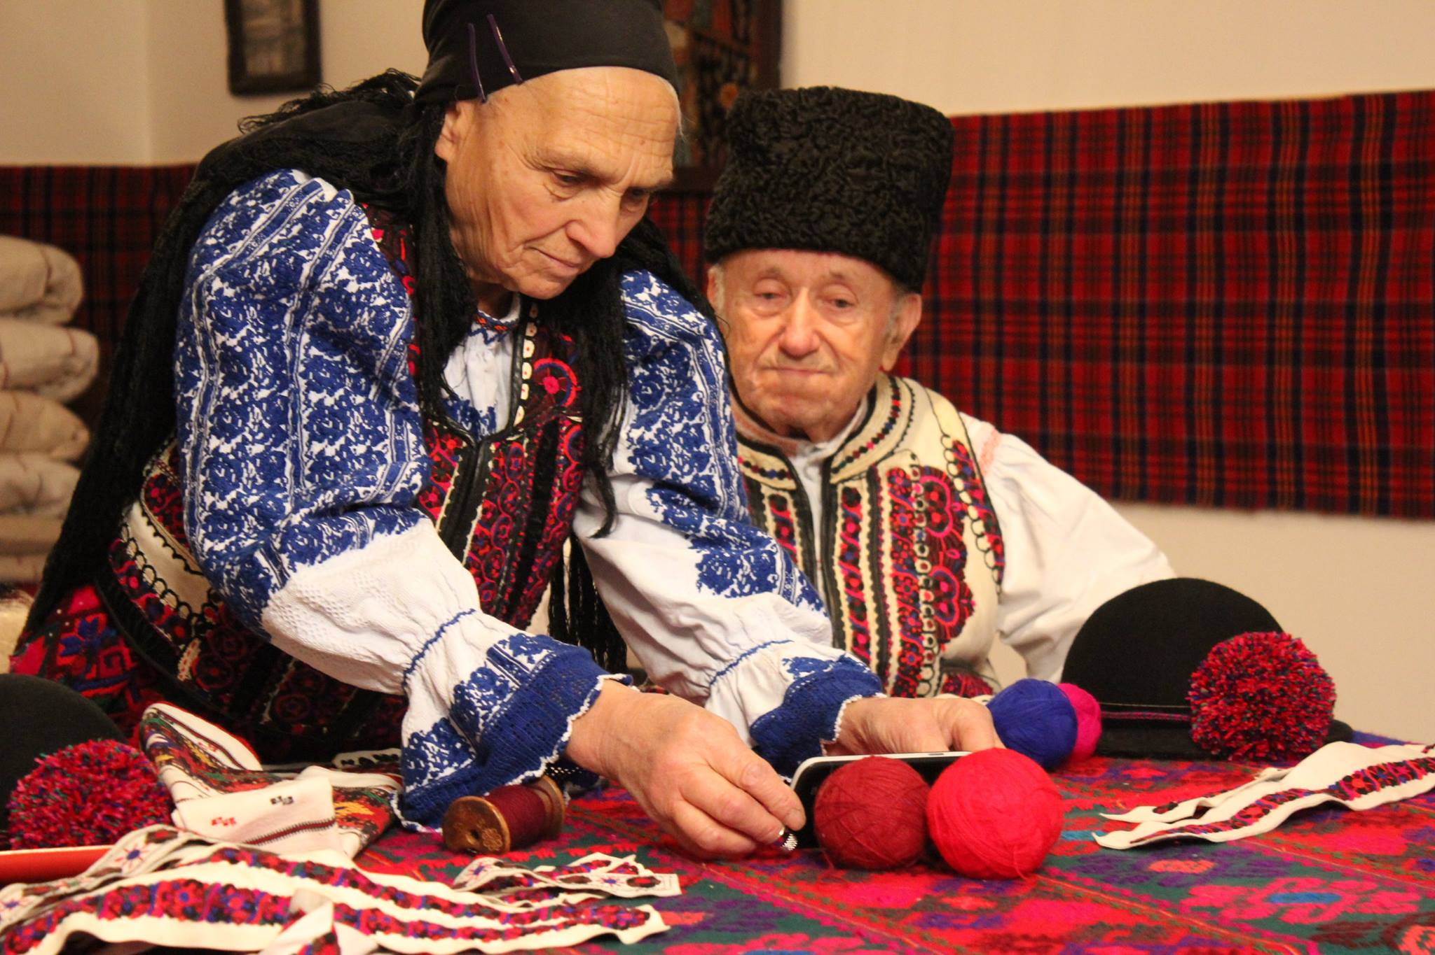
Raising awareness
“Using digitization for documenting traditional knowledge will enable local knowledge holders to access and build upon subsequent transformations of their knowledge by others. Documentation thereby represents an important step in re-positioning Indigenous and local communities to make the most of the opportunities that are likely to emerge as a result of placing their knowledge in the public domain. In sum, documentation has the potential to bridge the distributional inequity which the new public domain movement appears to neglect”.
Chidi Oguamanam, Documentation and digitization of traditional knowledge and intangible cultural heritage, 2009
©România nedescoperită

Slide 24

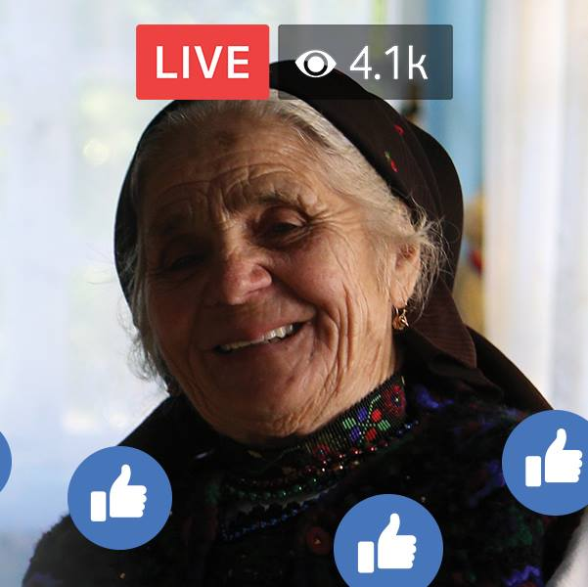

The “intangible cultural heritage” means the practices, representations, expressions, knowledge, skills – as well as the instruments, objects, artefacts and cultural spaces associated therewith – that communities, groups and, in some cases, individuals recognize as part of their cultural heritage. This intangible cultural heritage, transmitted from generation to generation, is constantly recreated by communities and groups in response to their environment, their interaction with nature and their history, and provides them with a sense of identity and continuity, thus promoting respect for cultural diversity and human creativity.

Slide 25

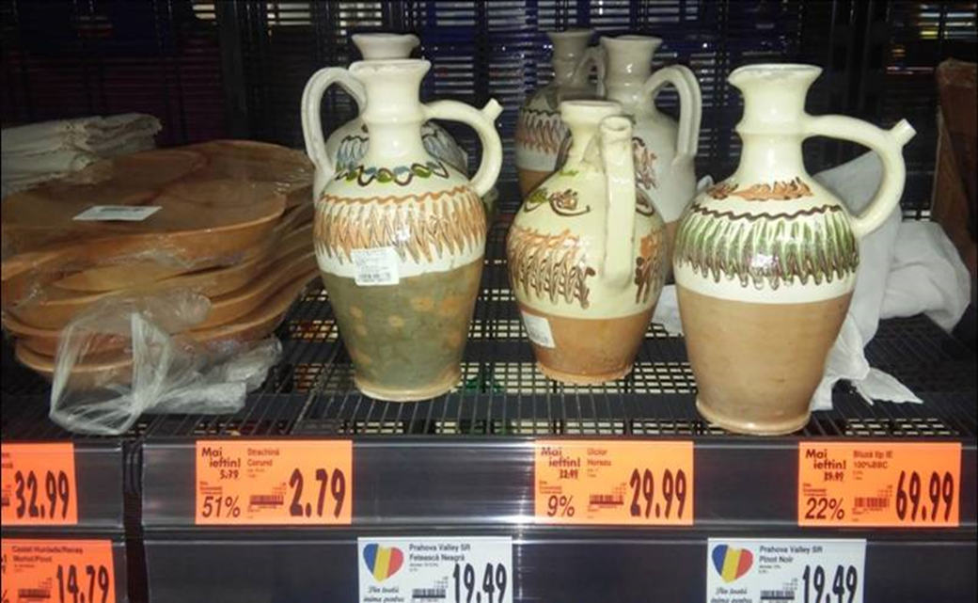
Misappropriation
Horezu pottery made in... China
”Traditional” clothing

Slide 26
Do you know any similar example of misappropriation in your community?

Slide 27
Role of communities in safeguarding
Communities, groups and individuals
Engage in …
and may do ...
Transmission
Enactment of ICH
Identification
Inventorying
Documentation
Research
Revitalization
Ensuring access to places and materials
Transmission through education
Raising awareness
Note: community participation is needed in all these activities
…with help from other agencies if needed

Slide 28
Things to take-away
Key questions
Who is the community concerned?
Who represents them, and with what mandate?
How can they be informed and involved?
How can safeguarding measures and other actions be developed with their involvement and consent?
Who may and should be involved in the implementation and monitoring of safeguarding and other actions?

Slide 29

(Any more) questions?

Slide 30

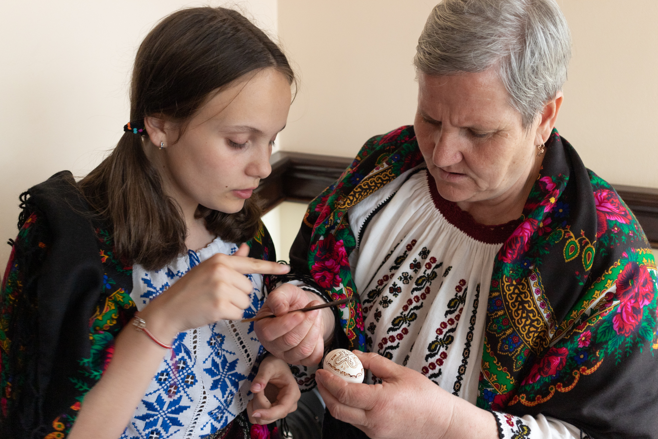
Thank you for your attention!
Contact:
adina.hulubas@ gmail.com

