Slide 1
Creation of inventories and archives of intangible cultural heritage at local level
dr.sc. Tamara Nikolić Đerić

Slide 2
I. PART: Introduction Key concepts
III. PART:
Building an inventory
exercise
II. PART:
Inventories
Practical examples

Slide 3
AIM OF THIS WEBINAR
To present the requirements of a community-based inventory framework, which reflects the spirit of the Convention.

Slide 4
KEY CONCEPTS
Inventorying: the process of identifying, gathering information and listing ICH with the view to safeguarding
Documenting: a step within the process of inventorying which relates to the
process of recording information about an element
Archiving: a step within the process of inventorying which relates to the storing of the recorded material (notes, audio and video recording)
Meta data (administrative and descriptive): ‘information about the information’ information about the content that is collected on a source to help cite the source and to later create a finding aid

Slide 5
FUNCTIONS and PURPOSES driving the end-result
Inventory:
identify ICH, raise awareness about ICH, set ground for future safeguarding measures
difference between national, regional and local inventories
difference between the scope (to nominate elements on the UNESCO lists, to give context to museum collections, to conduct an educational program, to support environmental initiatives, to support local communities in

Slide 6
FUNCTIONS and PURPOSES driving the end-result
Document:
documentation ‘per se’ is a safeguarding measure BUT it is also as supporting activity in transmission, education, awareness raising, research (”...”)
The different goals of documentataion will guide the way of taking records and edit the final documentation (especially film, field-work diary…)
Archive:
- preserving information for future use

Slide 7
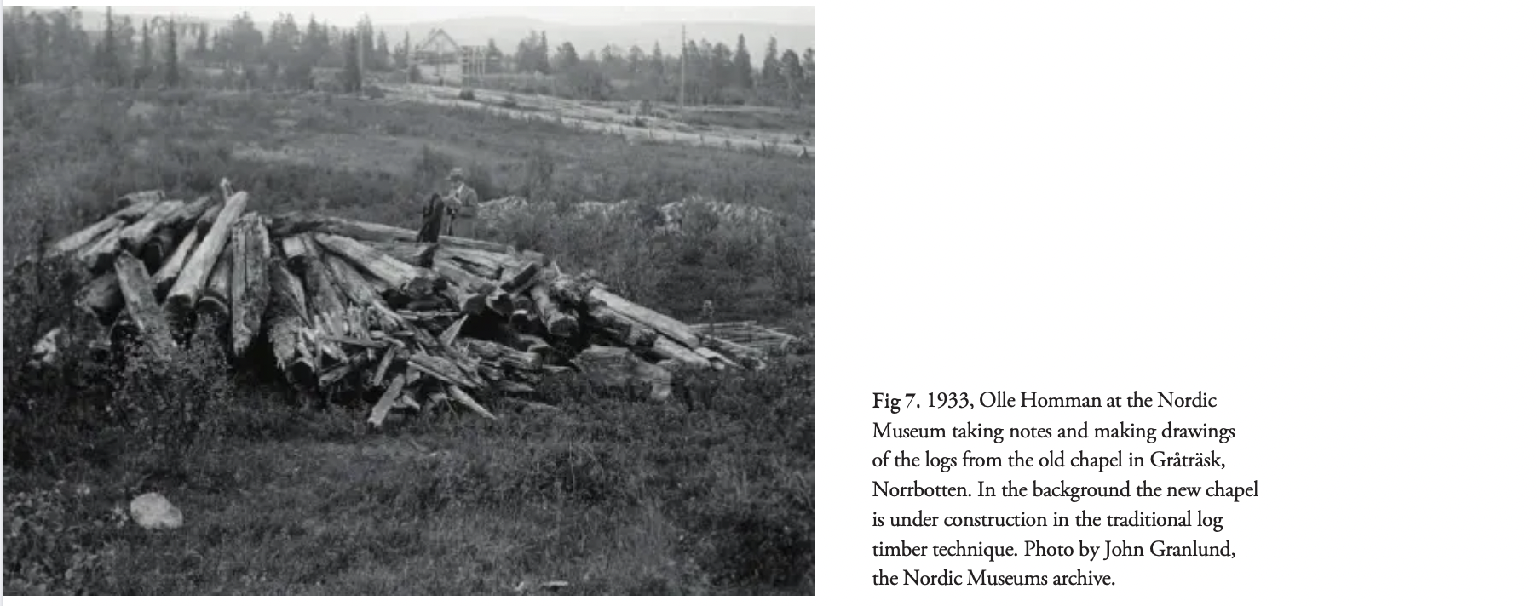
The trajectory of DOCUMENTATION
The development of documentation depended greatly on technological progress. Field texts, drawings and photographs were soon replaced by moving images directly influencing the changes of the paradigms of qualitative field research and visual theories.
Audio-visual documentation methods are most comprehensive when documenting living heritage.
Almevik, Gunnar
From Archive to Living Heritage.
Participatory Documentation Methods in Crafts

Slide 8
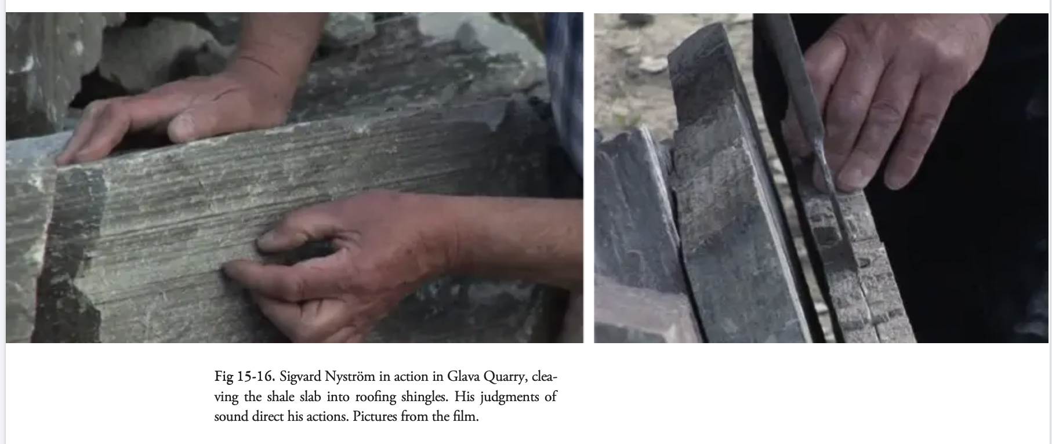
The trajectory of DOCUMENTATION
Almevik, Gunnar
From Archive to Living Heritage.
Participatory Documentation Methods in Crafts

Slide 9
KEY CONCEPTS
Inventories
Under the Convention, the term ‘inventories’ is reserved for compilations of intangible cultural heritage practised in States Parties (Article 12.1), while the term ‘Lists’ is reserved for the two international Lists of the Convention (Articles 16 and 17) and the term ‘Register’ concerns the equally international Register of Good Safeguarding Practices (Article 18, OD 42-46).

Slide 10
WHAT DOES THE CONVENTION SAY
Article 11 Roles of State Parties
Each State Party shall: (a) take the necessary measures to ensure the safeguarding of the intangible cultural heritage present in its territory; (b) among the safeguarding measures referred to in Article 2, paragraph 3, identify and define the various elements of the intangible cultural heritage present in its territory, with the participation of communities, groups and relevant nongovernmental organizations.

Slide 11
WHAT DOES THE CONVENTION SAY Role of State Parties
Article 12 Inventories
To ensure identification with a view to safeguarding, each State Party shall draw up, in a manner geared to its own situation, one or more inventories of the intangible cultural heritage present in its territory. These inventories shall be regularly updated.
When each State Party periodically submits its report to the Committee, in accordance with Article 29, it shall provide relevant information on such inventories.

Slide 12
WHAT DOES THE CONVENTION SAY
Article 20 Purposes of international assistance
International assistance may be granted for the following purposes:
(a) the safeguarding of the heritage inscribed on the List of Intangible Cultural
Heritage in Need of Urgent Safeguarding;
(b) the preparation of inventories in the sense of Articles 11 and 12;
(c) support for programmes, projects and activities carried out at the national,
subregional and regional levels aimed at the safeguarding of the intangible
cultural heritage;
(d) any other purpose the Committee may deem necessary.
TOOLKIT ON INTERNATIONAL ASSISTANCE
https://ich.unesco.org/doc/src/53724-EN.pdf

Slide 13
WHAT DOES THE CONVENTION SAY Operational directives
III.1 Participation of communities, groups and, where applicable, individuals, as
well as experts, centres of expertise and research institutes
80. States Parties are encouraged to create a consultative body or a coordination
mechanism to facilitate the participation of communities, groups and, where
applicable, individuals, as well as experts, centres of expertise and research
institutes, in particular in:
(b) the drawing up of inventories;

Slide 14
WHAT DOES THE CONVENTION SAY Operational directives
V.1 Reports by States Parties on the implementation of the Convention
153. The State Party reports on the legislative, regulatory and other measures
taken for implementation of the Convention at the national level, including:
(a) drawing up of inventories of the intangible cultural heritage present in
its territory, as described in Articles 11 and 12 of the Convention;

Slide 15
WHAT DOES THE CONVENTION OFFER Role of NGOs
Art 9 of the Convention:
“The Committee shall propose to the General Assembly the accreditation of non-governmental organizations with recognized competence in the field of the intangible cultural heritage to act in an advisory capacity to the Committee.”
The first accreditation of NGOs was in 2010.
Today, there’s 217 accredited NGOs around the world (23 in Eastern Europe).

Slide 16
WHAT DOES THE CONVENTION OFFER Role of NGOs
Article 11(b): States Parties should identify and define the ICH in its territory with the participation of communities, groups and individuals and ‘relevant’ NGOs
OD 90: involvement of ’relevant’ NGOs in identifying, defining and safeguarding ICH in cooperation with other actors involved in implementation of the Convention
OD 151, 157, 160, 163: States Parties are encouraged to include information from ‘relevant’ NGOs and other actors aside from communities, groups and individuals concerned in Periodic Reports, reports on the RL elements and report inter alia on their involvement in safeguarding, and preparation of the reports
OD 175: States Parties encouraged to foster scientific studies and research methodologies, including those conducted by communities and groups concerned, and NGOs, on the value of ICH safeguarding for sustainable development

Slide 17
ACCREDITETION OF NGO’s to act in an advosory function to the Committee
Non-governmental organizations (NGOs) that meet the criteria for accreditation set out in paragraph 91 of the Operational Directives may request to be accredited by the General Assembly to provide advisory services to the Committee.
Interested NGOs should provide the information requested in paragraph 97 of these Operational Directives and use the standard format (ICH-09) to submit such requests. Requests must be submitted in English or French, the working languages of the Committee.

Slide 18
LEEWAY
States Parties can draw up their inventories ‘in a manner geared to their own situation’. This means that they are free to organize, present and update their inventories according to their own circumstances and needs. This includes the number and design of the inventories, the criteria for inclusion, and the definitions or classification systems used therein. It also includes the ways in which communities, groups or individuals are identified and the manner in which they are involved in identifying and documenting their intangible cultural heritage. Under the 2003 Convention, there is no single model or template for inventories, nor for identifying intangible cultural heritage or the communities concerned.

Slide 19
THE 8 GUIDING PRINCIPLES
The Convention and the Operational Directives, together with a number of Committee documents, provide explicit guidance on a set of guiding principles or requirements for inventories that States Parties wish to present at the international level as official inventories covering the intangible cultural heritage present in their territory. Such inventories:
1) should be based on procedures that were agreed upon with the communities, groups or, where appropriate, individuals concerned, while their consent is required before the start of inventorying processes, and for major decisions during these processes (Article 15; Ethical Principle 4; Committee documents); ➢ see paragraph 20: Community Consent

Slide 20
THE 8 GUIDING PRINCIPLES
2) should present intangible cultural heritage elements that were identified with the participation of the communities and groups concerned, and of relevant nongovernmental organizations (Article 11(b), Ethical Principle 1); ➢ see paragraphs 21-24: Community Involvement
3) should aim to be inclusive (Article 11(b)); ➢ see paragraphs 25-26: Inclusive Inventorying
4) should contain substantial information about the inventoried elements (Article 12.1); ➢ see paragraphs 27-28: Substantial Information

Slide 21
THE 8 GUIDING PRINCIPLES
5) should be designed in such a way that they contribute to the purposes of the Convention, safeguarding in the first place (Article 12.1); ➢ see paragraphs 29-30: Purposes of Inventorying
6) should be regularly updated (Article 12.1), with the participation of the communities, groups and individuals concerned (Article 15); ➢ see paragraphs 31-32: Updating

Slide 22
THE 8 GUIDING PRINCIPLES
7) should be reported about in the six-yearly periodic reports that States Parties have to submit to the Committee (Article 12.2); ➢ see paragraph 33: Reporting about inventorying
8) should respect customary practices concerning access to intangible cultural heritage (Article 13(d)(ii)). ➢ see paragraphs 34-35: Access

Slide 23
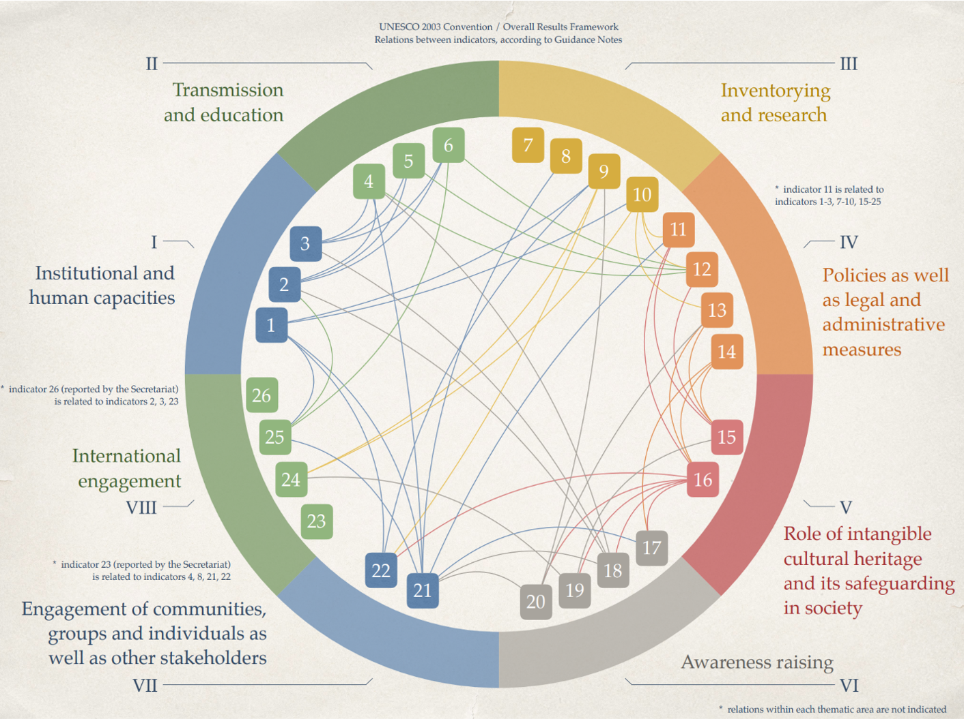
OVERALL RESULTS FRAMEWORK
Core Indicator(s)
7. Extent to which inventories
reflect the diversity of ICH and
contribute to safeguarding

Slide 24
OVERALL RESULTS FRAMEWORK
Assessment According to the Following
7.1 One or more inventorying systems oriented towards safeguarding and reflecting the diversity of ICH have been established or revised since ratification.
7.2 Specialized inventories and/or inventories of various scopes reflect diversity and contribute to safeguarding.
7.3 Existing inventory or inventories have been updated during the reporting period, in particular to reflect the current viability of elements included.
7.4 Access to ICH inventories is facilitated, while respecting
customary practices governing access to specific aspects of ICH, and they are utilized to strenghten safeguarding

Slide 25
7.2 Specialized inventories and/or inventories of various scopes reflect diversity and contribute to safeguarding (ORF)
The concept and format of the inventory will be guided by its purpose and the available recordings or the material planned to be collected:
MEDIA CONTENT
Text and photographs - All domains
Text and audio files - One spacific domain
Text and audio-visual files - Education purpose
Multimedia - Tangible & Intengible - …

Slide 26
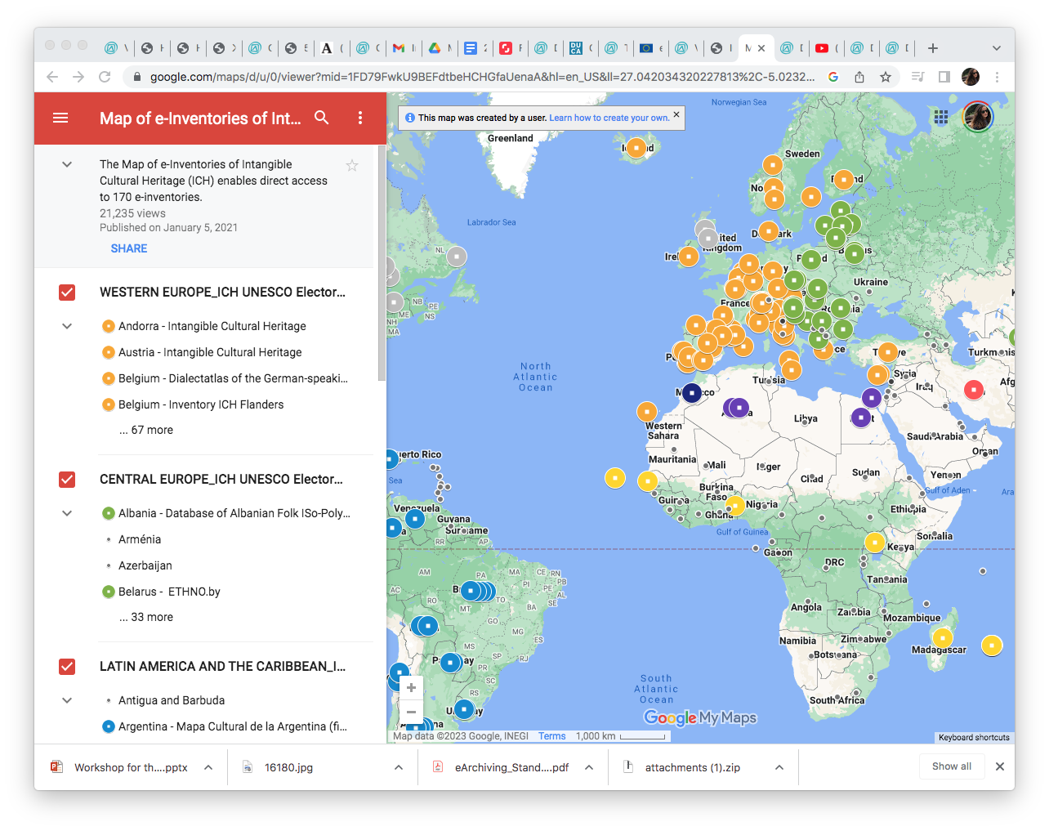
7.2 Specialized inventories and/or inventories of various scopes reflect diversity and contribute to safeguarding (ORF)

Slide 27
INTERNATIONAL LEVEL The relation between national Inventories and UNESCO Lists
The fifth criterion for inscription on both Lists of the Convention states that elements nominated for inscription must figure in an inventory drawn up in conformity with Articles 11 and 12 of the Convention. These are criterion U.5 (OD 1) for the Urgent Safeguarding List and criterion R.5 (OD 2) for the Representative List. In order to meet these criteria, States Parties must fill in the boxes in section 5 (Inclusion of the element in an inventory) of nomination form ICH-01 or ICH02.

Slide 28
INTERNATIONAL LEVEL The relation between national Inventories and UNESCO Lists
Nomination forms request technical details such as: (1) the name of the inventory; (2) the name of the agency (institution, etc.) responsible for the inventory; (3) the method and frequency of updating; (4) the reference number and name of the element concerned in the inventory; (5) the date of the inclusion of the element in the inventory, as well as; (6) a substantial explanation of how the inventorying took place with the participation of the communities groups and individuals concerned. Finally, documentary evidence is requested in the form of pages copied from the inventory confirming the technical details and that inventorying was carried out in conformity with Articles 11 and 12

Slide 29
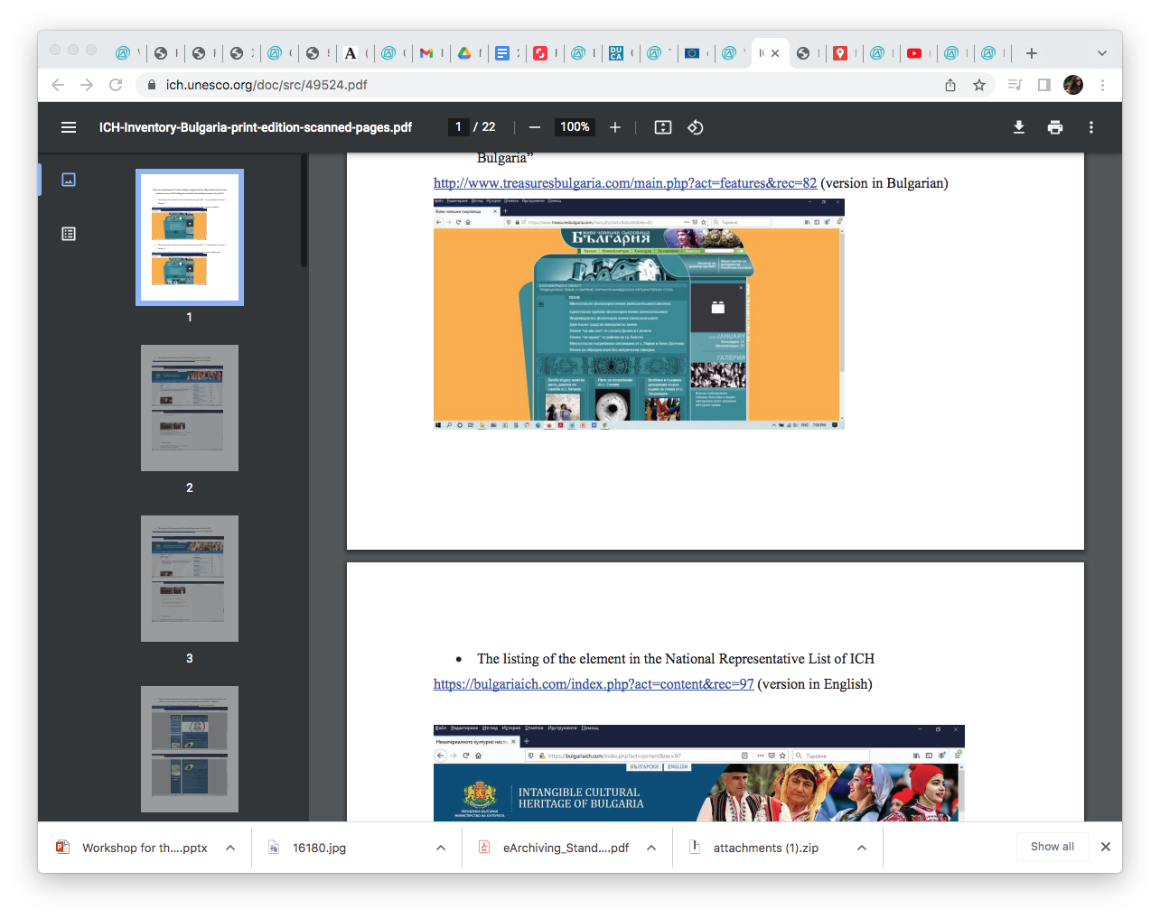
Whoever is involved in preparing the inventories, and whoever takes the initiative to inventory intangible cultural heritage, it is ultimately the prerogative and responsibility of States Parties to the Convention to recognize one or more inventories as official inventories of the intangible cultural heritage present within their borders. Inventorying under the Convention is inevitably both a top-down and a bottom-up process; States Parties need to find a balance between both approaches.

Slide 30
7.2 Specialized inventories and/or inventories of various scopes reflect diversity and contribute to safeguarding (ORF)
https://youtu.be/kuTSC9TB5Ds
Dive into ICH

Slide 31
DEVELOPING NEW INVENTORIES a constant work- in- progress
Drawing up an inventory or inventories from scratch typically involves four main phases:
(1) planning;
(2) gathering information/documentation;
(3) systematizing/analysing and archiving the information collected and
(4) drafting and publishing inventory entries.

Slide 32
DEVELOPING NEW INVENTORIES Criteria
Criteria: inclusion
- States Parties are free to develop criteria for the inclusion of elements of intangible cultural heritage in their inventories. The criteria should be clear, in line with the spirit of the Convention, and not large in number.
Criteria: compliance with the definition of intangible cultural heritage
A commonly used criterion is compliance with a definition of intangible cultural heritage; the definition used in Article 2 of the Convention is frequently referenced.

Slide 33
DEVELOPING NEW INVENTORIES Criteria
Criteria: compliance with the spirit of the Convention
Criteria that focus on intangible cultural heritage elements of outstanding value or antiquity, authenticity, size or scope are against the spirit of the Convention. The Convention, inspired by the UNESCO Universal Declaration on Cultural Diversity (2001), considers the fundamental equality of cultures as an overarching principle.
Criteria: ‘transmitted from generation to generation’
The term ‘generation’, in the definition of intangible cultural heritage in Article 2.1, was never defined and consequently there is no guidance on how long practices need to have been practised to be considered as elements of intangible cultural heritage under the Convention.

Slide 34
WORKING WITH EXISTING INVENTORIES
Some inventories are not in line with the spirit of the 2003 Convention because, for example, these focus on elements of ICH that are considered to have outstanding value and/or to be authentic or original, whereas the Convention emphasizes the living, everchanging nature of heritage and does not promote the idea of externally imposed hierarchy or may have been drawn up with minimal or no community participation
States may choose to bring existing inventories (called lists, registers, or otherwise) into conformity with Articles 11 and 12, to better align them with the objectives of the Convention. They might do so by updating them in intensive collaboration with the communities concerned.

Slide 35
WORKING WITH EXISTING INVENTORIES challenges
The community no longer wishes to safeguard this element
Impossibility to receive Free prior and informed consent

Slide 36
PART II.
Inventories
Practical Examples

Slide 37
Intangible search
Lombardy Region has activated (Regional Law 27/2008) a process of identification, preservation and enhancement of intangible cultural heritage through specific projects that promote the recognition, dissemination and transmission. The online inventory makes it accessible and disseminates knowledge of the living heritage, which are manifested through oral traditions, languages, performing arts, social practices, rituals and festive events, knowledge and practices concerning nature and the universe. The UNESCO Convention for the Safeguarding of the Intangible Cultural Heritage of 2003 is the basis of this inventory online, created by the Lombardy Region in collaboration with the project partners E.CH.I. "Swiss-Italian Ethnographies for the enhancement of the intangible heritage" - Italy-Switzerland Programme 2007-2013. The inventory is constantly updated and implemented by communities and individuals, holders and actors of the intangible heritage.

Slide 38
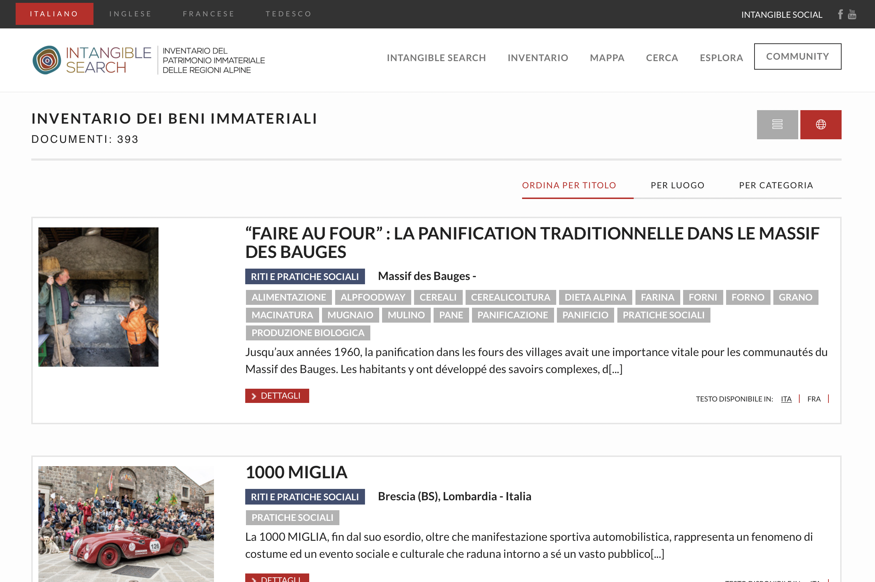
Intangible search

Slide 39
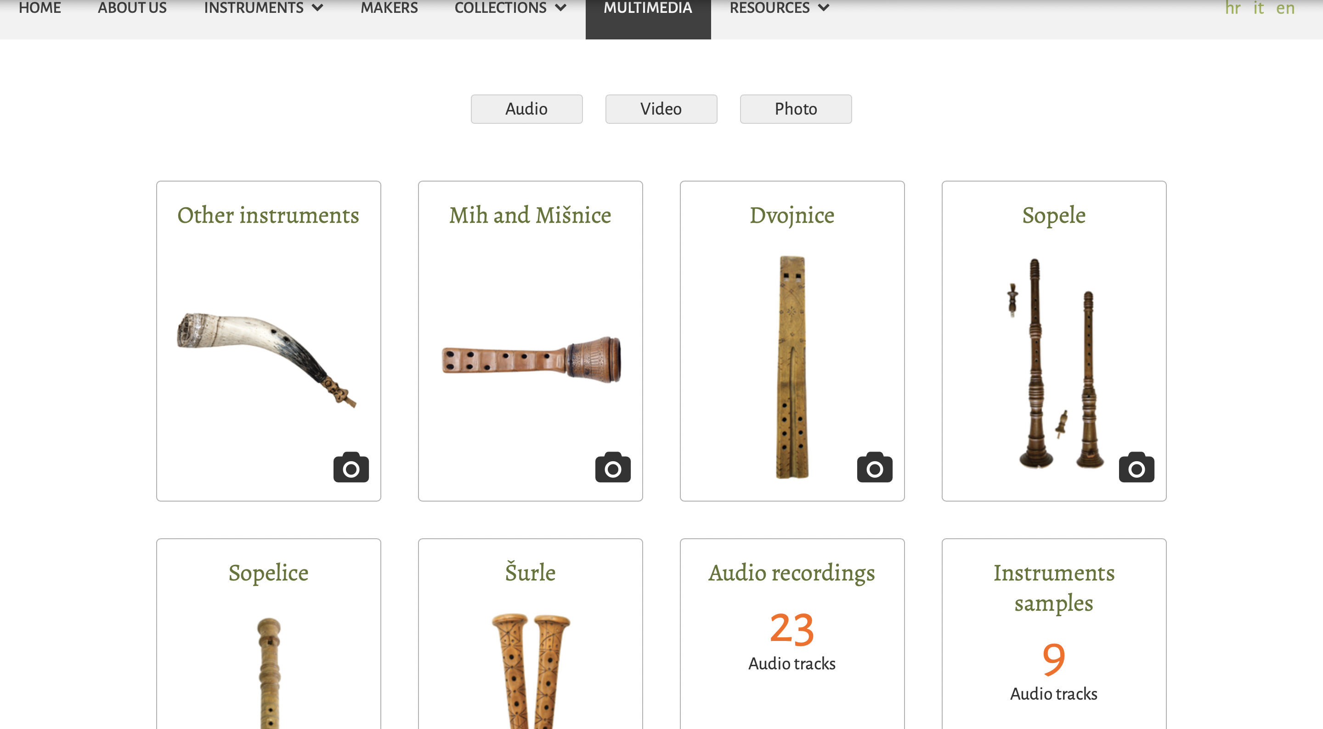
Istrian traditional instruments online
The virtual collection of traditional musical instruments from Istria is an example of combining inventorying and archiving of tangible and intangible cultural heritage.
Along with objects a collection of audioand video material is accessible.

Slide 40
Virtual museum Mala barka
Muzej Mala barka is a virtual museum of maritime heritage of the northern Adriatic including Slovenian Littoral, Istria and Kvarner in Croatia and it was created within the EU interreg project Mala barka 2. The purpose of the virtual museum Mala barka is to enable a virtual walking tour through this cross-border area to learn about rich maritime heritage that is an important part of the local identity. Maritime heritage in the virtual museum Mala barka has been presented through several categories: architecture related to the maritime heritage, objects of maritime signalization, museums, interpretation centres, collections and visitor centres, monuments and memorial plaques with maritime titles and motifs, cultural-historical heritage on the shore and in the sea.

Slide 41
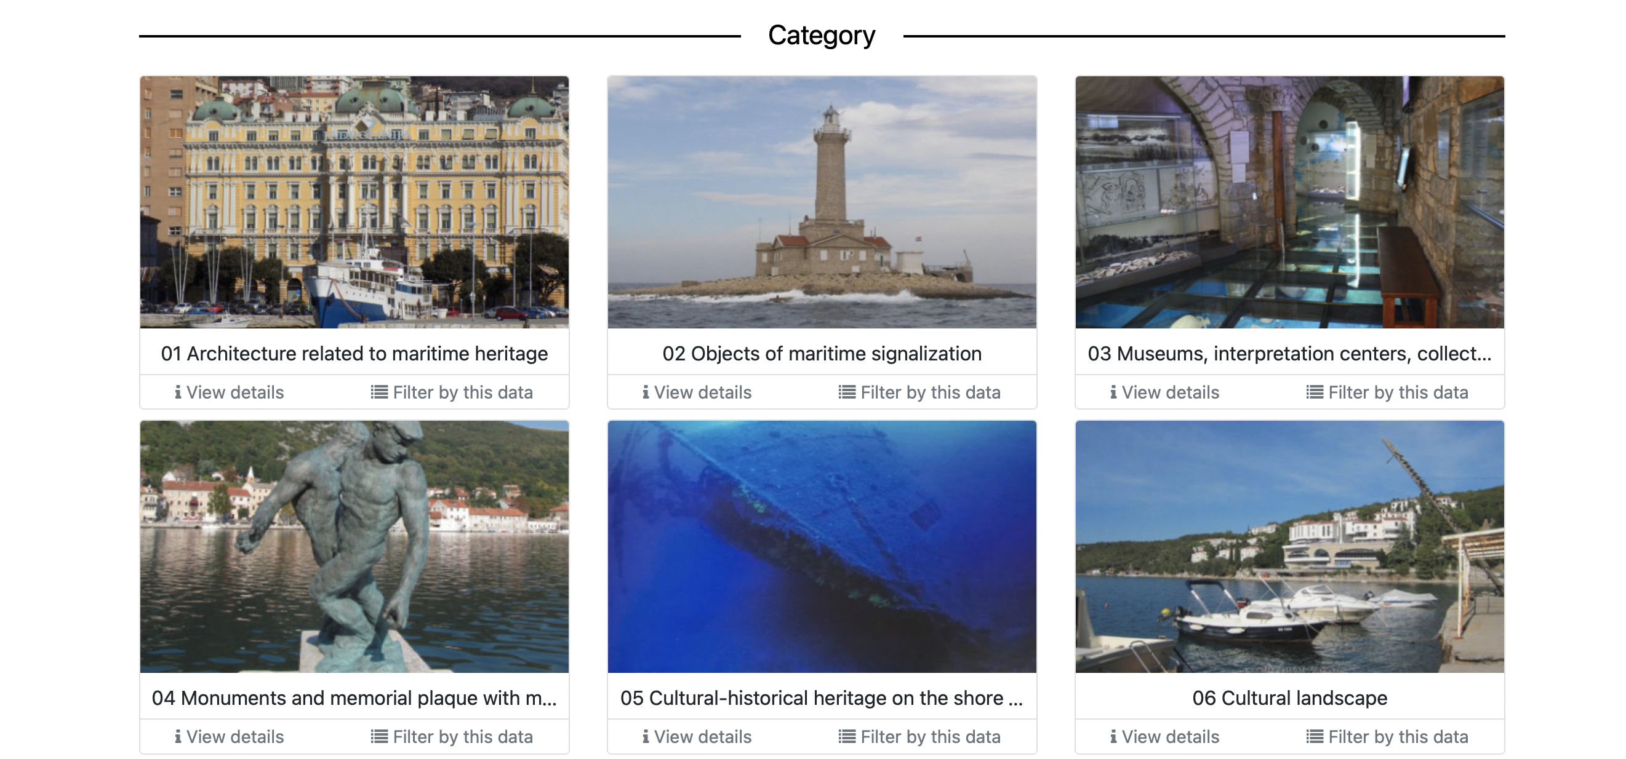
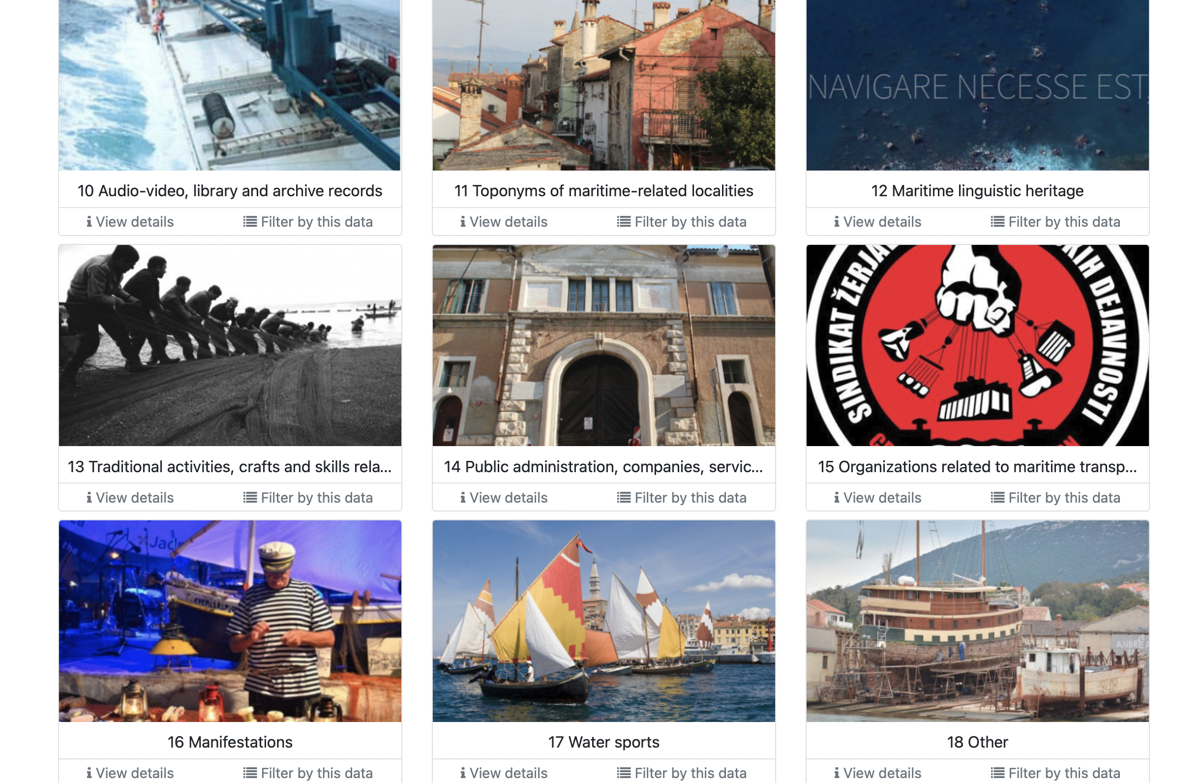
Virtual museum Mala barka

Slide 42
Tkanica.org
The pilot project Digitization of the intangible cultural heritage elements of three communities in Bosnia and Herzegovina. Implemented by the local agency Society for Digitalization of Traditional Cultural Heritage in collaboration with the National Section of CIOFF® Bosnia and Herzegovina, this project aimed at collecting local living heritage elements and making them digitally available to the wider public. The platform tkanica.org is now live and it features numerous aspects of living heritage from Bosnia and Herzegovina.

Slide 43
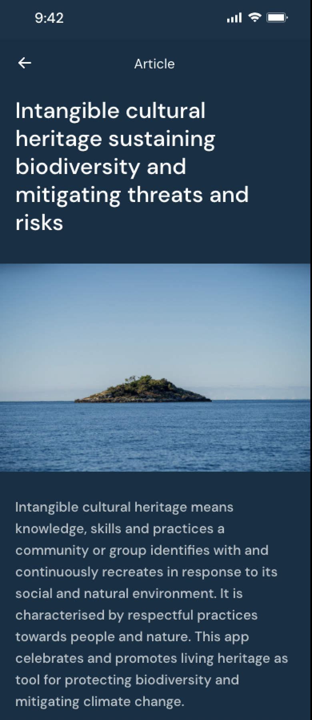
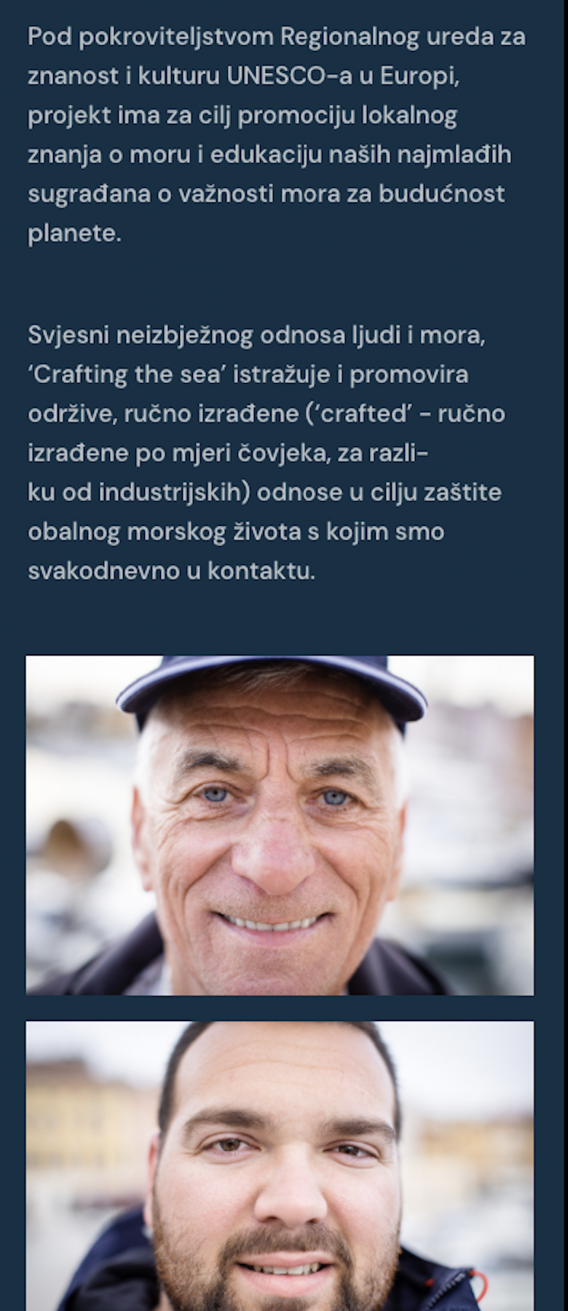
Crafting the Sea
Crafting the sea is a 15-month multidisciplinary innovative project aimed at identifying local knowledge for monitoring climate change, identifying biodiversity, mitigating risks and promoting a more balanced relationship between humans and nature. To this end, the project focuses on the marine life of the Rovinj archipelago, a NATURA2000 protected area in Croatia. The first phase of the project, which ran from May to October, concentrated on identification and research and included a 3-day workshop on 19-21 October, on the nexus between intangible cultural heritage and sustainable human-nature relationships.

Slide 44
PART III.
Building an inventory

Slide 45
STEP 1
Attributes of an element: what do we want to know?
(agree jointly on one element and propose questions you think should be included in an inventorying process)
Weaver (Weaving) from Sofia
National Library "Sts. Syril and Methodius", Collection "Portraits and Photographs", signature C 1-5140

Slide 46
STEP 2
Matching the questions with the National Formular

Slide 47
TIME FOR QUESTIONS

Slide 48
THANK YOU FOR YOUR ATTENTION
tnikolicdjeric@gmail.com

