Slide 1
Ethical Principles For Intangible Cultural Heritage Safeguarding
Alla Stashkevich, Director ‘Cultural Heritage & Modernity Foundation’,
Belarus. Facilitator, Facilitator, UNESCO global facilitators’ network
(European chapter, intangible cultural heritage section).

Slide 2
In this presentation …
Clarifying terminology
Ethical principles for safeguarding intangible cultural heritage
Identifying the roles of different actors and the different ethical issues they need to consider
Key ethical issues
Practical tips for an ethical approach to safeguard ICH

Slide 3
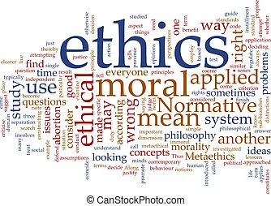
Ethics: what does it mean?
Doing the ‘right’ thing
Honesty, transparency
Sensitivity to cultural norms
Not exploiting
Morally
Legally
Commercially

Slide 4
Related terms
Confidentiality
Tradition
Acknowledgement
Privacy
Respect
Permission
Rights
Customary
practice
Creativity
And some more …

Slide 5
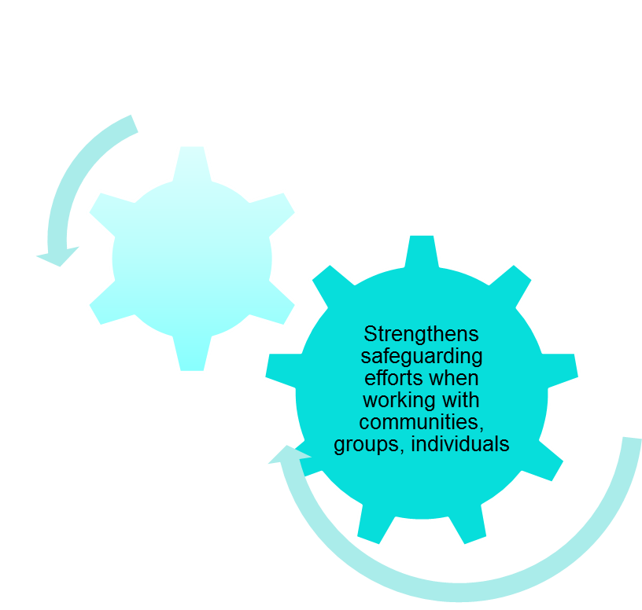
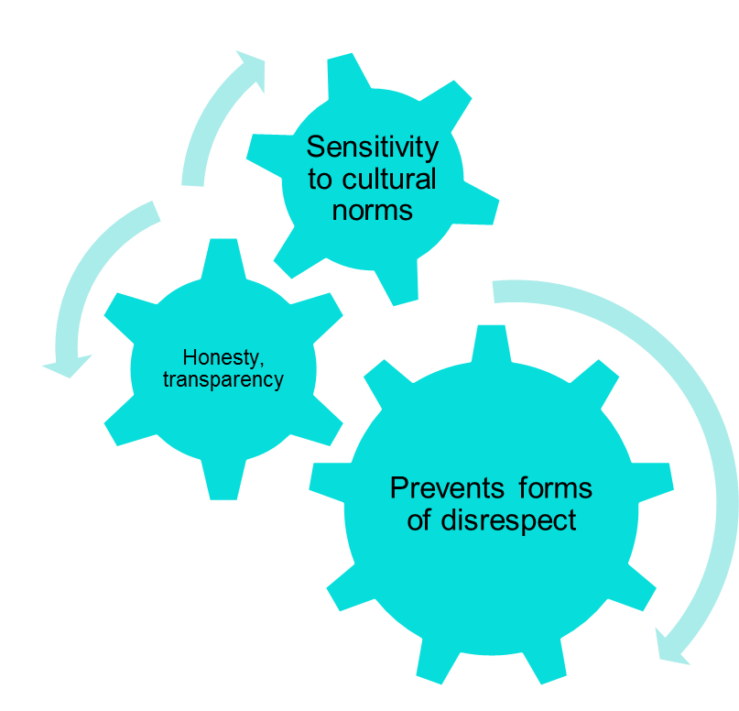
Why are ethics important in safeguarding ICH?

Slide 6
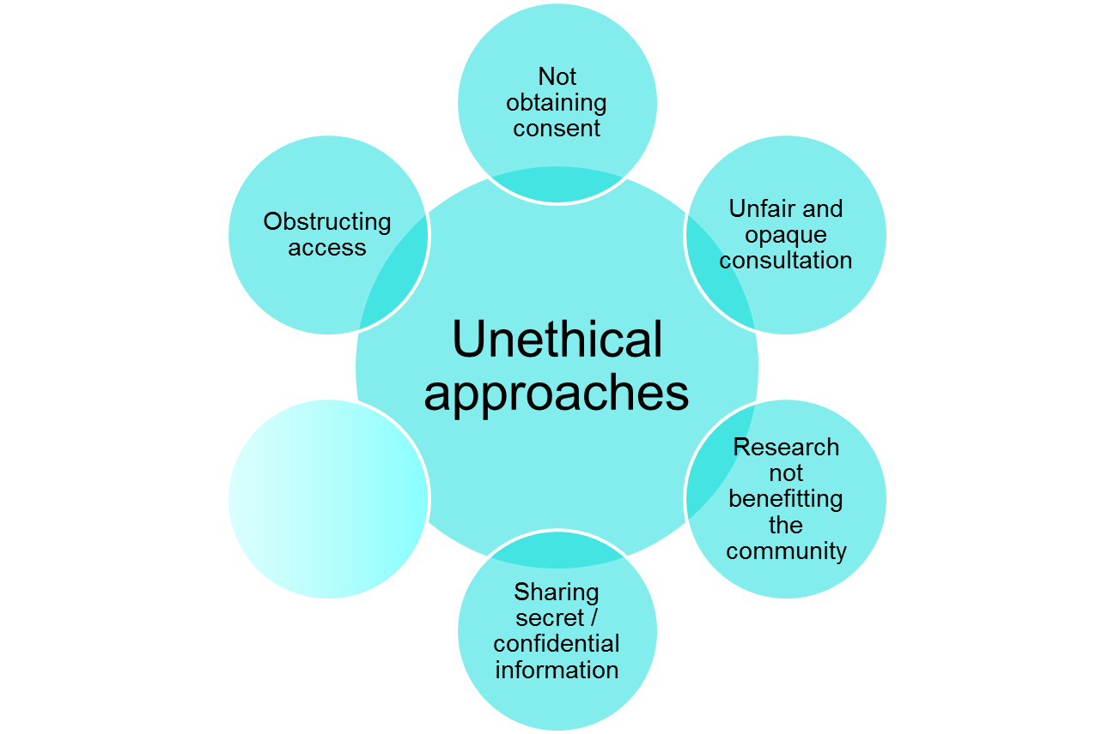
Potentially unethical approaches

Slide 7
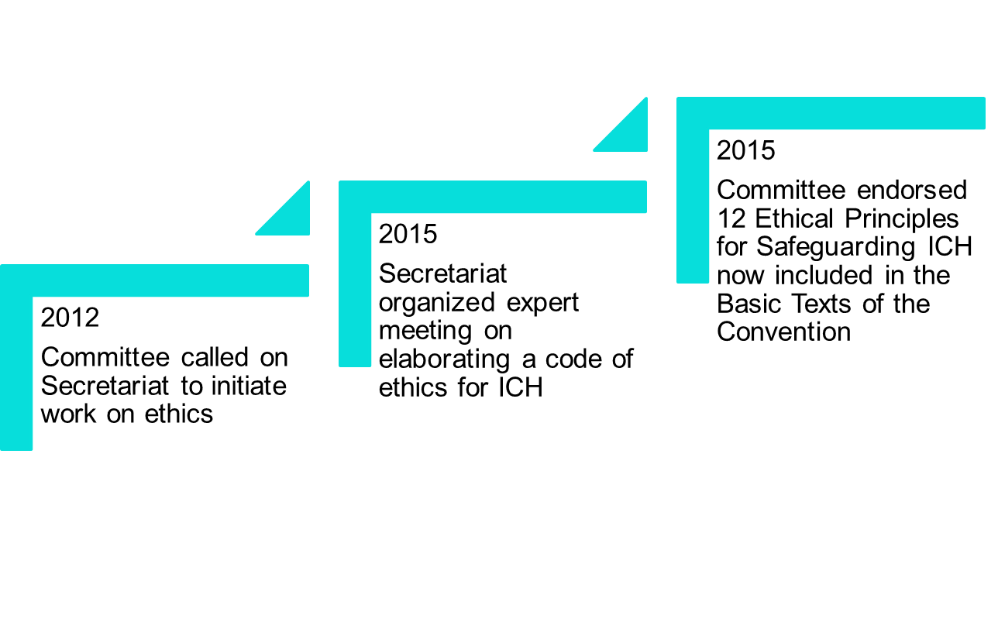
History of the Ethical Principles for Safeguarding ICH

Slide 8
What is an ethical principle?
An ‘ethical principle’ is a general standard or norm that helps establish baseline expectations for respectful and responsible behaviour…

Slide 9
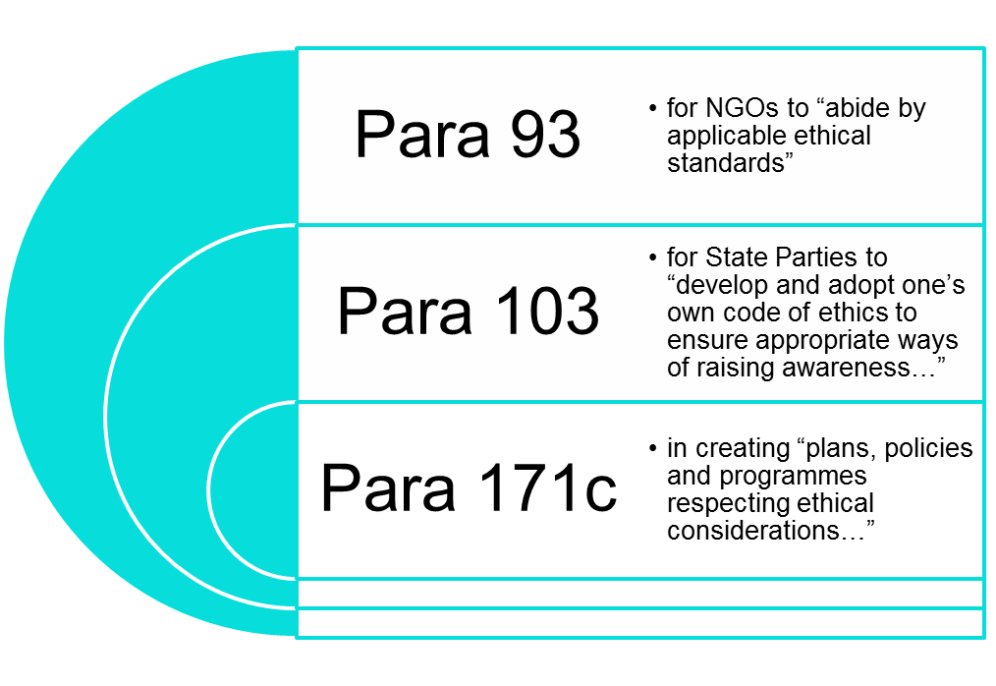
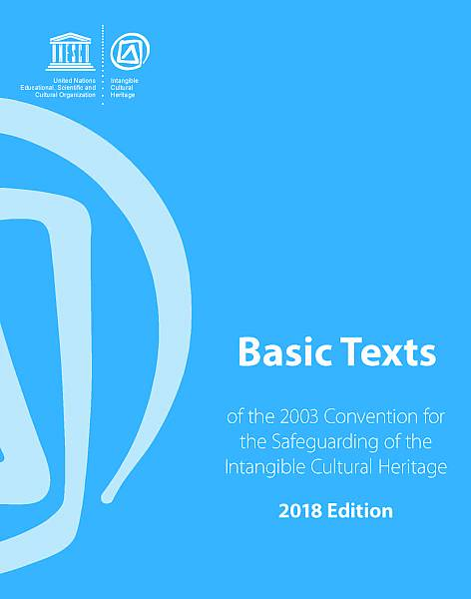
What does the Convention say?
No specific guidelines
BUT ethical considerations present in Operational Directives

Slide 10
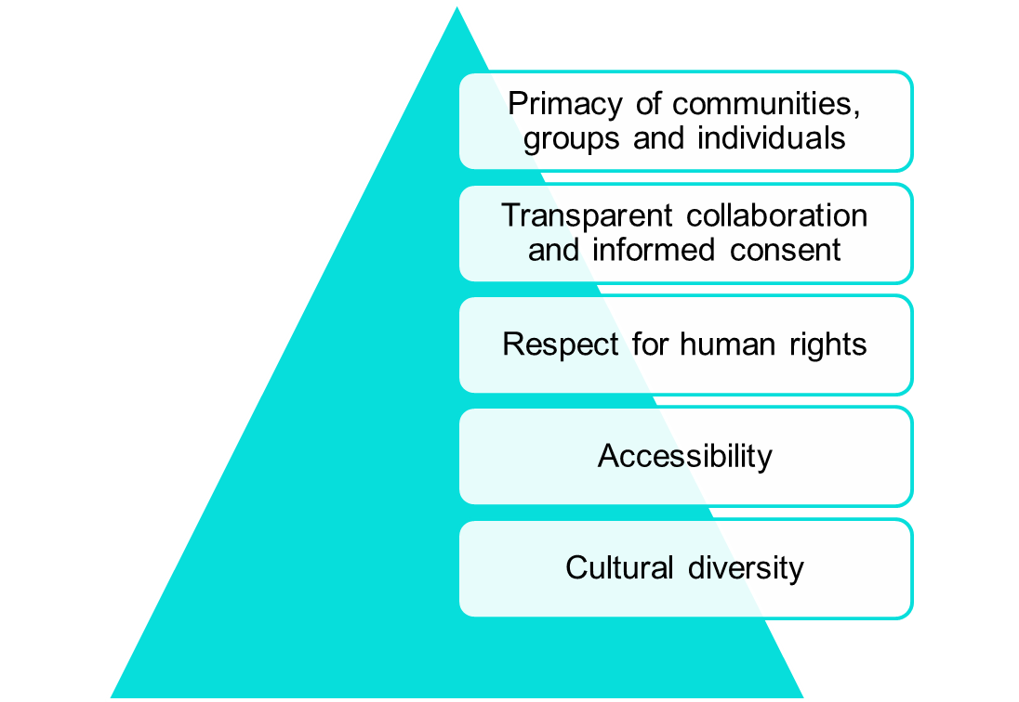
Convention’s core values
What the 12 ethical principles were founded on

Slide 11
Ethical principles for safeguarding ICH (Valencia, 2015)
Communities are the main beneficiaries of ICH
Communities should have the primary role in safeguarding their ICH
The right of communities to ensure viability of their ICH should be recognized
Mutual respect for ICH should prevail in interactions between States and communities
All interactions with communities should be transparent and with free, prior, sustained and informed consent
10. Communities should determine threats to ICH and decide how to prevent and mitigate these

Slide 12
Ethical principles for safeguarding ICH (cont.)
Access to the ICH
Access of communities to objects, spaces and places necessary for expressing ICH should be ensured
Communities should assess the value of their ICH
Communities who create ICH should benefit from the protection of the moral and material interest resulting from their ICH
9. Communities should assess impact of any action on viability of their ICH and the communities themselves

Slide 13
Ethical principles for safeguarding ICH (cont.)
Common approaches to ICH
8. The dynamic and living nature of ICH should be respected
11. Cultural diversity should be fully respected
12. Safeguarding of ICH should be done in cooperation of all key stakeholders

Slide 14
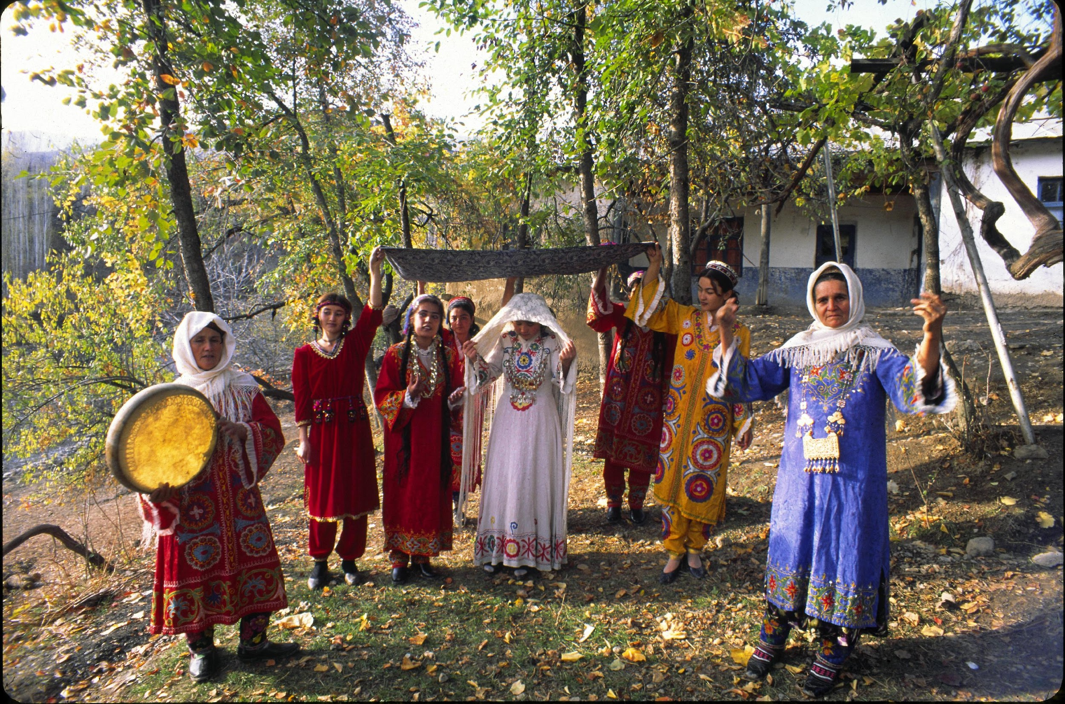
Ethics concern all involved
Community members, those involved with
the community, and outsiders
Practitioners
Community representatives
Researchers
Government representatives
Cultural workers
….
© National Commission of Uzbekistan

Slide 15
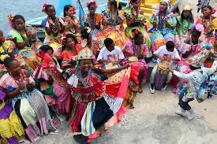
Different types of community participants
Practitioners
Teachers/gurus
Composer
Poet/lyricist
Deity/spirit

Slide 16
Inclusion: a key principle
Safeguarding ICH should include all communities and groups who are present in the area:
Marginalized communities or groups
Migrant communities or groups
Women
Children

Slide 17
Ethical and legal issues
Ethical and legal issues often overlap
Ethical norms often come to the foreground when the law fails to protect
Moral rights
Free, prior and informed consent
Possible conflicts
Copyright
State laws
Ethics
Law

Slide 18
When should ethical approaches be practiced?
Research and documentation, inventorying and promoting ICH
UNESCO Nomination process
Reproduction and practical application of ICH
Commercial use

Slide 19
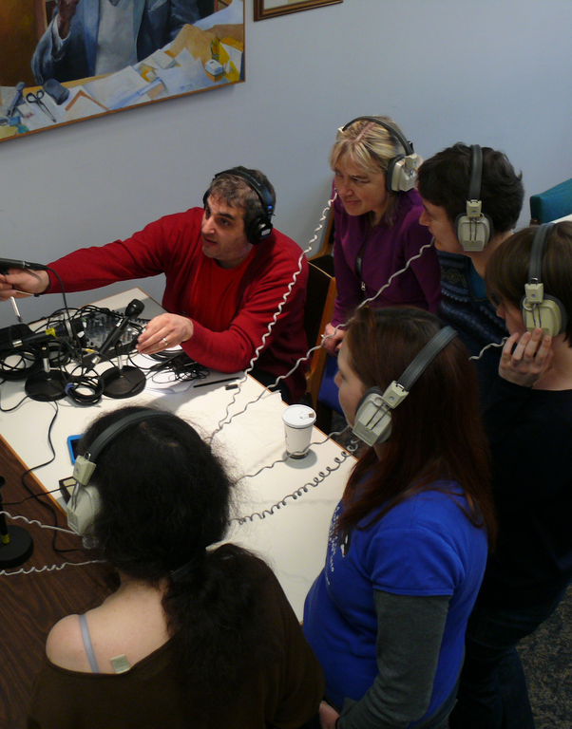
Ethics for documenting and using data about ICH
Nomination process
ICH Inventory
Research
To record
To photograph
To interview
To participate
Permission is required for
data collection

Slide 20
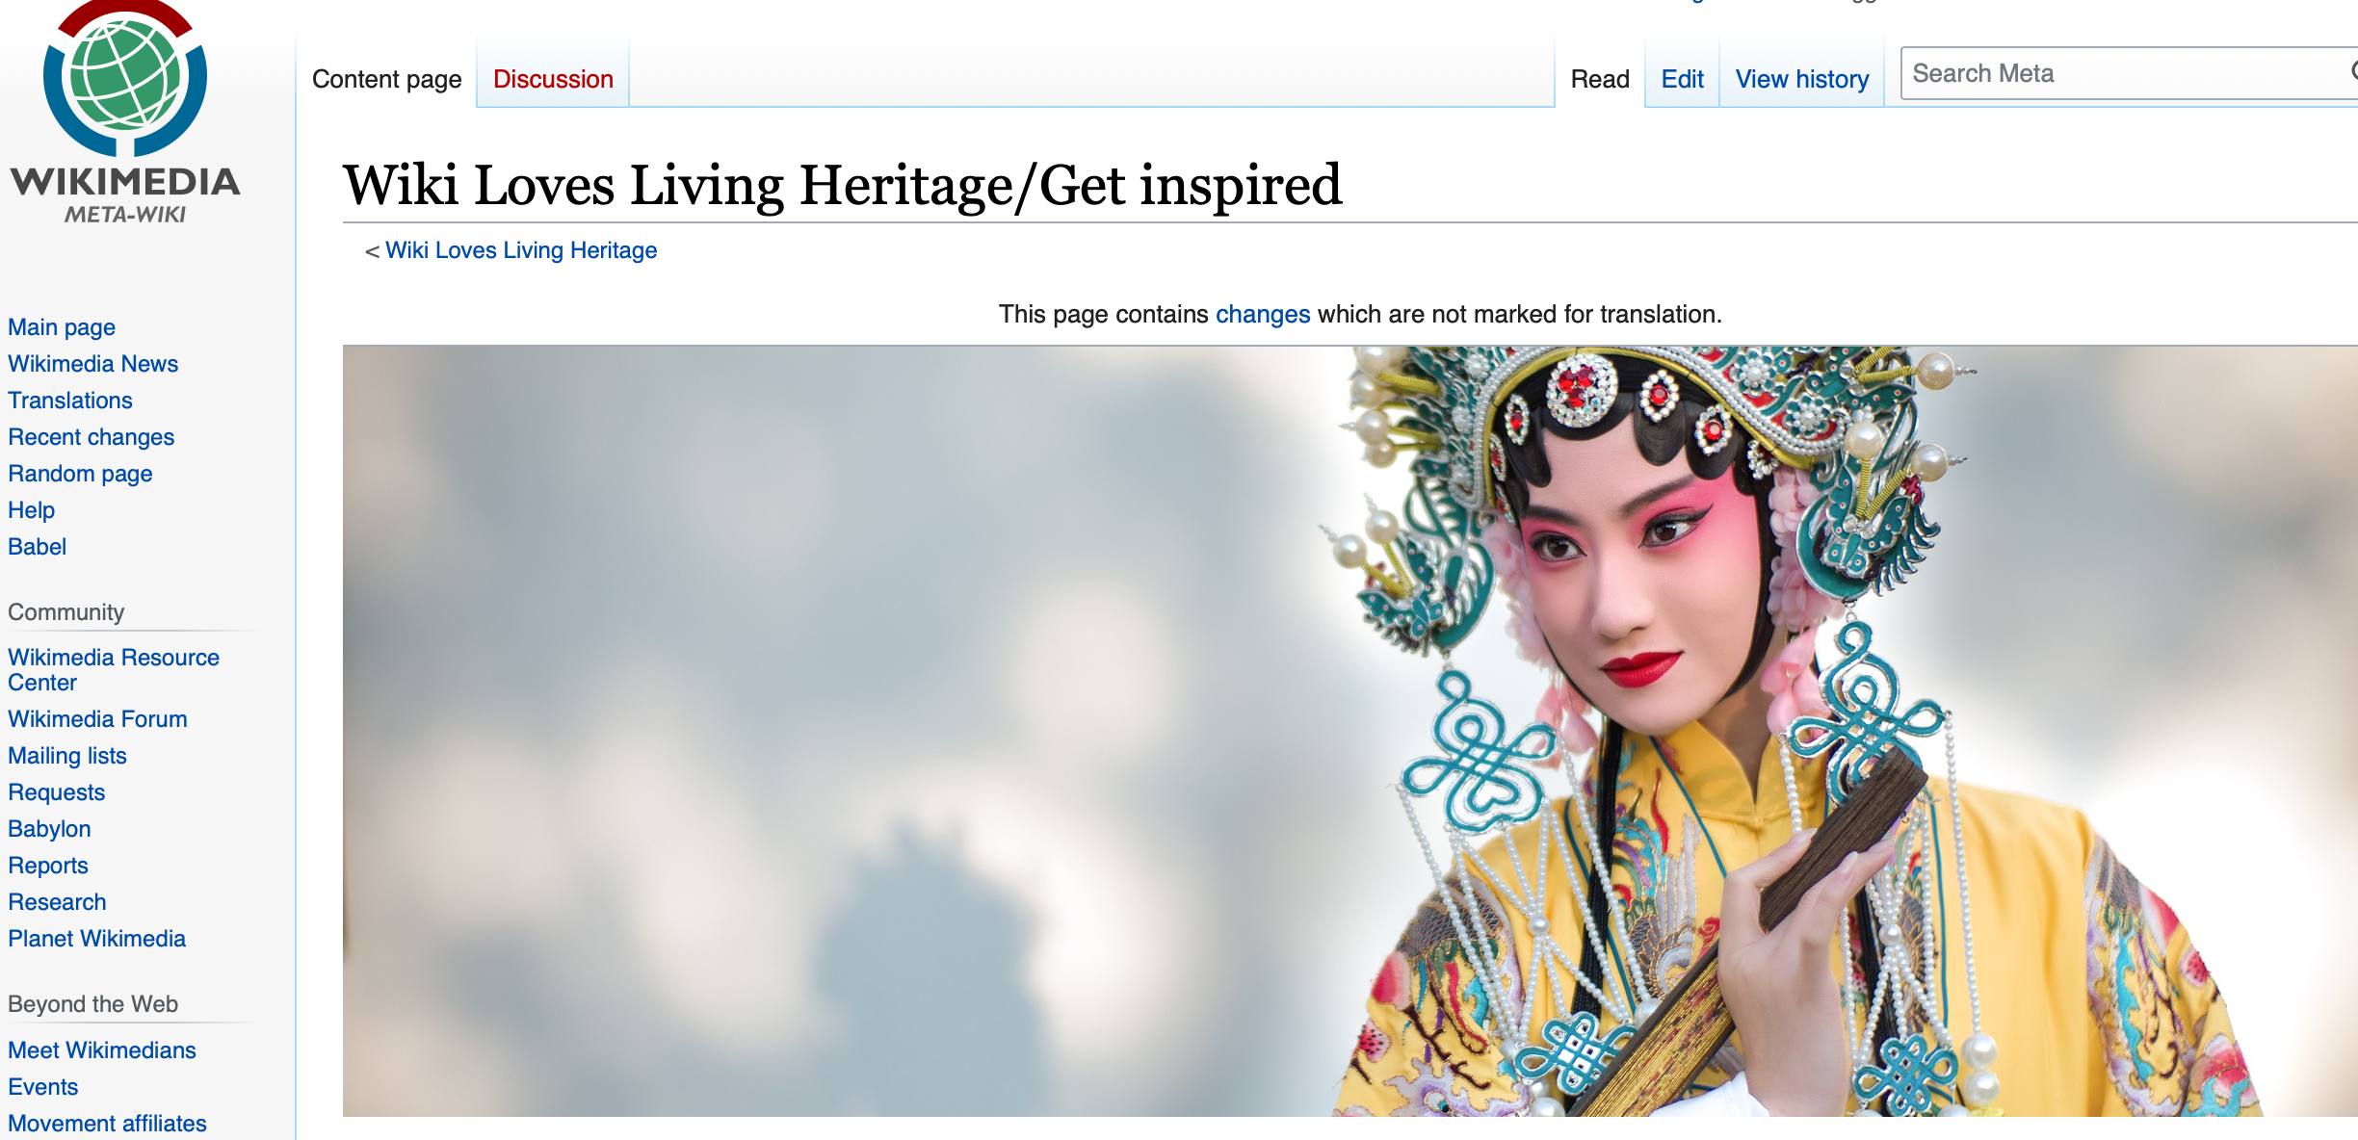
Permission is required for future use
Publish
Educational use
Publicity
Broadcast
Radio, TV, internet..
Archive
Share with others
Research
Learn/perform

Slide 21
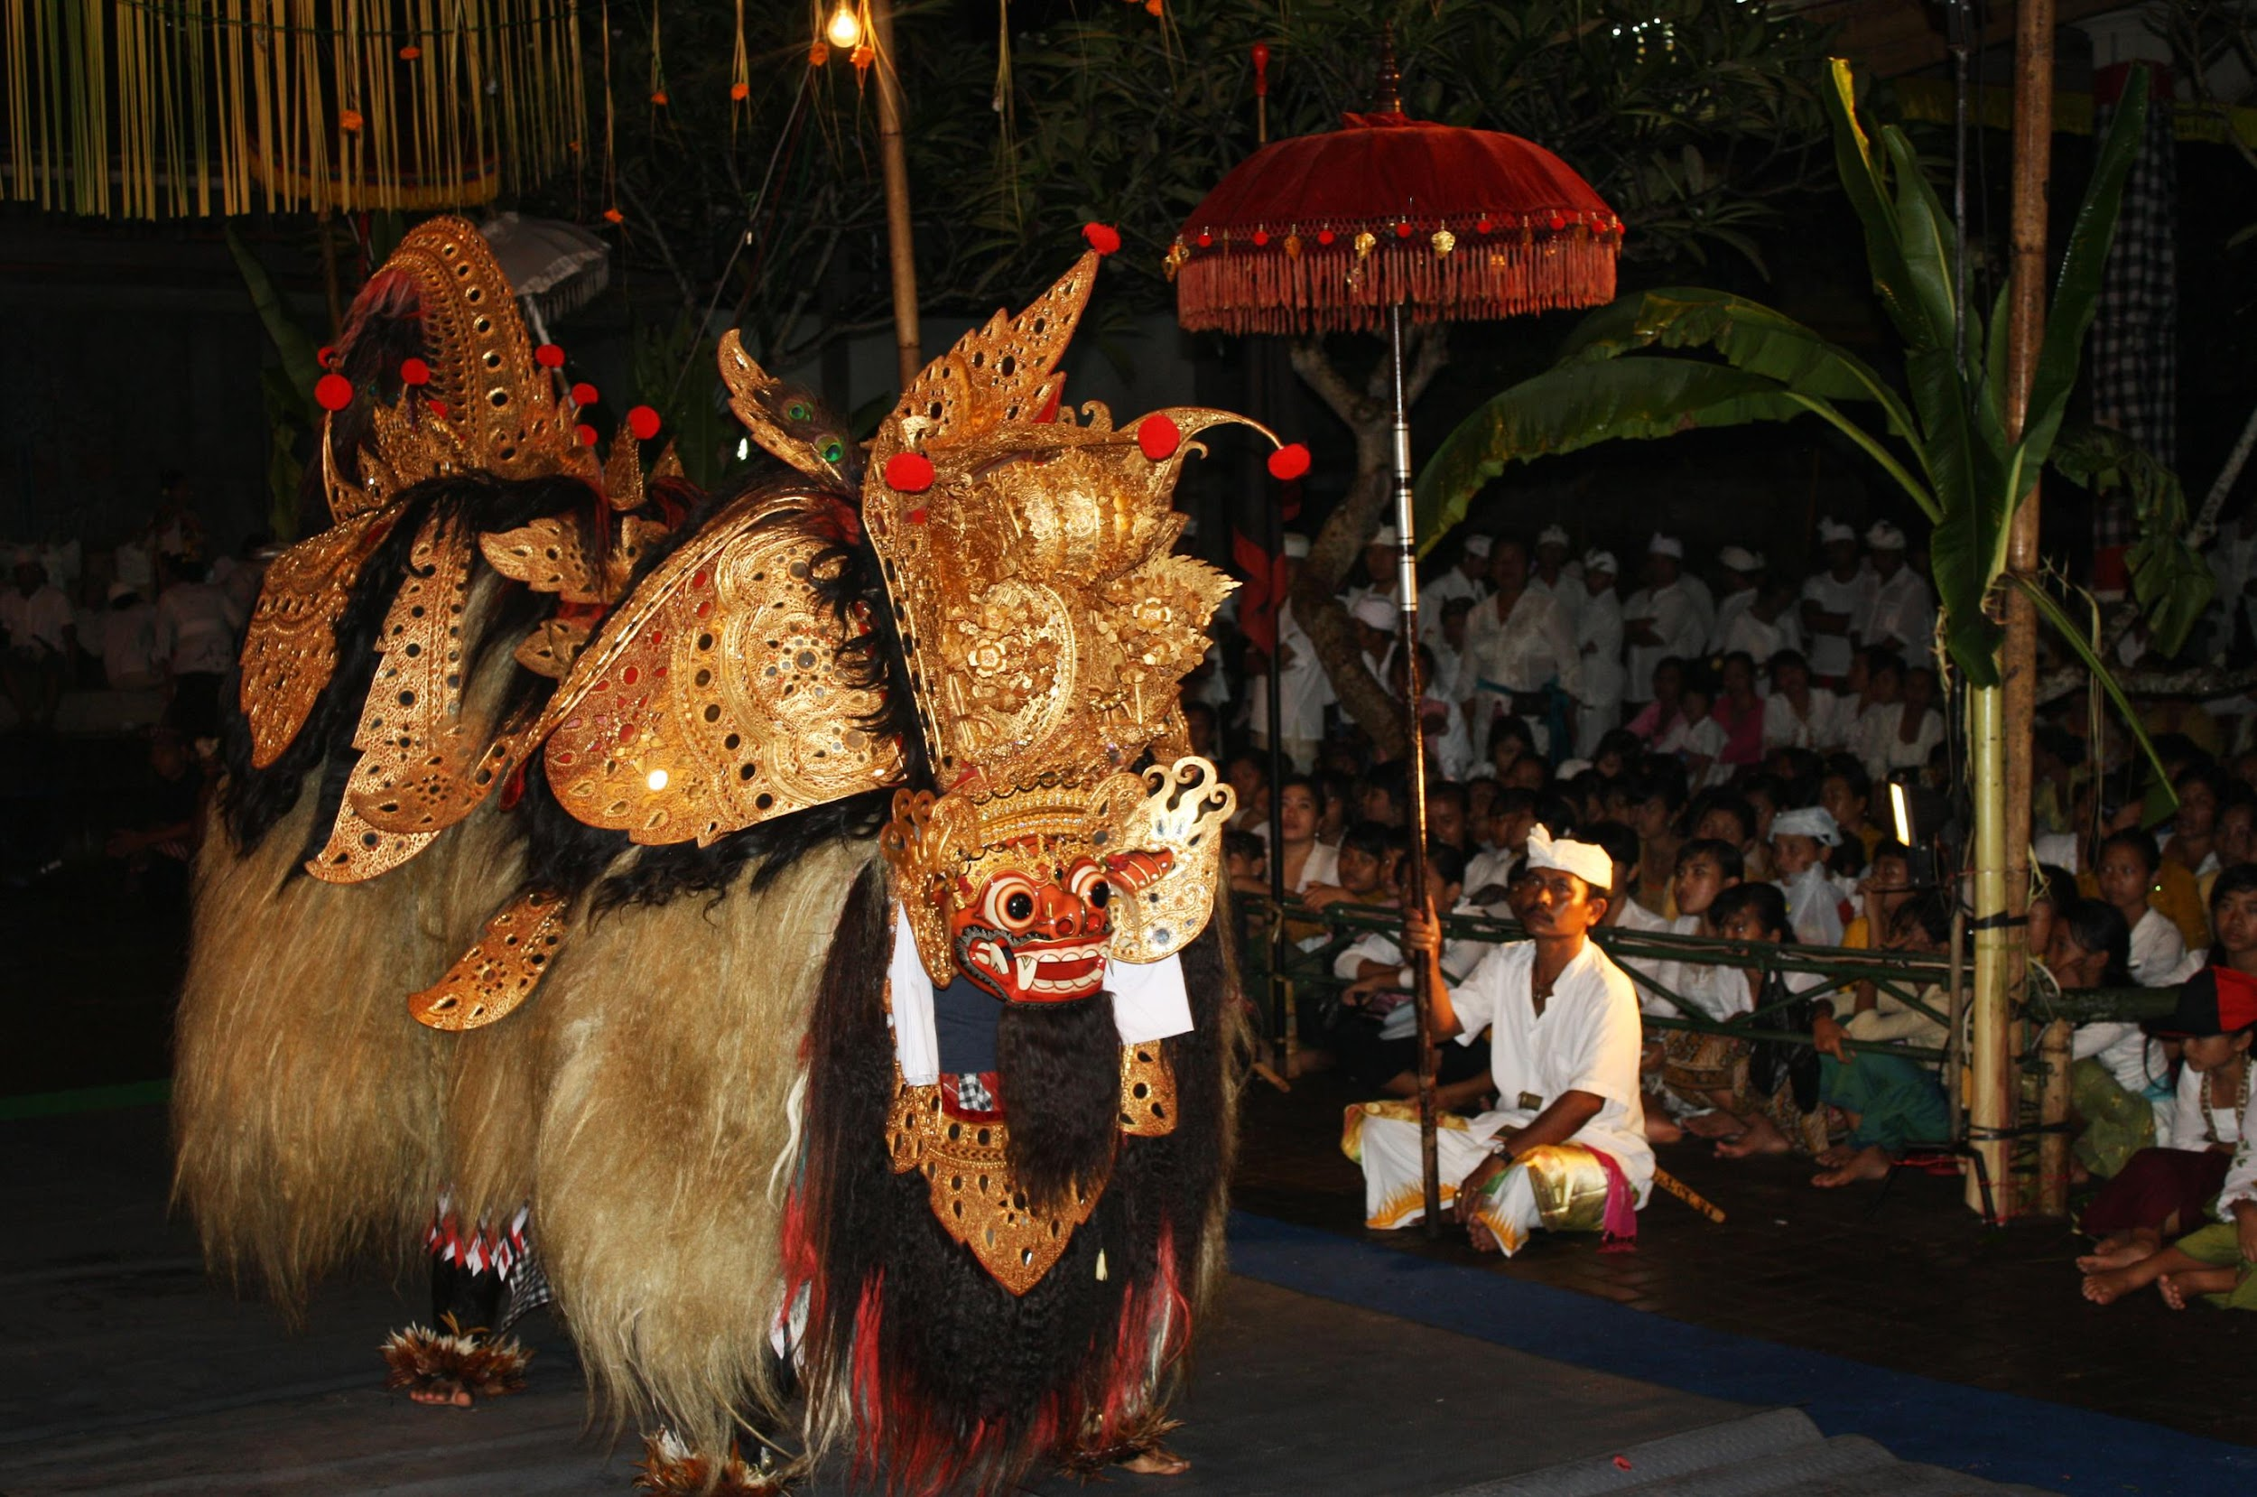
Ethics regarding adequate representation
Getting it right
Names
Function
Process
Meaning and significance
© 2010 by Centre for Research and Development of Culture

Slide 22
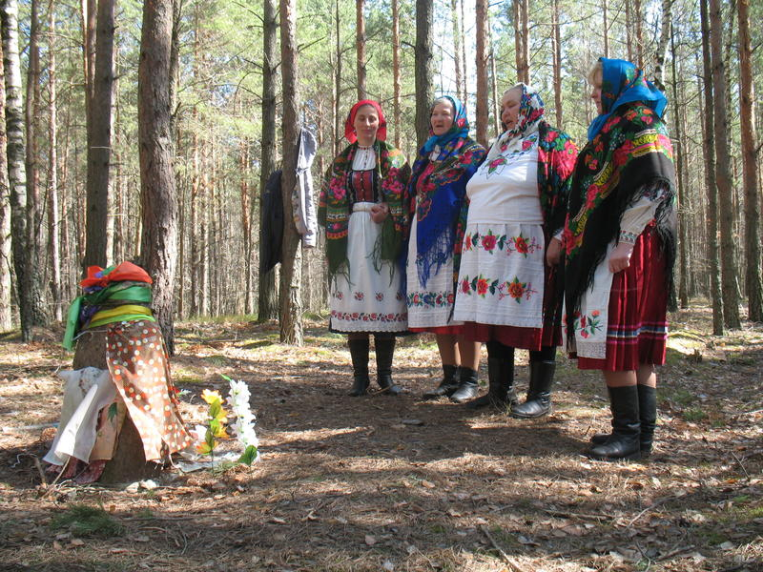
Permission is required to access the ICH
to present the element (to the media and the public)
to be visited (with times and places to visit)
to participate (e.g., in a celebration).
© 2016 Stashkevich, “Stone girls”, Gomel region, Belarus

Slide 23
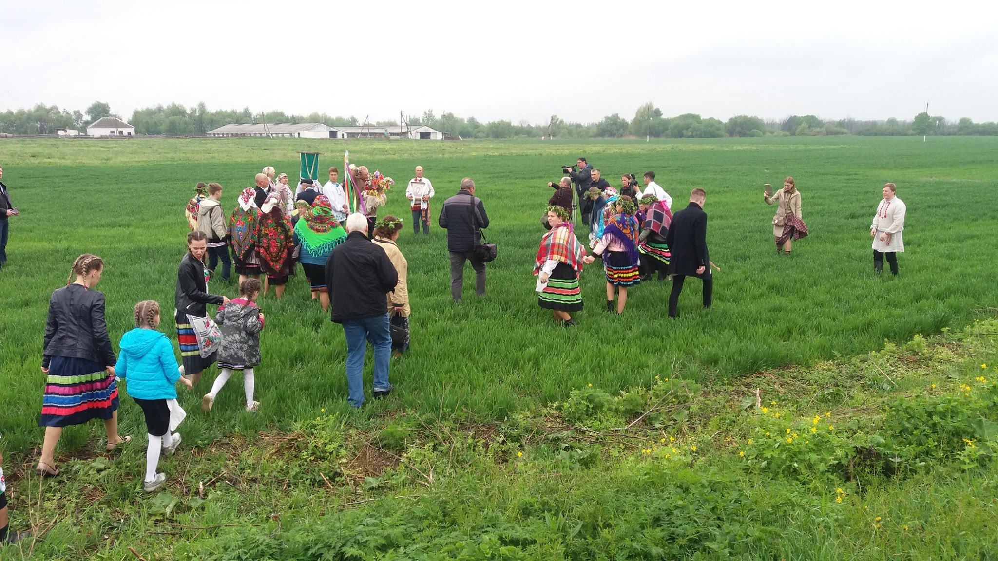
Ethics regarding inappropriate behavior
Spring rite of ‘Jurauski Karahod’, Belarus, 2019

Slide 24
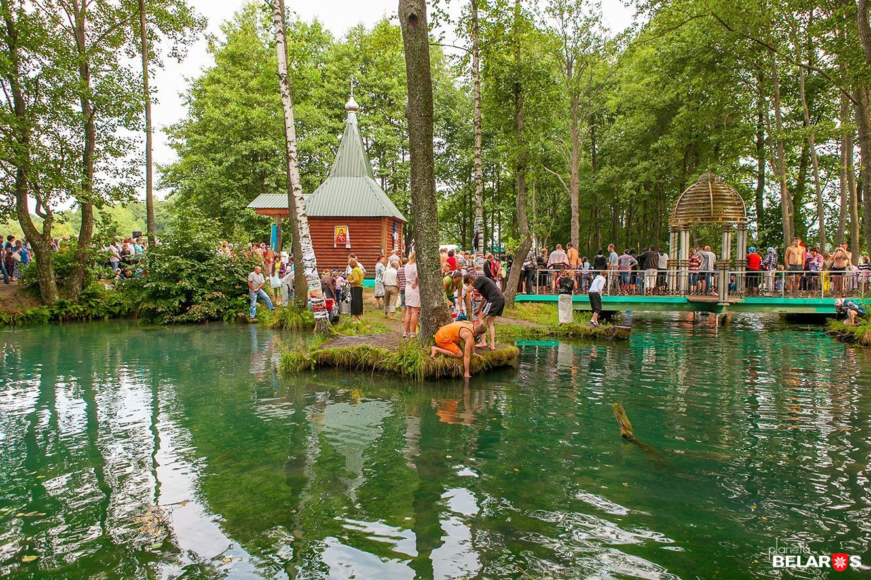
Ethics regarding proper representation and commercial use
Slavgorod Blue Spring, Mogiliev region

Slide 25
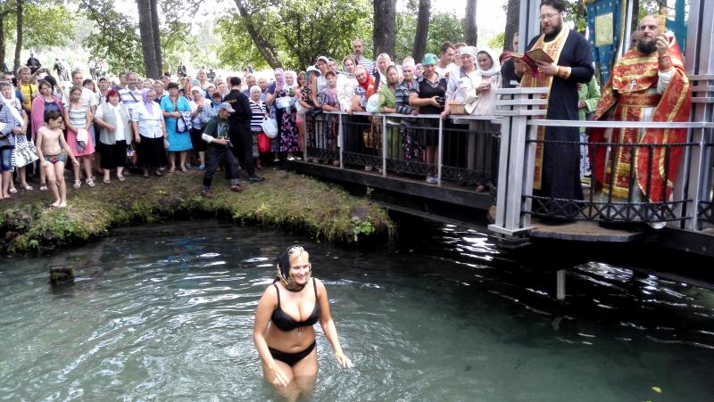
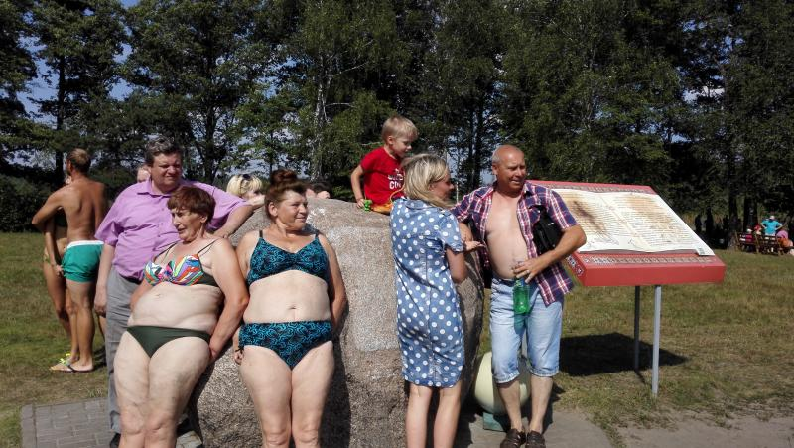
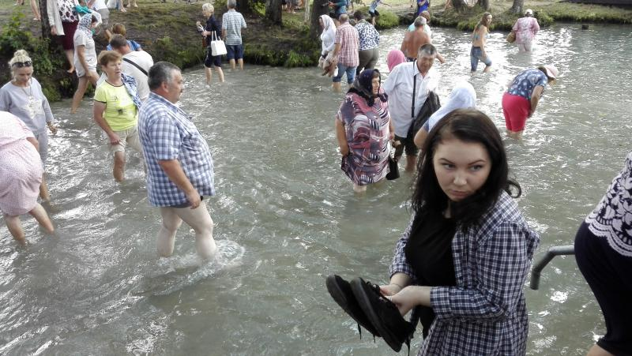
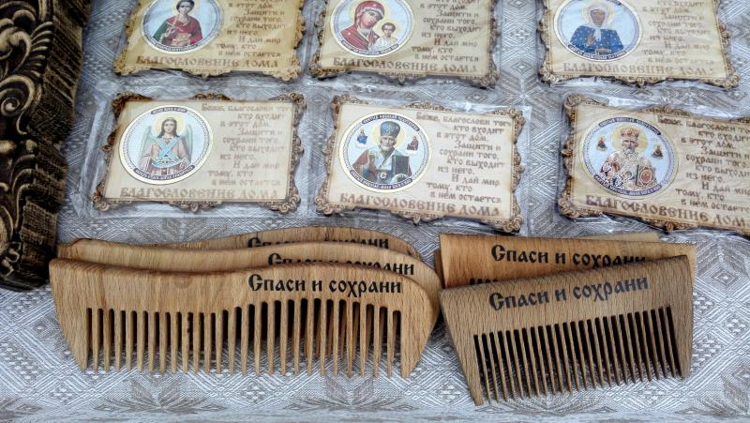
Ethics regarding proper representation and commercial use

Slide 26
What risks are we looking at?
Unsustainable tourism,
Commercial benefit of third parties,
Unethical use
Environmental threat and loss of context

Slide 27
Rights and respect
Respect for all community members
Recognition of community and individual contributions
Representation according to community or practitioner
Appropriate use
Acknowledgment
Attribution
Artistic Integrity

Slide 28
Some tools for minimization of risks …
Ensure free, prior and informed consent
Keep records of all agreements
List degrees of access for specific materials
Recording agreements
Ethical Codes, Community protocols

Slide 29
Questions?
OR….. share from your own experience if you’ve ever encountered an ethical issue, conflict or dilemma in your line of work.

Slide 30
5 minutes

Slide 31
Human and intellectual rights protection
of ich bearers
Alla Stashkevich, Director ‘Cultural Heritage & Modernity Foundation’,
Belarus. Facilitator, Facilitator, UNESCO global facilitators’ network
(European chapter, intangible cultural heritage section).

Slide 32
Main documents
The Universal Declaration of Human Rights
The UNESCO Universal Declaration on Cultural Diversity
The UNESCO Convention for the Safeguarding of Intangible Cultural Heritage, 2003
UN Convention on Biological Diversity, 1992 (article 8j) — mentions traditional knowledge & practices linked to genetic resources.
The Nagoya Protocol on Access to Genetic Resources and the Fair and Equitable Sharing of Benefits Arising from their Utilization to the Convention on Biological Diversity, 2004: Prior and informed consent of indigenous and local communities to use their traditional knowledge and genetic resources (art.7); Art. 12 proclaims the creation of Community protocols providing access to traditional knowledge associated with genetic resources. It also provides the fair and equitable sharing of benefits arising from such knowledge.
WIPO documents: https://www.wipo.int/tk/en/

Slide 33
ICH categories according to the WIPO (World Intellectual Property Organization)
Traditional Knowledge and Practices | Knowledge and customs related to people's worldviews Knowledge about nature and the universe Traditional medicine Cuisine Yoga, martial arts Traditional arts and crafts Knowledge about animals' habits and migrations, about plant properties Knowledge of water and resource management Construction technologies based on natural materials Traditional agro-technologies
Cultural Expressions | oral traditions and forms of expression performing arts customs, rites, holidays

Slide 34
Why do we need to safeguard ICH?
ICH is a significant element of local communities' cultural heritage and identity, as well as countries and peoples. It contributes to sustainable development, cultural viability, growth and welfare of these communities.
There is economic potential in ICH, creating a basis for the growth of trades, crafts, and enterprises of the bearers.
ICH can serve as a basis for innovation and new enterprises.

Slide 35
ICH Protection/Safeguardiang
PROTECTION
PROTECTION OF HUMAN AND INTELLECTUAL RIGHTS OF ICH BEARERS (COMMUNITIES)
Protection against misappropriation (copying, adaptation or use by third parties) Recognition and exercise of exclusive rights (to the exclusion of others) Patentable forms of protection (moral rights, equitable remuneration schemes, protection against unfair competition)
SAFEGUARDING
IDENTIFICATION INVENTORYING DIGITALIZATION PROVIDING THE TRANSMISSION ENSURING PARTICIPATION PROMOTION/RAISING OF AWARENESS SUSTAINABLE DEVELOPMENT
Intellectual property protects creations of the human mind, including trade secrets, literary and artistic works, inventions, designs and symbols, and names and images used in commerce.

Slide 36
Individual and Community Rights
Individual
Copyright
Traditional cultural expressions and community rights
(WIPO)
Community

Slide 37
Protection of human and intellectual
rights of ich bearers
2000 г. Intergovernmental Committee on Intellectual Property and Genetic Resources, Traditional Knowledge and Folklore - Need for an "international legal instrument" (or instruments) to ensure effective protection of traditional knowledge, genetic resources and traditional practices".
Existing forms of ICH bearers' intellectual rights protection:
PATENT, CERTIFICATE, TRADEMARK
Sui Generis (positive protection) - granting rights that allow communities to promote their traditional knowledge and practices, control their use and benefit from their commercial exploitation.

Slide 38
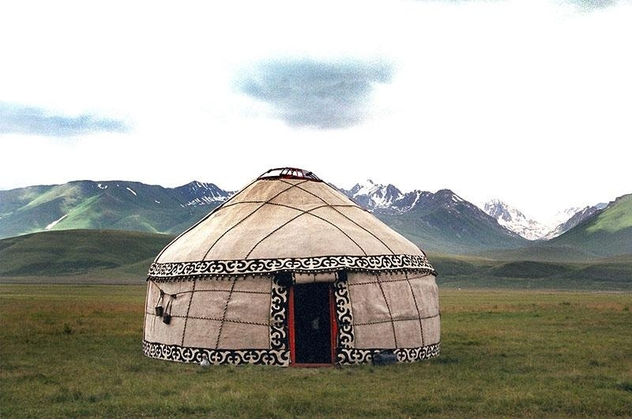
Forms of protection of ICH bearers' intellectual rights
Patent:
Protects authors' rights to inventions. In relation to traditional practice - inventions (know-how based on traditional knowledge)
Kyrgyzstan: Yurt

Slide 39
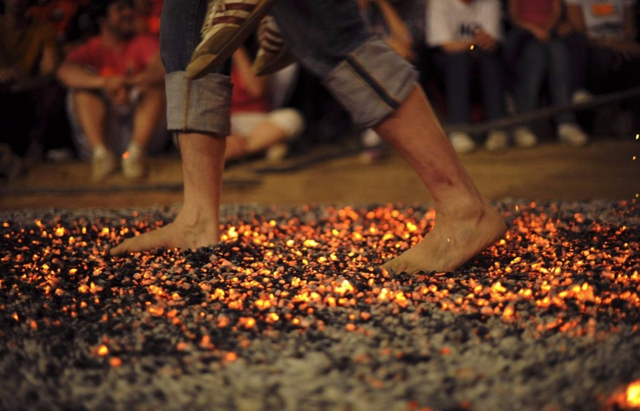
Forms of protection of ICH bearers' intellectual rights
Trademark
The transfer to a private person or a group of persons of the exclusive right to use a sign that identifies them. This is in the production and distribution of products and services.
Mark of Nestiar (dancing on coals)
Registered with the Bulgarian Patent Office (2009). The owner is the municipality of Tsarevo. The right is regulated by the City Council.

Slide 40
New Zealand
In 2002, the Maori Arts Council of New Zealand's national arts development organization, Creative New Zealand, introduced the toi iho (toi iho ™) trademark to denote Maori art quality and authenticity.

Slide 41
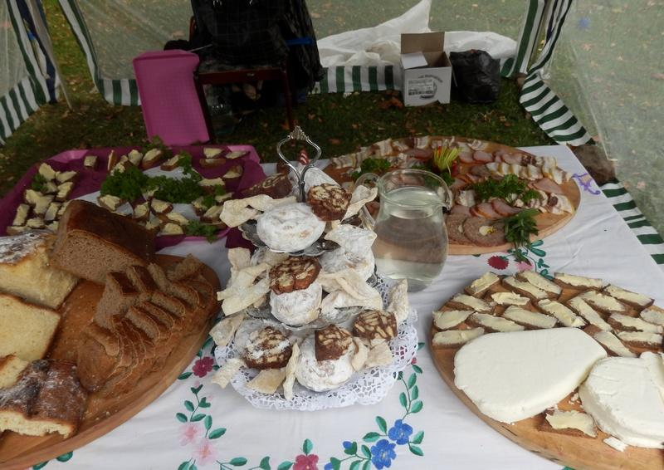
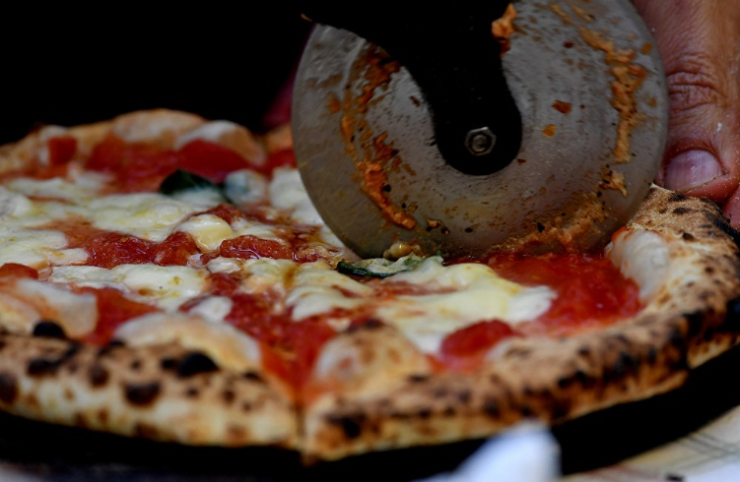
Geographical indication (place of origin)
A designation used on goods that possess the qualities, reputation and characteristics attributed to
their place of origin.
Examples are Adelsk cuisine (Belarus), Neapolitan pizza (Italy).

Slide 42
Sui Generis (positive protection)
Granting rights that allow communities to promote their traditional knowledge and practices, control their use and benefit from their commercial exploitation:
Development of a national strategy, using legislative and practical tools
Inventorying and certification
Incorporation of social law into legal mechanisms
Prohibiting those living outside the ICH community from acquiring intellectual property rights to traditional knowledge and practices
Free, prior and informed consent
Codes of Ethics, Community Protocols

Slide 43
ICH Inventorying
INTERNATIONAL LEVEL
UNESCO LISTS
NATIONAL, REGIONAL OR LOCAL LEVELS
ICH INVENTORIES

Slide 44
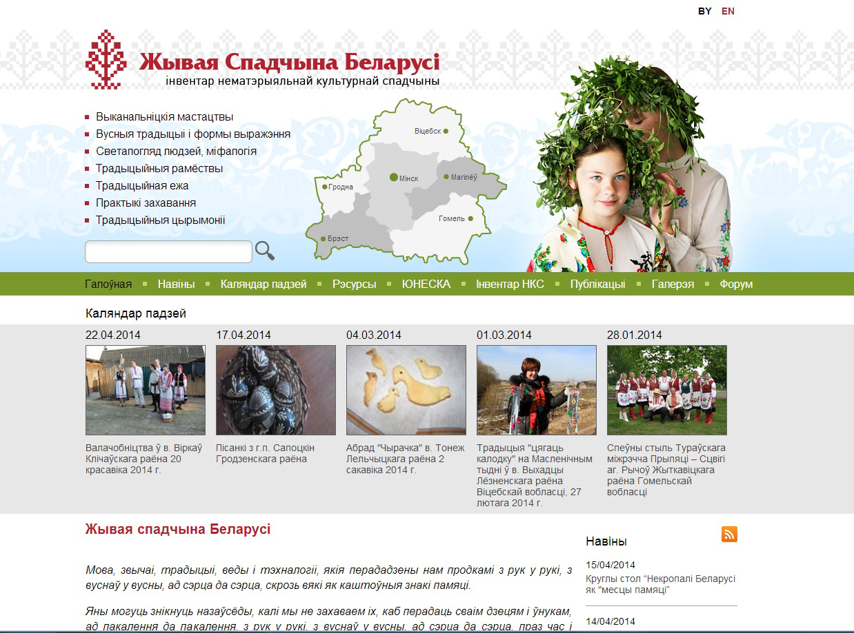

Slide 45
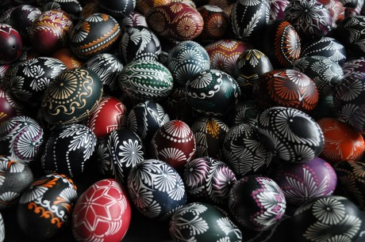
CERTIFICATION OF ICH
Products of Lithuania's national heritage
http://www.tautinispaveldas.lt
Stratified products are defined as originals for Lithuania, differ in form, content, and other characteristics of quality.
Using the certification system, ethnic products, objects, intangible elements can be classified and coded.
Essentially, it includes artisanal products, food products, folk musical instruments, costume and other elements of ethnic heritage, manufactured using traditional materials, using old or appropriate new technologies while maintaining their qualitative properties.

Slide 46
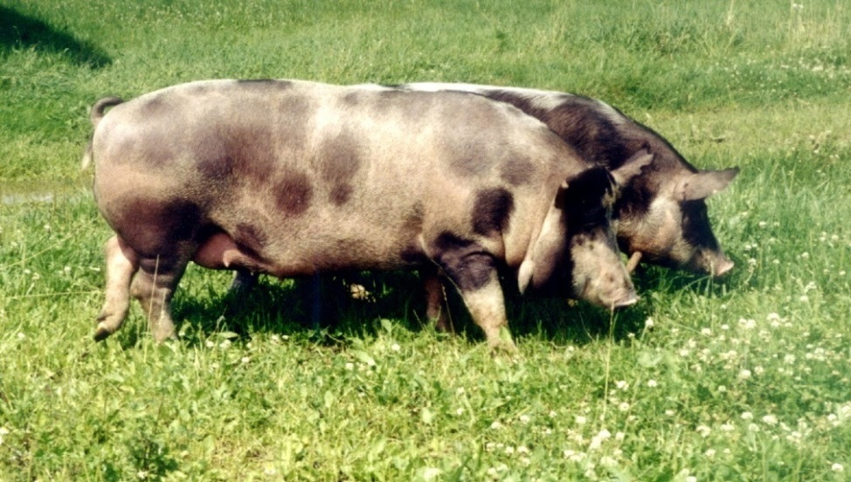
Traditional plant and animal species

Slide 47
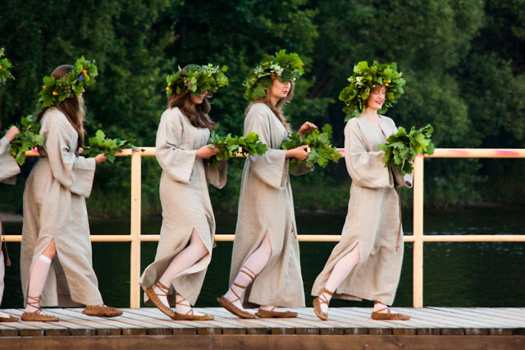
Forging horses, cleaning chimneys, cultural forms of folklore, conducting traditional events (calendar and family holidays, traditional fairs and similar events) and other services based on ethnic culture.

Slide 48
Category A: original in content and form (made with traditional technology and using traditional materials)
Categories of Lithuanian national products
Category B: products close to traditional, preserving form and context, but made using modern methods of advancing technology

Slide 49
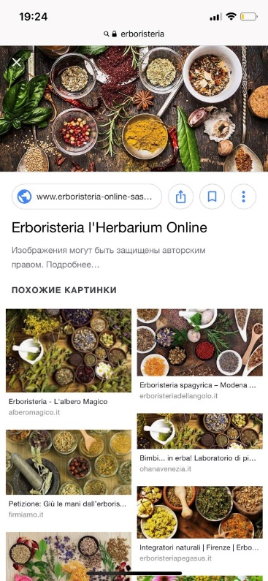
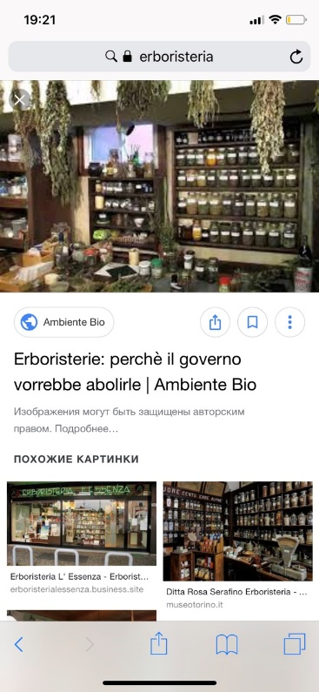
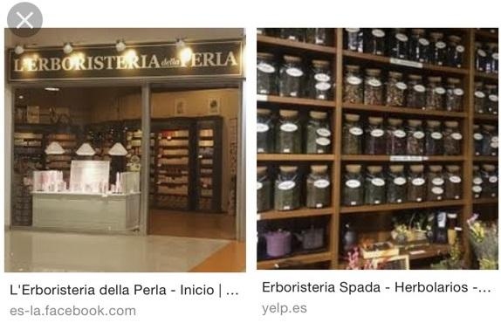
CERTIFICATION: ERBORISTERIA IN ITALY

Slide 50
CERTIFICATION: ITALY

Slide 51
Free, prior and informed consent
Legal
Instrument
Ethics

Slide 52
Free, prior and informed consent and the Convention (1)
Free, prior and informed consent required and process to be described
Nomination
Safeguarding
Free, prior and informed consent recommended
Inventorying, promotion

Slide 53
Free, prior and informed consent and the Convention (2)
Different safeguarding measures foreseen in the Convention require the free, prior and informed consent of the community concerned.
Free, prior and informed consent is required for the development and submission of nomination files to the Convention’s Lists. Selection criteria for inscription on the Urgent Safeguarding List, for example, includes the following:
U.4 The element has been nominated following the widest possible participation of the community, group or, if applicable, individuals concerned and with their free, prior and informed consent.
Community consent is also required when a State Party nominates a practice for selection as a best safeguarding practice (OD 7, P.5) or when it prepares an awareness-raising activity that concerns the ICH of one or more specific groups (OD 101(b)).

Slide 54
Why ‘free’?
‘Free’ implies that it is given without any pressure, manipulation or fraud.
Freely given without any coercion, manipulation or intimidation or any fear of repercussions.
‘we can decide what we want and is good for us because we want to’

Slide 55
Why ‘prior’?
‘Prior’ means that consent is given before any decisions are made or any activities are planned.
Community concerned must be given sufficient time for their internal agreement on activities for which consent is sought in accordance with their customs.
Prior to any action taking place, including planning, implementation, evaluation, and closure.
‘Don’t tell me to sign the paper after you have made your recording and taken photographs’

Slide 56
Why ‘informed’?
‘Informed’ implies that the people concerned are provided in accessible way (language, format) with comprehensive information on proposed activities, including their economic, social and cultural impacts, as well as their possible consequences.
Informed about the nature, scope, purpose, duration, benefits, impacts, risks, and personnel; accurate and with complete transparency in language the community understands.
I am conscious
or
I know about
or
I heard about

Slide 57
Why ‘consent’?
The right of the target group to say yes or no, the right to form an independent opinion after being well informed.
Consent by the representative body of the peoples involved, and includes the right to say no. In no case should consent be presumed or implied; new consent must be sought for uses other than that for which the original consent was granted.

Slide 58
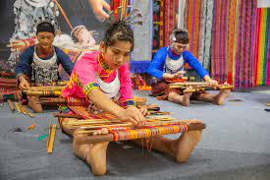
Protection of ICH
Protect against misuse
Protect customary practice
Give voice to communities and practitioners
Protect against commercial exploitation

Slide 59
Creating agreements
Free, prior and informed consent: Is there a fixed format or form?
No, the format can and should be created according to context and issues that it covers.
Who can create this document ?
Anybody can but it is recommended that it include community representation

Slide 60
https://www.wipo.int/edocs/pubdocs/en/wipo_pub_1048.pdf

Slide 61
Ownership of the ICH
ICH...
is developing
constantly updated
has a public character
is collectively owned
Therefore, the application of intellectual property rights within the existing legal framework is not satisfactory

Slide 62
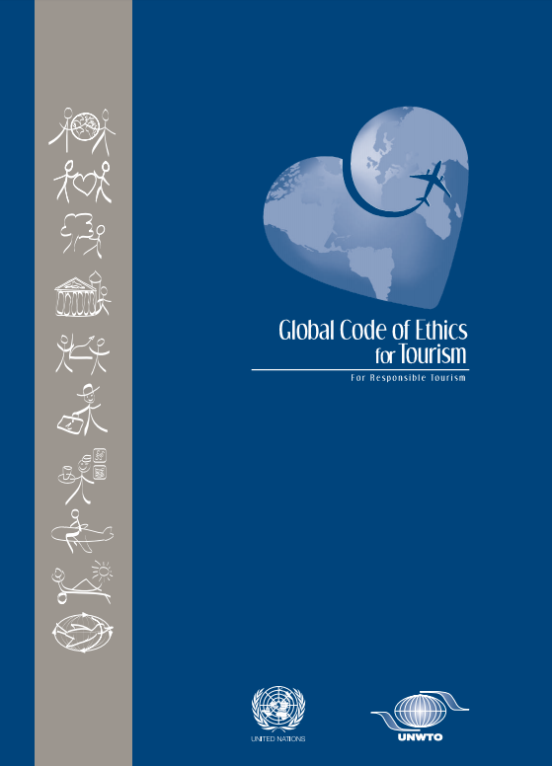
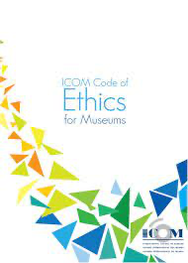
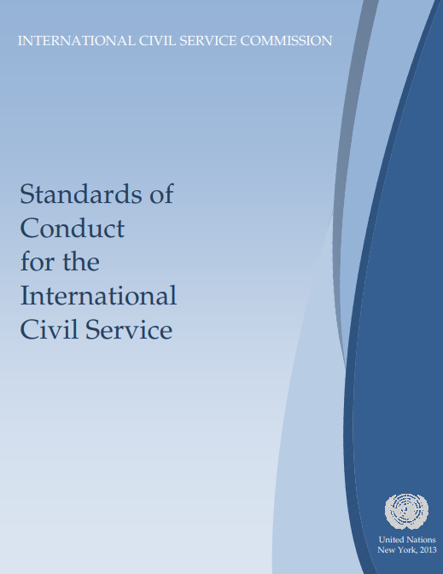
Code of Ethics
A system of rules or ethical principles governing the behavior of members of a particular community (social, professional, or ethnic group), expressing an understanding of appropriate behavior in accordance with ethical principles, and themorality of that community.
https://ich.unesco.org/en/examples-of-codes-of-ethics-00868

Slide 63
Positive enabling feature
Access according to customary practice
Ownership and pride
Revitalisation
Awareness raising
Educational use
Research
Respect and recognition
Nomination of ICH elements

Slide 64
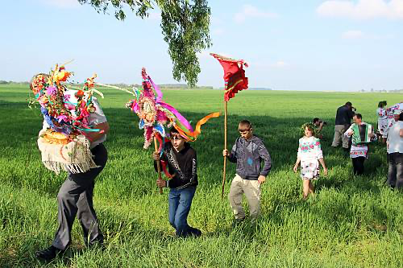
Сommunity Protocol
WHY THE COMMUNITY PROTOCOLS BEING DEVELOPED?
COMMUNITY PROTOCOL is the rules and procedures governing behavior between community members and other (external) parties.
They form a vital part of customary law and are codified in various ways, such as oral tradition, folklore, social practices and traditional knowledge.
Communication is bottom-up: from bearers to other parties. The protocol ensures respect for community members and protects their rights.
Jurauski Karahod rite,
Gomel region, Pahost village, Belarus

Slide 65
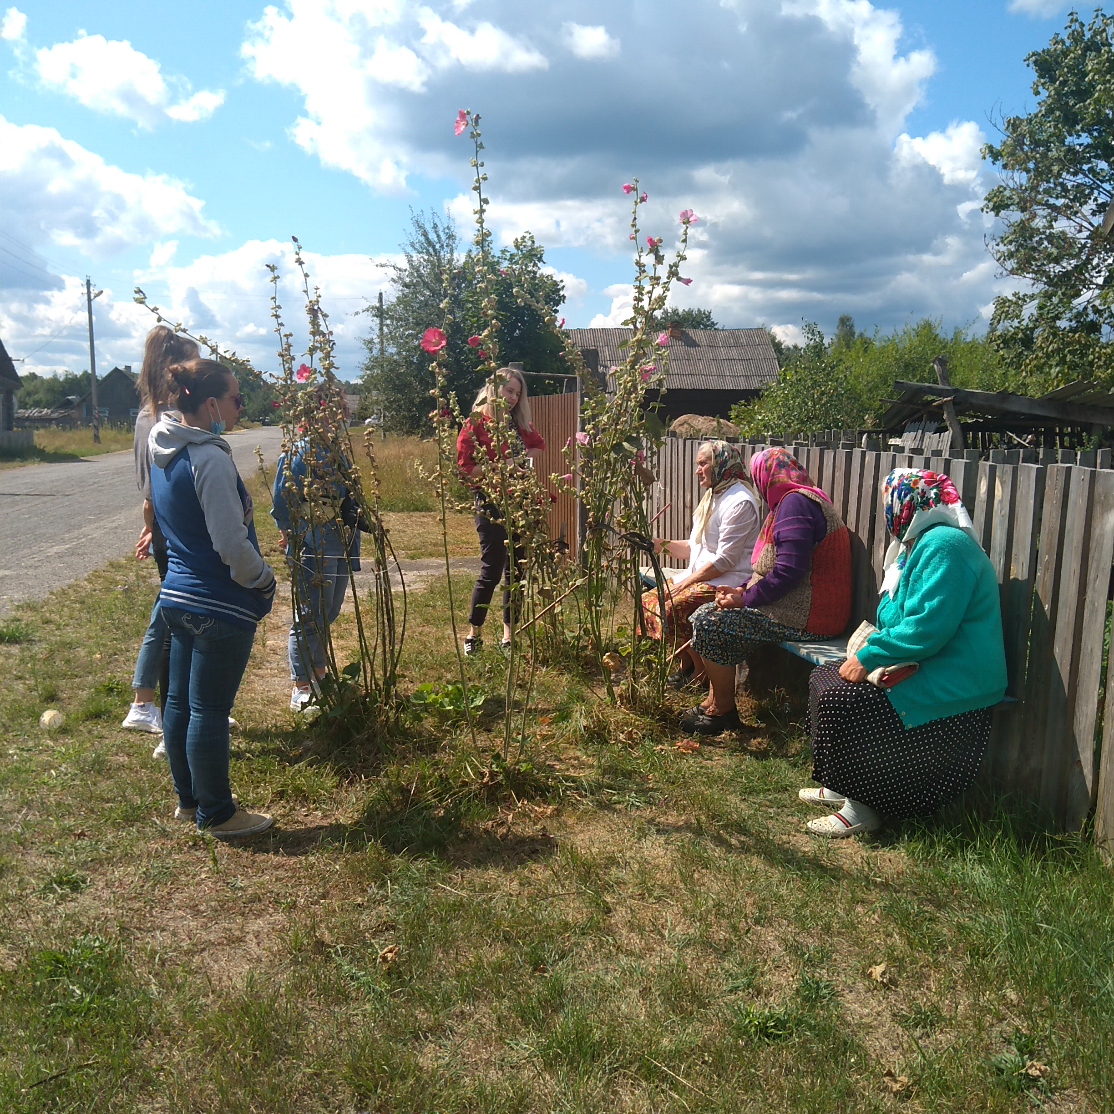
COMMUNITY PROTOCOL
IS USED TO PROTECT COMMUNITY MEMBERS' RIGHTS

Slide 66
COMMUNITY PROTOCOL:
main principles (1)
Identity, diversity and locality
Community protocols are developed for each community individually. Reflect local characteristics and values.
Respect and recognition
In their protocols, communities ensure that others respect their rights to natural resources and traditional territories; their knowledge and customs, customary law, way of life, culture and values are respected
Full and effective participation in the development and implementation of the community protocol involves the inclusion of the broader community in the decision-making process.
Full and effective participation also reflects the principle of procedural fairness associated with processes such as prior informed consent. Taking part fully and effective participation leads to empowerment.

Slide 67
COMMUNITY PROTOCOL:
main principles (2)
Collective Guardianship.
Community protocols reflect the collective custody of knowledge and resources. Resources are often stored collectively and shared. The principle of collective trusteeship is also relevant to dispute resolution. Reciprocity and distributive justice
Knowledge and practices must be distributed equitably among community members.
The principle of reciprocity applies both within the community and between the community and a group or individual outside the community.
Flexibility and responsiveness
Community protocols are flexible and can be modified over time to meet the community's needs.
Duality
Community protocols can help reveal the connections between customary law and national, regional, and international legal and political structures. This ability to act as an interface between customary and formal systems is one of the key strengths of community protocols. It is relevant to many policy areas.

Slide 68
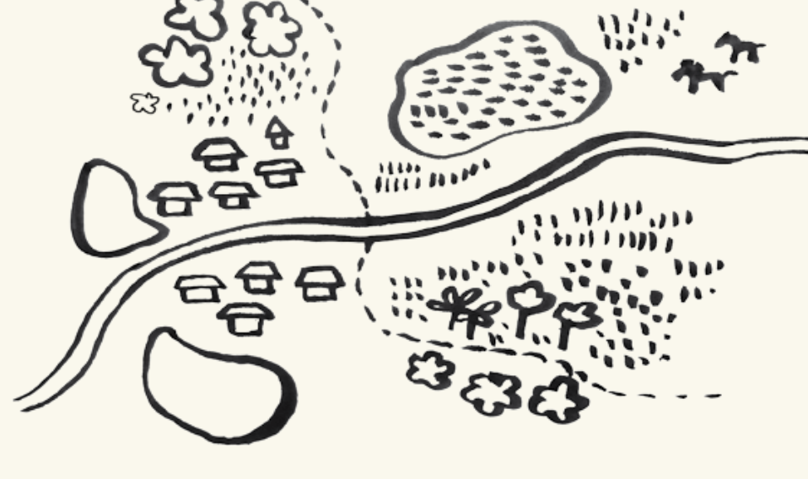
COMMUNITY PROTOCOL:
Approximate structure
1) Community identity
History of origin, core values and norms
2) The relationship between culture, language, customary law, resource use practices, and the cultural and natural landscape.
3) Community governance and self-governance aspects
Traditional institutions, decision-making processes, how to join a community
4) Problems and solutions:
What are the problems, and how does the community address them? Problem-solving in national legislation
5) Specific references to different actors.
Securing land rights. Access to genetic resources and traditional knowledge. Rules of Participation. Rules of Tourist Attendance. Communication Locations.

Slide 69
Possible stages in a community protocol process
Community consultations about development priorities and potential development of protocol
Community self-identification of catalysts, drafting team and other key functional positions
Legal aspects addressed, such as relevant national and international laws
Series of community meetings and workshops to collate initial information and create space for discussion
Collate information and draft protocol
Community meetings to introduce protocol and identify gaps
Revision of protocol based on new information (if necessary)
Finalisation of protocol, formal approval or adoption by the community, and publication
Presentation of protocol to external parties (if appropriate) as basis for constructive engagement

Slide 70
Facilitation of a community protocol process requires skill, sensitivity, patience, flexibility, and willingness to learn and adapt to changing conditions.

Slide 71
Questions?

